Slide 1
Guide for Radiology resident didactics
Things to know before giving your next noon conference

Slide 2
Do’s and Don’ts
DO
DON’T
Be a little early to set up
Try to incorporating interactive learning
Use your resources (this site)
Ask questions (Heather Cowart)
No show
Be nervous
Hesitate to ask questions!

Slide 3
Details
Didactic: 12-12:30
Break: 12:30-12:45
Case conference: 12:45-1:15
Didactic session is recorded.
No PHI please
Case conference is NOT recorded

Slide 4
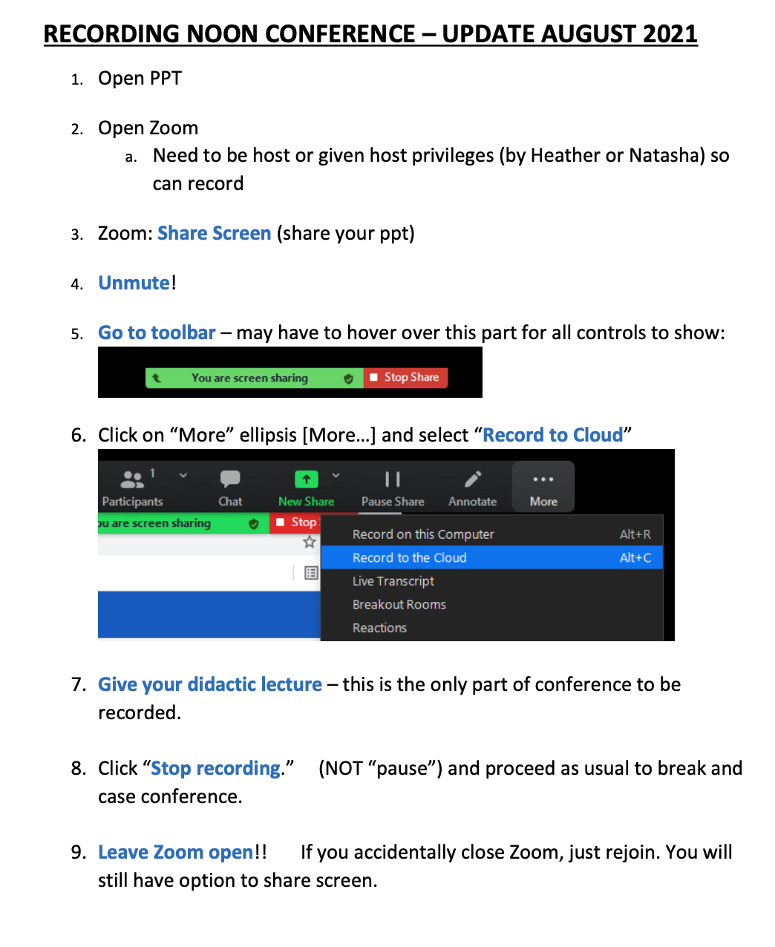
Directions for recording lecture
All lectures are uploaded to Kaltura.
Radiology only has access to this.
While it is password-encrypted, it is not secure for PHI.

Slide 5
Powerpoint templates
These can be found on UABs branding page or Department of Radiology resource page. These are not required but may be helpful.
Department of radiology PPT templates
UAB medicine PPT

Slide 6
Link to resources for lectures
https://www.uab.edu/medicine/radiology/education/remote-teaching includes information on the following:
1. Interactive Lecturing How to interact with your attendees on Zoom. Made specifically for faculty teaching didactics & case conferences to residents and students.
2. Lecture annotation How to use annotation bar effectively with attendees. Made specifically for faculty teaching didactics & case conferences to residents and students.
3. Schedule a lecture How to schedule a lecture/meeting through Zoom.
4. Invite without an assistant How to invite others to your scheduled Zoom lecture/meeting.
5. Resident Check outs How to set up an all-day zoom for resident check outs.
6. Nearpod how to basics How to create an interactive lecture using Nearpod

Slide 7
Slides to include
Please make sure that the following slides are included in each lecture

Slide 8
Learning Objectives
Everything
Learners
Should
Glean
From
This
Talk

Slide 9
Disclosures
I have no relevant financial conflict of interest
I have no financial interests or relationships to disclose
None

Slide 10
QR code: please scan and provide feedback before leaving today! Thanks!

