Slide 1


UNIVERSITY OF ALABAMA AT BIRMINGHAM
Center for Teaching and Learning
Medical Educators Certificate
Session #6
Innovative Teaching
March 24th, 2017
Jason Robert Hartig, MD FAAP FACP
Associate Professor of Medicine and Pediatrics

Slide 2

FIRST THINGS FIRST
J. R. Hartig, MD

Slide 3
Activity #1
2 Things
You remember from the sessions
You’ve tried or attempted
You’ve done differently

Slide 4

Activity #1

Slide 5
My Objectives for the Hour…
By the end of this session, you will be able to (have):
Actively participate in learning and faculty development sessions
Define ‘innovation’ in a practical and meaningful manner for medical education
List a minimum of 2 new techniques/methods to attempt during next clinic or ward session.
Explain the role of repetition in adult learning and retention.

Slide 6
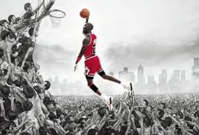

Activity #2
Describe someone who inspired you…
What did they do that was ‘cool,’ ‘neat,’ or different?
What made you remember them?
What was ‘fun’ about learning from them?

Slide 7
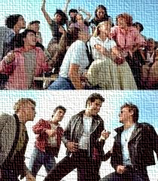
Tell me more!

Slide 8
Activity #3
Define ‘innovation’
For fun: What was the most important innovation in the 19th, 20th or 21st century?

Slide 9
Activity #3
Define ‘innovation’
Notes:
Edison did not invent the first electric light bulb, but instead invented the first commercially practical incandescent light.[46] Many earlier inventors had previously devised incandescent lamps, including Alessandro Volta's demonstration of a glowing wire in 1800 and inventions by Henry Woodward and Mathew Evans. Others who developed early and commercially impractical incandescent electric lamps included Humphry Davy, James Bowman Lindsay, Moses G. Farmer,[47] William E. Sawyer, Joseph Swan and Heinrich Göbel. Some of these early bulbs had such flaws as an extremely short life, high expense to produce, and high electric current drawn, making them difficult to apply on a large scale commercially.[48]:217–218
After many experiments, first with carbon filaments and then with platinum and other metals, in the end Edison returned to a carbon filament.[49] The first successful test was on October 22, 1879;[48]:186 it lasted 13.5 hours.[50] Edison continued to improve this design and by November 4, 1879, filed for U.S. patent 223,898 (granted on January 27, 1880) for an electric lamp using "a carbon filament or strip coiled and connected to platina contact wires".[51]
Although the patent described several ways of creating the carbon filament including "cotton and linen thread, wood splints, papers coiled in various ways",[51] it was not until several months after the patent was granted that Edison and his team discovered a carbonized bamboo filament that could last over 1,200 hours. The idea of using this particular raw material originated from Edison's recalling his examination of a few threads from a bamboo fishing pole while relaxing on the shore of Battle Lake in the present-day state of Wyoming, where he and other members of a scientific team had traveled so that they could clearly observe a total eclipse of the sun on July 29, 1878, from the Continental Divide.[52]

Slide 10
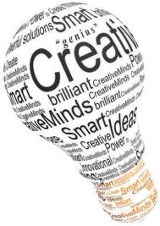

Slide 11
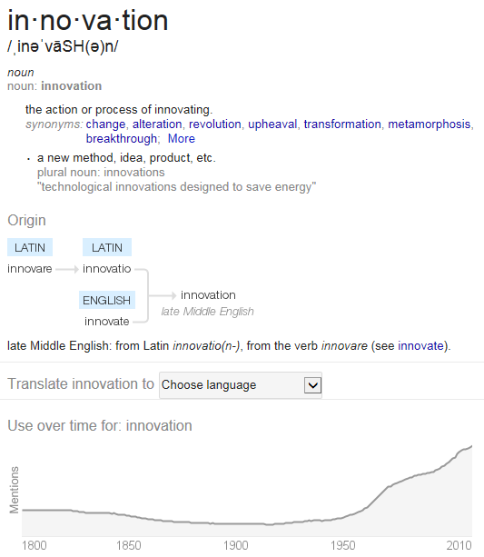

Slide 12
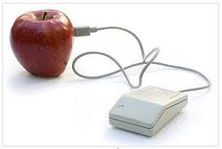
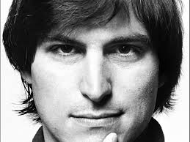
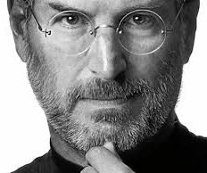
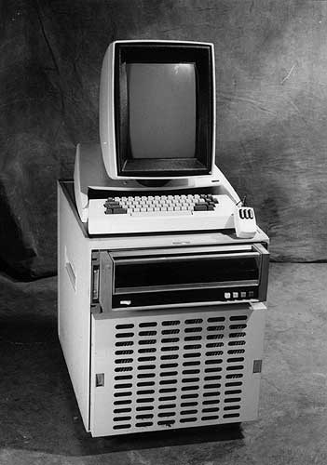
Innovation Reconsidered
Notes:
In the latest episode of NPR’s All Things Considererd, Malcolm Gladwell tells the story about how Steve Jobs first brought the mouse to Apple. It’s a fantastic look inside Steve’s brain, and how he can reduce a complicated concept down to its essence for mass consumption.
According to Gladwell, when Steve Jobs visited Xerox’s Palo Alto Research Center in the late 1970’s, he was amazed by what he saw: a demonstration of a new three-button computer mouse.
The only problem? It cost $300. Realizing that this would be the perfect interface innovation for his Apple Computer, Jobs took the concept to industrial designer Dean Hovey, who “improved” the mouse by dropping two of its buttons… and, along with them, the mouse’s build price, which sank to just $15.
Obviously, Apple’s decision to favor just a single mouse button has been a contentious one. To this day, it’s one of the first snarky comments Windows users like to ignorantly drop when you say you’re a Mac user. In fact, Apple’s single mouse button aesthetic is commonly leveled as an example as to how Cupertino’s obsession with simple interfaces can be taken too far.
When you actually hear Gladwell explain how the single button mouse came about, though, the genius of the decision really clicks. Not only is a single button mouse an easier interface to introduce to users either new to computers or used to text-only input, but it dropped the build price of the mouse to a level where every consumer could afford to buy one.
And why was it so important for every Apple Computer owner to have a mouse? So Steve Jobs could unveil his other big new product inspired by his Xerox Labs visit: the Macintosh, and its GUI-based OS. Genius.
Read more at http://www.cultofmac.com/95614/how-steve-jobs-invented-the-computer-mouse-by-stealing-it-from-xerox/#wBV6SStAl4qrcCiK.99

Slide 13

Activity #4
Notes:
Edison did not invent the first electric light bulb, but instead invented the first commercially practical incandescent light.[46] Many earlier inventors had previously devised incandescent lamps, including Alessandro Volta's demonstration of a glowing wire in 1800 and inventions by Henry Woodward and Mathew Evans. Others who developed early and commercially impractical incandescent electric lamps included Humphry Davy, James Bowman Lindsay, Moses G. Farmer,[47] William E. Sawyer, Joseph Swan and Heinrich Göbel. Some of these early bulbs had such flaws as an extremely short life, high expense to produce, and high electric current drawn, making them difficult to apply on a large scale commercially.[48]:217–218
After many experiments, first with carbon filaments and then with platinum and other metals, in the end Edison returned to a carbon filament.[49] The first successful test was on October 22, 1879;[48]:186 it lasted 13.5 hours.[50] Edison continued to improve this design and by November 4, 1879, filed for U.S. patent 223,898 (granted on January 27, 1880) for an electric lamp using "a carbon filament or strip coiled and connected to platina contact wires".[51]
Although the patent described several ways of creating the carbon filament including "cotton and linen thread, wood splints, papers coiled in various ways",[51] it was not until several months after the patent was granted that Edison and his team discovered a carbonized bamboo filament that could last over 1,200 hours. The idea of using this particular raw material originated from Edison's recalling his examination of a few threads from a bamboo fishing pole while relaxing on the shore of Battle Lake in the present-day state of Wyoming, where he and other members of a scientific team had traveled so that they could clearly observe a total eclipse of the sun on July 29, 1878, from the Continental Divide.[52]

Slide 14
Innovation… it can be simple!

Slide 15

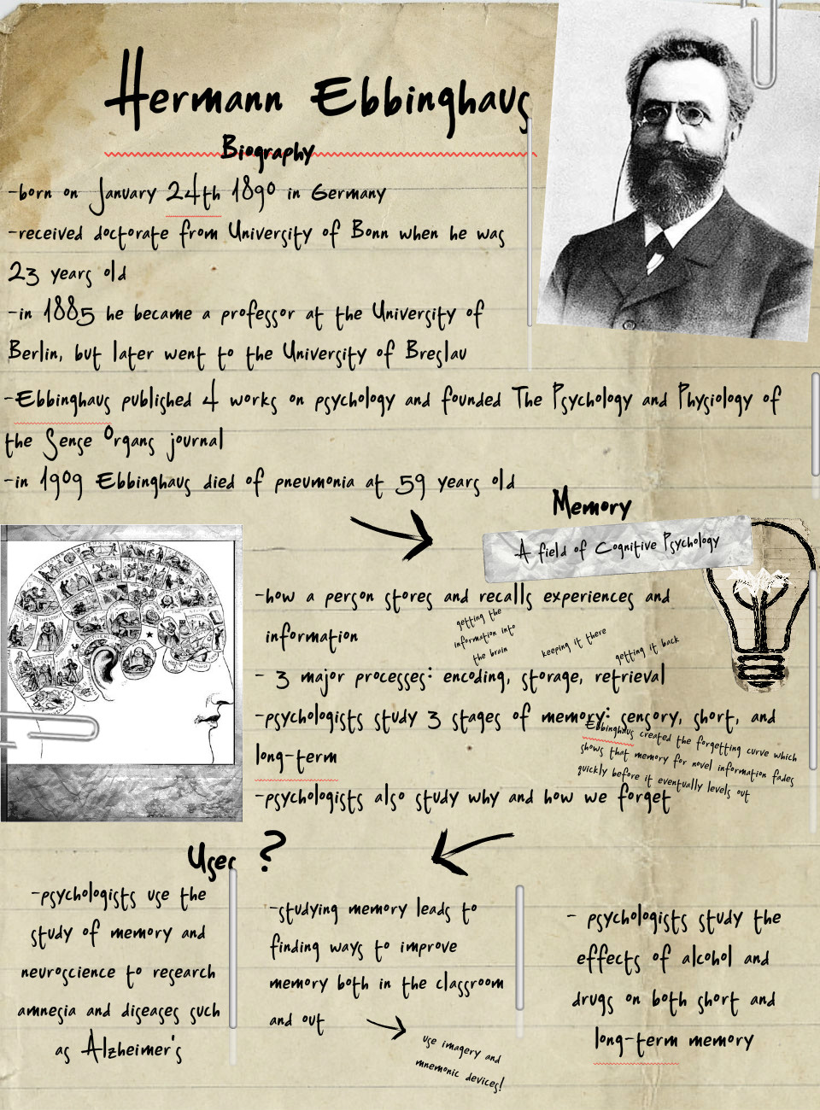

Slide 16
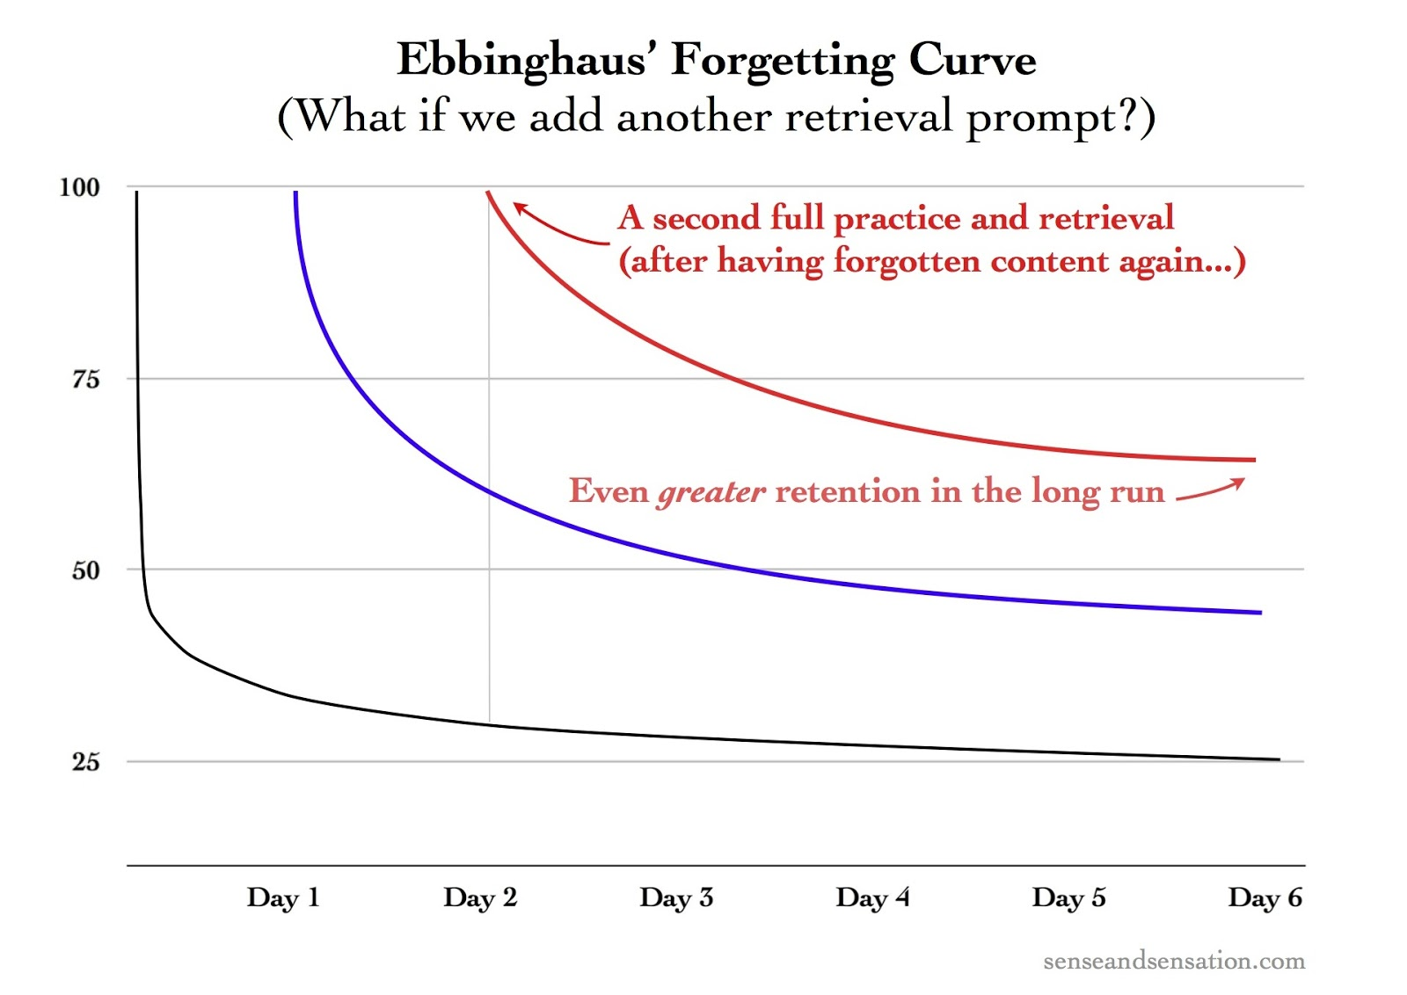
1 Hour

Slide 17

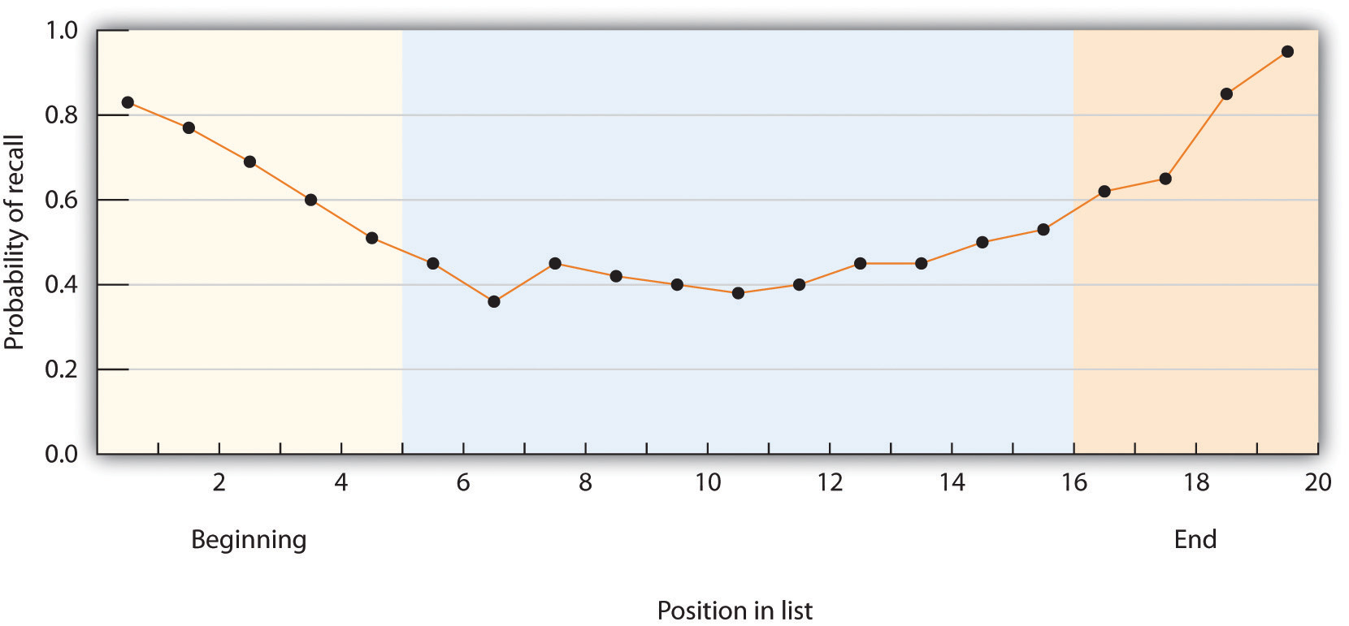
If you’re not first… be last.

Slide 18
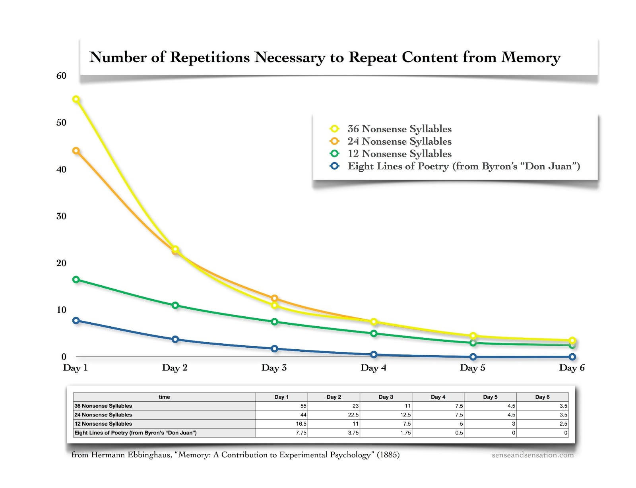

Slide 19
1 Hour

Slide 21
My Objectives for the Hour…
By the end of this session, you will be able to (have):
Actively participate in learning and faculty development sessions
Define ‘innovation’ in a practical and meaningful manner for medical education
List a minimum of 2 new techniques/methods to attempt during next clinic or ward session.
Explain the role of repetition in adult learning and retention.

Slide 22
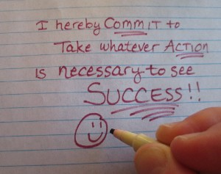
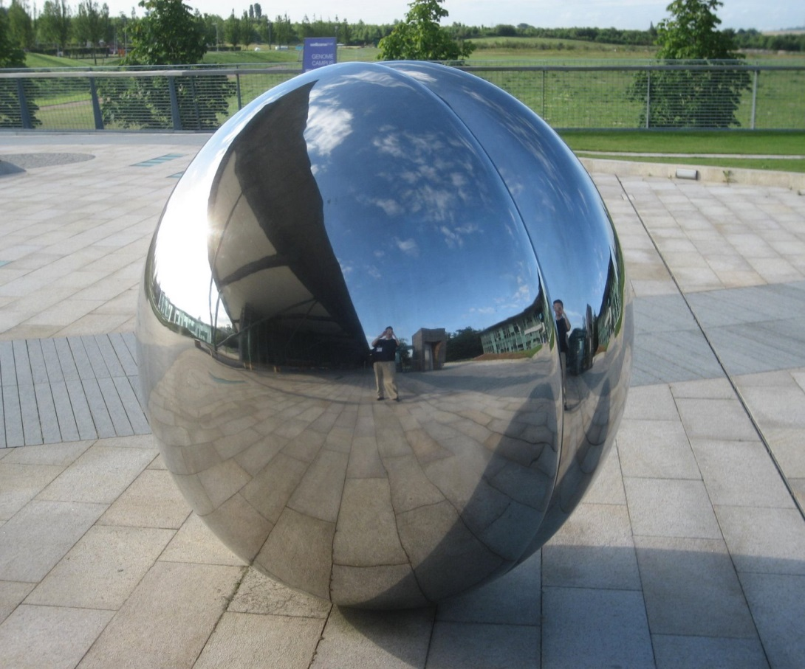
Wrapping Up – next steps…
Commitment to Act
Reflective Process

Slide 23

“Anybody who believes that all you have to do to be a good teacher is to love to teach also has to believe that all you have to do to become a good surgeon is to love to cut.”
Adam Urbanski, President of the Rochester, New York Teachers Association
Quoted by: L. Mansnersus. The New York Times. November 7, 1993: Section 4A

Slide 24
UNIVERSITY OF ALABAMA AT BIRMINGHAM
Center for Teaching and Learning
Medical Educators Certificate
Session #6
Innovative Teaching
March 24th, 2017
Jason Robert Hartig, MD FAAP FACP
Associate Professor of Medicine and Pediatrics

