Slide 1


Mindfulness
Heather Austin, PhD
Assistant Professor
Pediatric Psychologist
haustin@peds.uab.edu

Slide 2
Financial Disclosure
The presenter has no financial
arrangements or affiliations with (a)
corporate organization(s) offering financial
support or grant monies for, or related to,
this content.

Slide 3
Learning Objectives
Upon completion of this live activity, participants will be able to:
Utilize effective techniques for interpersonal communication
Recognize effective teaching and learning methodologies
Utilize effective techniques to foster physician scholarship

Slide 4
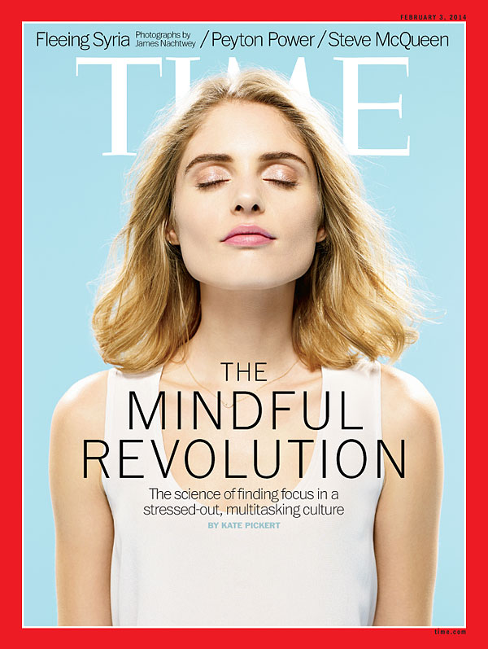
What is Mindfulness
Paying attention, in a particular way: on purpose, in the present moment, and non-judgmentally
Purposeful, nonjudgmental awareness
Being mindful of our senses, our inner world of thoughts and emotions
Recognition that much of our stress and suffering comes from being pulled away from the present moment
Helps us respond, rather than react
Simple, but often not easy

Slide 5
More Mindfulness Descriptions
Seeing Clearly
Being Present
Awakening
Concentration plus attention
Awareness
Openheartedness
Loving Presence
Compassionate Awareness

Slide 6
Mindfulness is NOT
Long periods of passive sitting and gazing
  It can be active
    Yoga
    Walks
Living in the present, never thinking of the past or the future
  It is awareness and deliberate attention – even on the act of planning...
  “Is this useful?”
Relaxation
  It might be relaxing. It might be boring and annoying. It’s being with WHAT IS.
Zoning OUT
  It is zoning IN

Slide 7
Mindfulness is NOT
Thinking about nothing
  It is about being aware of our thoughts
  Treating your bundle of anxiety like a new baby
Being happy all the time, every second
  It is bringing non-judgmental awareness to the present moment
Religious
  It can be a secular practice.
  It is mental training.
  It is supported by clinical research.
  It is integrated into many workplaces, including Google, General Mills, and the Huffington Post

Slide 8

The Science Behind Mindfulness Meditation https://www.youtube.com/watch?v=VTA0j8FfCvs

Slide 9

Mindfulness in the Headlines
The Thai soccer coach taught his team to meditate in the flooded cave — and it may have played a powerful role in keeping them alive
– Business Insider July 10,201
    Helped team cope with stress
    Reduces depression, anxiety and pain
    Helped turn down the intensity of outside disturbance
    Relaxed state conserves energy, reduces oxygen use

Slide 10
Mindfulness
(practice and logistics)
Find a quiet, safe place where you can be alone without interruption for at least 5 minutes
  Do not meditate in spaces where worry of danger exists
Sit comfortably in a chair or on the floor with your back straight and your hands in your lap
  You can lie down, but it may make you sleepy or make it difficult to concentrate
If you can, close your eyes or lower your eyelids a bit
  If it makes you anxious, you can keep them open
Focus on your breathing, and only your breathing
  Feel the air going into and out of your lungs

Slide 11
Mindfulness
(practice and logistics)
When you mind wanders, just remind yourself to breath
  Let the thoughts and feelings come and go
  Do not criticize or judge yourself when this happens
  Just notice the thoughts and go back to watching yourself breathe in and out
  Don’t think of your thoughts and feelings as important
  They feel real and they are real to you
  But sometimes they don’t tell the truth
  They are neither good nor bad, right nor wrong
  They are just thoughts and feelings that come and go
  Practice not reacting to them
  Notice them and then go back to your breath

Slide 12
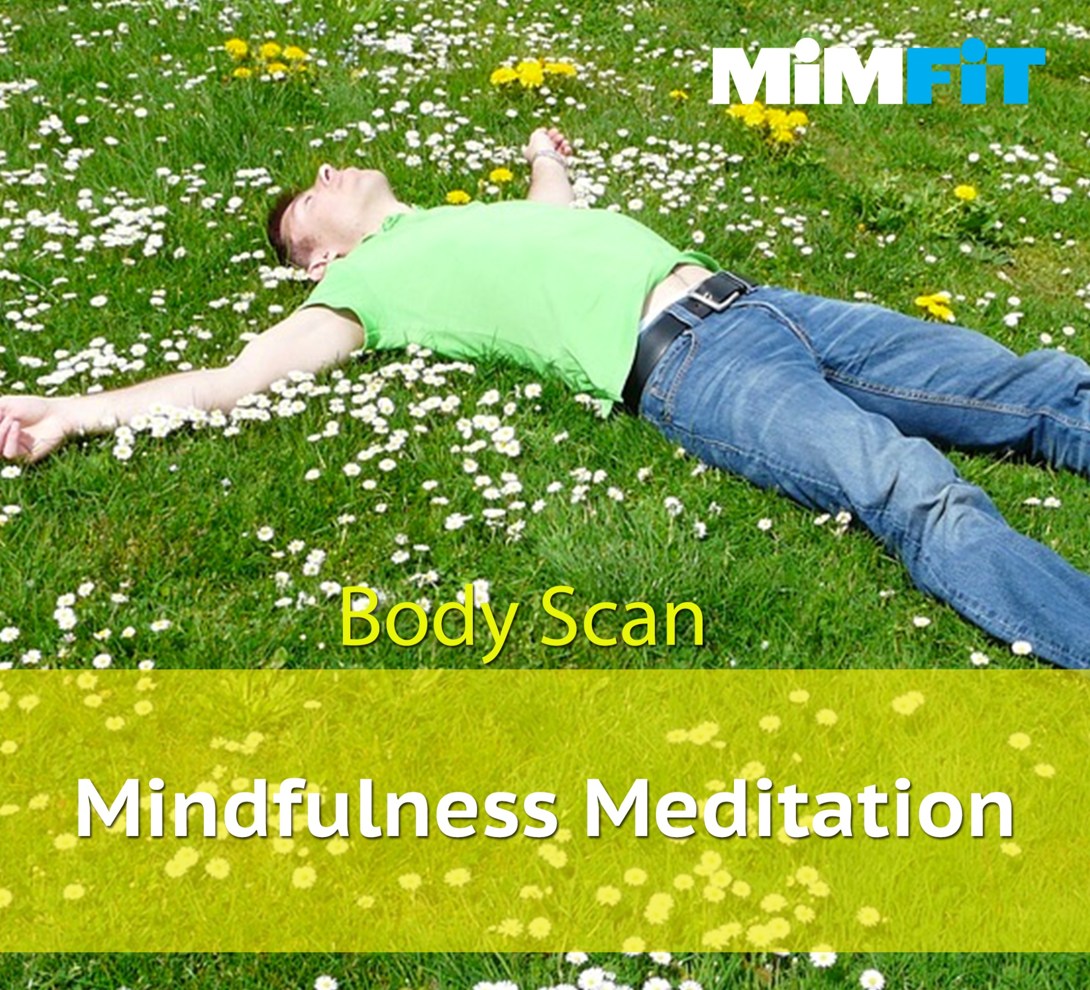
Notes:
Get as comfortable as you can in chair. Sit with your backs straight but not stiff, with both feet on the floor and with your hands comfortably in your lap.
Close your eyes if that feels comfortable to you.
Tell yourself that in this moment, you have nothing to do and nowhere to go. You can simply allow yourself to be present, just as you are.
Connect with your breath. Your breath is the bridge that connects your body and mind together in the present moment. If it helps, you can say silently to yourself, Breathing in. I know that I am breathing in. Breathing out, I know that I am breathing out. And let the breath flow freely into and out of the body.
If you notice your mind wandering, as it will, gently bring it back to focus on your body and your breath. Become aware of your belly rising as the breath moves into your body and falling as the breath moves out of your body. Let your breath find its own rhythm, not controlling it in anyway. Feel your body sink deeper into the chair.
With your next breath, direct our attention all the way down through your body to the soles of both feet. Become aware of your toes, the arches of your feet, the place where your heel meets the floor, the feeling of your sock if you have one. Notice any feelings in your feet, any warmth or coolness, pressure, tingling or tightness, strength, comfort, or maybe no sensation. Just notice that, Adjust your feet to be more comfortable if you wish, And now direct your breath to both of your feet, imagining that you can breathe right into your feet, first into your right foot, and smile to your right foot, and now breathing into your left foot, and smiling to your left foot. And on each out breath, letting go of any tiredness, any tension, right from the soles of both feet.
Now gathering up your attention, slowly move it away from your feet, focus on your left ankle, noticing any sensations there, As you continue to breath mindfully, bring your awareness up your leg, to you calf, your shin and your knee, Notice sensations in your left upper leg and your left hip. In the same way that your breathed and smiled to your left foot, bring awareness, care and curiosity to your left leg. Now bring your attention to your right leg, starting with your ankle…
Be curious and gentle with the moment to moment sensations in your body, allow your body to rest and release stress
Abdomen and belly, upper body, chest and shoulders, back, hands and arms
Check in with your body, how does your body feel, the same or different, notice any parts that may need more time to relax, what about your emotions and your stress level, are they the same as when you started or different?
Wake up your body, wiggle your toes and fingers, slowly open your eyes if they were closed, when you are ready return your attention to the room.

Slide 13
Benefits of Mindfulness for Children and Teens
Improve mental health and well being by reducing
  Stress
  Negative Affect
  Symptoms of Depression
  Symptoms of PTSD
  Symptoms of Anxiety

Slide 14
Benefits of Mindfulness for Children and Teens
Improve concentration (Crescentini, Capurso, Furlan, & Fabbro, 2016)
  Enhance focus of children with ADHD (Zhang et al., 2016)
    Even at the EEG level
Improves impulse control
Improve social skills and cultivates empathy (Black et al., 2013)
Improves sleep
Improves immune system
  Increases in telomerase in white blood cells
Teaches self-care

Slide 15
Benefits of Mindfulness for Teens
Adolescence
  Critical window
    Vulnerability to stress
    Opportunity for intervention to promote stress management and resilience
Mindfulness practice with adolescence
  Stimulate and promotes neural circuits
    Emotional regulation
    Resilience
    Healthier Adolescent Brain Development
  Provides lifelong coping habits
Siegel, 2010

Slide 16
Mindfulness: Youth Voices https://www.youtube.com/watch?v=kk7IBwuhXWM

Slide 17
How to Share Mindfulness
Set the stage for mindfulness
Practice mindfulness yourself – Model Mindfulness
  Use a mindfulness app
  Practice a short daily meditation
  Set a reminder on your phone
  Meditate with friends
    Start with a formal meditation (e.g. body scan)
    Share a mindful meal together
  Invent your own mindfulness phrases
  Place reminders and inspirations in your environment
If you want others to be happy, practice compassion.
If you want to be happy, practice compassion
- The Dalai Lama

Slide 18
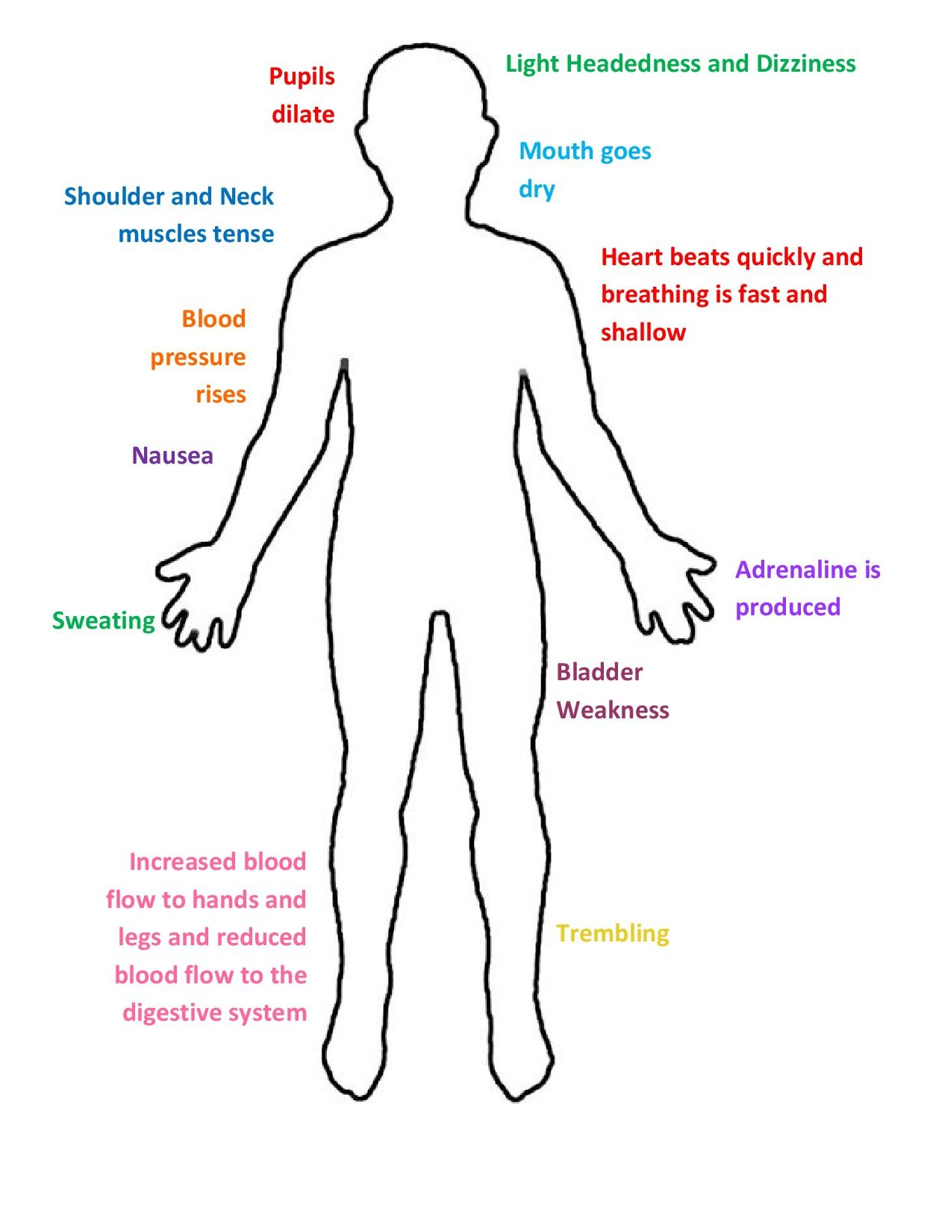
How to Share
Mindfulness
Provide Education on
brain, body stress and coping
Everyone has stress and pain
  What matters is how you manage it
Symptoms of stress
  Are experienced in the body & mind
Symptoms of pain
  Increase stress
Practices that connect body & mind
  Promote health and resilience

Slide 19
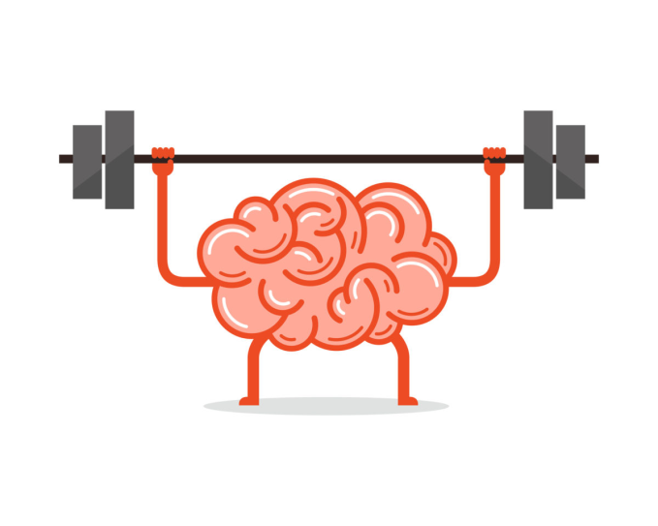
How to Share Mindfulness
  Explain ways that it could work for them
Mindfulness based practice
  Reduce symptoms of anxiety and depression
  Reduce negative impact of pain
  Improves performance when done before exam
  Improves concentration
Talk about Brains
  Mindfulness
    Trains the brain
    (like exercise can transform our bodies)
    Increases the gray matter in the portion of the brain responsible for self-awareness and compassion

Slide 20
How to Share Mindfulness
  Talk about being
  Mind FULL
    Jumping from thought to thought/controlled by thoughts
    Versus
    Mindful
    Being skillful about the thoughts that you attend to
      Seeing the chatter of the mind for what it is
      Acknowledge it rather than getting caught up in it

Slide 21
How to Share Mindfulness
Set the stage for mindfulness
Provide examples
Explore engagement
Encourage letting go of expectation and judgement
  Have a “beginner’s mind”
  Try an experiment to see how it works for you
Invite them to practice with you
  Do not force them
  Not to be used for punishment/management/requirements
  Allow them to opt out
Pick an appropriate time
  Not when there is a rush

Slide 22
How to Share Mindfulness
  Set the stage for mindfulness
Arrange environment for success
Use available concrete objects for focus
(cognitive forms are often harder depending on developmental level)
  Pen
  Set of keys
  Visual object to focus on
Practice for no more than 3 to 5 minutes to start
Don’t stare at them while they are trying it out
Encourage them to share their experiences
  What do they like/not like?
  How did they get distracted?

Slide 23
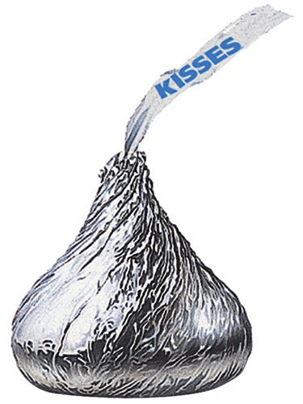
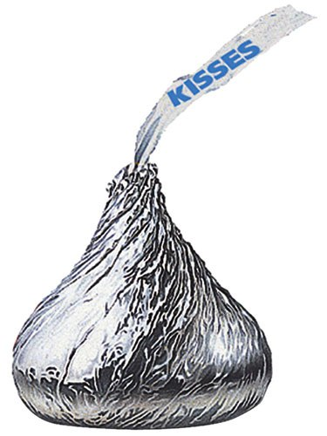
Mindfulness Practice
Notes:
Sit comfortably in your chair and I am going to come around and pass out a few objects to you.
I’d like for you to focus on one of the objects as if you have never seen it before. Imagine that you have arrived here from another planet and the object is completely new.
Now take the object in your hand and turn it around.
Be aware of what you see, the shape, texture, color, size, temperature, hardness, or softness
And if you notice that you are thinking something, perhaps like, Why are we doing this? And This is pretty silly – just notice them as thoughts and let them go. Bring your attention back to the object.
Now being aware of the movement of your arm, bring the object to your nose and smell it.
Place the object in your mouth, without chewing or swallowing, Become aware of all the sensations that you are experiencing.
Then when you are ready, consciously take a bite and notice the taste. Notice the texture. Notice the rest of your mouth and sensations there.
Now slowly and consciously chew the object and when you are ready allow yourself to swallow
What are somethings you notices as you looked at it? Some smells? Some textures? Some Colors? Some tastes? Some Sounds? Some movements?
What was it like to hold it in your mouth without eating it? Is this the way we normally eat?
Where was your attention during the activity?
What happened when it wandered?
Can you think of some ways to eat mindfully?

Slide 24
Informal Mindfulness
Mindfully STOPping
Bring mindful, present-moment and non-judgmental awareness to all activities of daily living.
  Brushing your teeth
  Walking
  Getting dressed
  Cleaning
  Exercising
  Drawing
  Coloring

Slide 25
Informal Mindfulness
  Mindfully STOPping
  Stop whatever you are doing. If you were about to start a new activity, just pause for a moment instead
  Take 3 mindful breaths
  Observe what is happening around you in the present moment. Check with yourself as well: What is happening inside of you right now
  Proceed mindfully with whatever it was you were doing or were about to do.

Slide 26

Mindfulness Practice
Coloring
Notes:
Today we’ll be doing a mindfulness exercise, but this exercise is more of a mindful attention exercise than a meditation or relaxation exercise. You’ll stay in your seat and keep your eyes open. In this time we’re going to be coloring and paying attention to the sensory experience. There will be invitations to breathe but no counted breathing. Take deep breaths at your own pace.
Consider the colored pencil in front of you and pick it up and hold it. Take your time, and give attention to its weight and the balance as it sits in your hand.
What does it feel like to be curious about this object?
How did you grip your pencil? What does it feel like in your hand?
Take a deep breath at your own pace. Did you notice a smell?
Breathe again, this time turning your attention to the air filling your lungs and take notice of any scents.
Without judgement, turn your attention to the color of your pencil- notice the vibrant color encased by wood. You might be disappointed in the color of your pencil, but just like all the feelings in your body have a role, all the colors have an important place in the color spectrum. Now let your fingers explore the smooth texture of your pencil and the rough exposed wood near the point.
Turn your attention inward and notice what you are feeling.
Do you notice impatience? Do you feel a sense of anticipation to color? What do your hands feel like as they wait to color? What emotions are coming up? You don’t have to change them, just notice.
Now, Hold your pencil in one hand and direct your attention to your paper. What do you notice in your body as you face a blank page with defined lines? When you color, will you choose to befriend those boundaries or will you choose to treat the paper as though there are no boundaries?
You have a choice.
Notice which option you are inclined towards and allow yourself to wonder what it would be like to choose the other.
Take another deep breath at your own pace, and give yourself a moment to anticipate coloring. What will it feel like to transfer this living color in your hand to the page in front of you?
Know that you will NOT finish coloring this page today and that is okay. Bless this quiet moment you are taking to enjoy coloring, with all your senses, in this small part of your day.
Now that you are familiar with your pencil and the space before you, choose a spot on your paper and gently place your pencil against it, just barely making contact with the paper. Now begin to color the page.
Keep coloring, noticing the sound of your pencil on the page, the texture of your paper, and any other sensations rising to your attention. Alternate coloring with pressure and gently tracing your pencil across the page. What changes about the color when you change pressure? What changes in your grip or in your breathing? Just notice.
Take the next few minutes to color, paying attention to your body, all it senses in this space, and miracle of the transfer of color as it moves from your pencil to the page.
[pause]
We are going to end our time coloring soon. When you are ready, telescope your attention back from the world created between your pencil and the page and notice the room around you. When you are ready, lay your pencil down and take a deep breath as we prepare to move forward into the day.

Slide 27
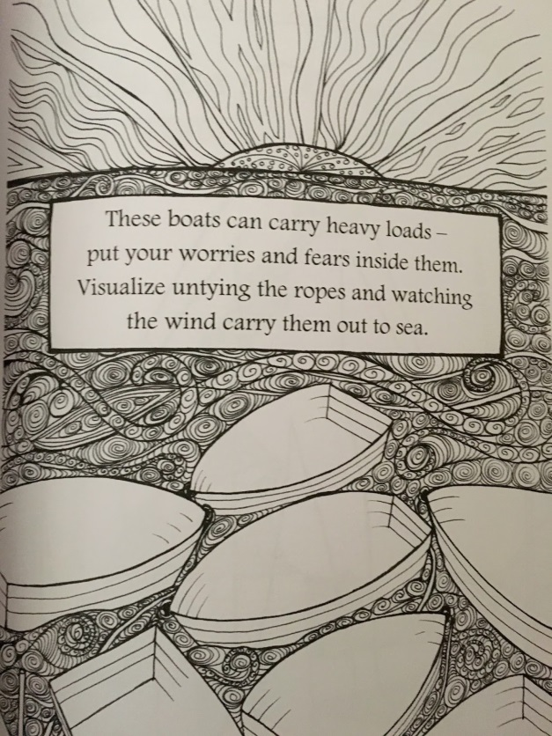

Slide 28
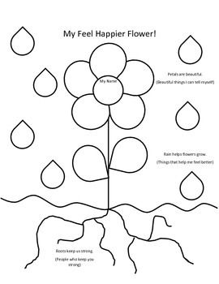

Slide 29
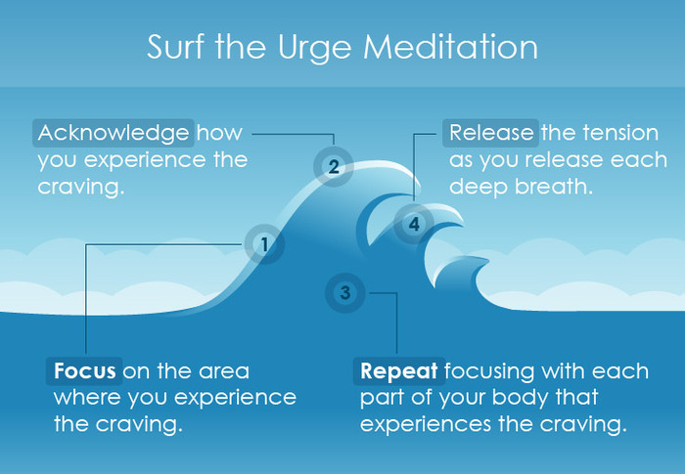
Mindfulness Practice
Urge Surfing
Notes:
Mindfulness technique developed for Substance Use and Abuse
It is a component of Mindfulness-based Relapse Prevention
Take a few moments to notice where you experience urges in your body. You can do this by taking some time to sit in a quiet place, and if you are comfortable doing so, closing your eyes, and just allowing your attention to go to the place(s) in your body where you tend to feel urges. For some people they notice that urges are most connected to sensations in their abdomens; for others, they notice urges in their mouth (e.g., their mouths water when experiencing an urge to drink). There is no right or wrong place for an urge to be located. What is most important is that you notice where in your body you most notice urges when they show up. If you are having trouble noticing urges, think back to a time when you experienced an urge to engage in an old habit. If you are concerned that thinking about a particular instance when you had an urge will lead to doing the habit, pick a situation where the urge was less strong or you successfully prevented yourself from acting on the urge. Picture the situation as clearly as you can in your imagination. Once the situation is clear in your mind notice where in your body you are experiencing the urge.
Once you have noticed what part of your body is most connected to the urge, focus your attention on it (if you notice that more than 1 area of your body is connected to an urge, start with the place that you most intensely notice the urge). Take note of the sensations you are having in this body part. What do the sensations feel like? Does it feel like pressure, tingling, warmth, or coolness? How much space do these sensations take up in this place in your body? Try to draw an outline around the place where the sensations are felt. See if the sensations have any movement. Some people tend to associate sensations with colors or temperatures. Check to see if you notice any colors or temperature associated with these sensations. For some people it can be helpful to silently describe the sensations in an objective and non-judgmental manner (e.g., I notice warmth and tingling in my belly). If more than one part of your body is associated with an urge, go through this exercise with each body part.
Bring your attention to your breath. You do not need to change your breathing at all. Notice your breath for the next 1-2 minutes. Some people find it helpful to bring their attention to a particular place in their body where they notice their breath (e.g., the abdomen); some find it helpful to say phrases like “breathe in,” “breathe out” as they inhale and exhale.
Gently shift your attention back to the part(s) of your body where you notice the urge. Allow yourself to notice whatever sensations come up in these places. If it becomes overwhelming to notice the sensations, gently return your attention back to breath for a few moments and then go back to noticing the sensations connected to the urge. You may find it helpful to imagine sending your breath to the parts of your body that are associated with the urge (e.g., you can breathe into your shoulders and let your breath fill up that part of your body). Notice if and how the sensations change as you watch them. Be sure to practice this step for at least 1 minute, but longer is probably better.
This next step is optional, but I have found it to be helpful in my own life and in working with people with addictions. Imagine that the sensations connected with your urge are a wave. Watch the wave rise and fall over and over again as the intensity of your sensations peak and subside. Your job is to use your breath as a surfboard to ride these waves. No matter how big the wave gets, no matter how much you feel as if the wave will consume you, you are a skilled surfer and you will use your breath to ride each wave as it comes. Practice this for at least 1 minute, but again, longer is probably better, particularly the first few times you practice this.
As you’re riding the wave (or just noticing the sensations), you may find it helpful to silently describe the sensations in an objective and non-judgmental way (e.g., I notice warmth in my belly that is increasing…the warmth in my belly is decreasing and my belly feels cooler).
When you are done surfing the urge, take a moment to thank yourself for taking the time and being willing to do something different with your urges. You can also use this time to set your intention for the next few minutes, hour, or day.

Slide 30
How do we get teens to try mindfulness?
5) There’s an app for that!
  Stop, Breathe, and Think. Opens with a short “interview” where the user selects several words to describe how they are feeling, and then the app recommends guided meditations for their current state.
  Smiling Mind. Designed for adolescents

Slide 31

Still Skeptical?
I Can’t Do This
I Don’t Have Time for This
People Might Think I’m Weird
Meditation is Self-Indulgent
  Giving a S*** About Yourself Meditation
Pandora’s Box
If I Get too Happy I Might Loose My Edge
__________ is My Meditation
I Can’t Keep it Going

Slide 32
REFERENCES
Burke, CA. Mindfulness-based approaches with children and adolescents: A preliminary review of current research in an emerging field. Journal of Family Studies, 2010; 19: 133-144.
Harnett, PH, Dawe, D. Review: The contributions of mindfulness-based therapies for children and families and proposed integration. Child and Adolescent Mental Health. 2012. DOI: 10.1111/j.1475-3588.2011.00643.x
Kabat-Zinn, J. Wherever You Go, There You Are: mindfulness Meditation in Everyday Life. New York, NY: Hyperion; 1994.
Siegal, Daniel J. Mindsight: The New Science of Personal Transformation. New York, NY: Bantam; 2010.
Vo, Dzung X. Mindfulness practice for resilience and managing stress and pain. In KR Ginsburg and SB Kinsman (Eds.) Guiding Adolescents to Use Healthy Strategies to Manage Stress. 2014. American Academy of Pediatrics.

Slide 33
Resources
https://www.mindful.org/
https://www.mdedge.com/pediatricnews/article/144818/mental-health/mindfulness-and-child-health

