Slide 1
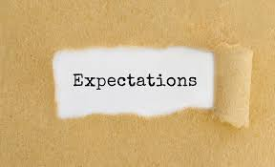
Faculty Development Series
Setting Expectations
Pediatrics Lunch and Learn
June 28, 2019
Lisa L. Willett MD MACM

Slide 2

True Story
My assignment:
Write an essay about a time you felt you made a positive impact on a learner

Slide 3


Our goal as educators

Slide 4
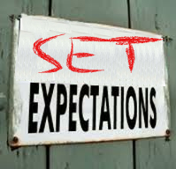
Setting Expectations
?
Who does?
Why?

Slide 5

Start with the end in mind!

Slide 6
Expectations Matter
Without them – aiming at the wrong target
Most will meet expectations, if clearly identified
Time efficient
Less frustration
Can be molded with feedback
Achieve the outcome you desire

Slide 7

A little storming…

Slide 8
Brainstorm
List as many categories, specifics instructions or values you believe you need to share with your learners at the beginning of your ward, consult, clinic or classroom time.

Slide 9
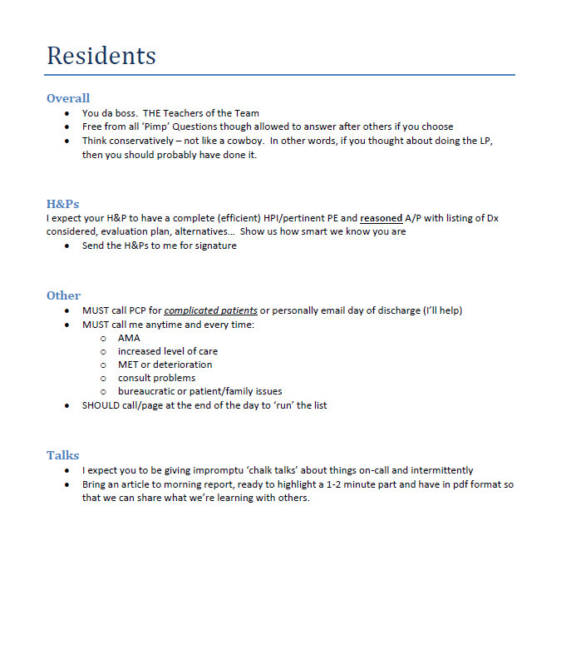
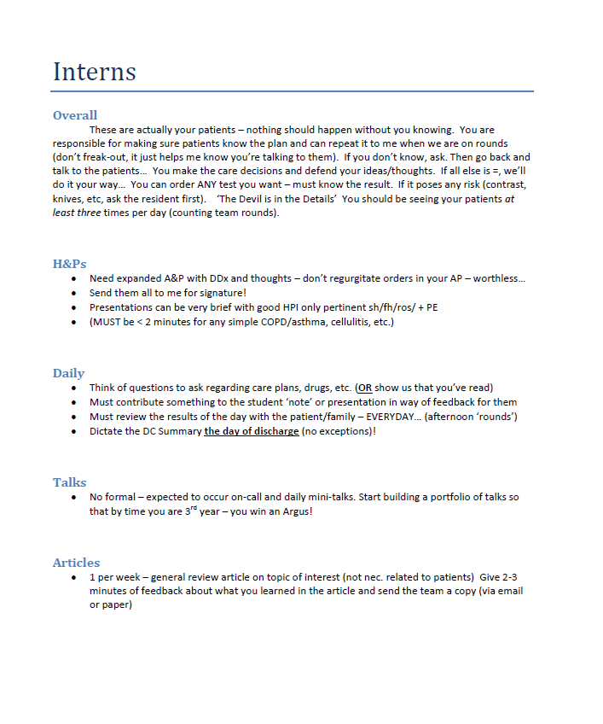
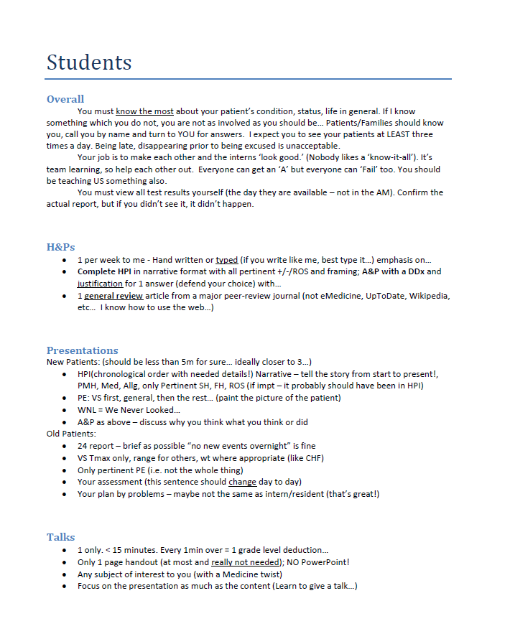
Assignment

Slide 10
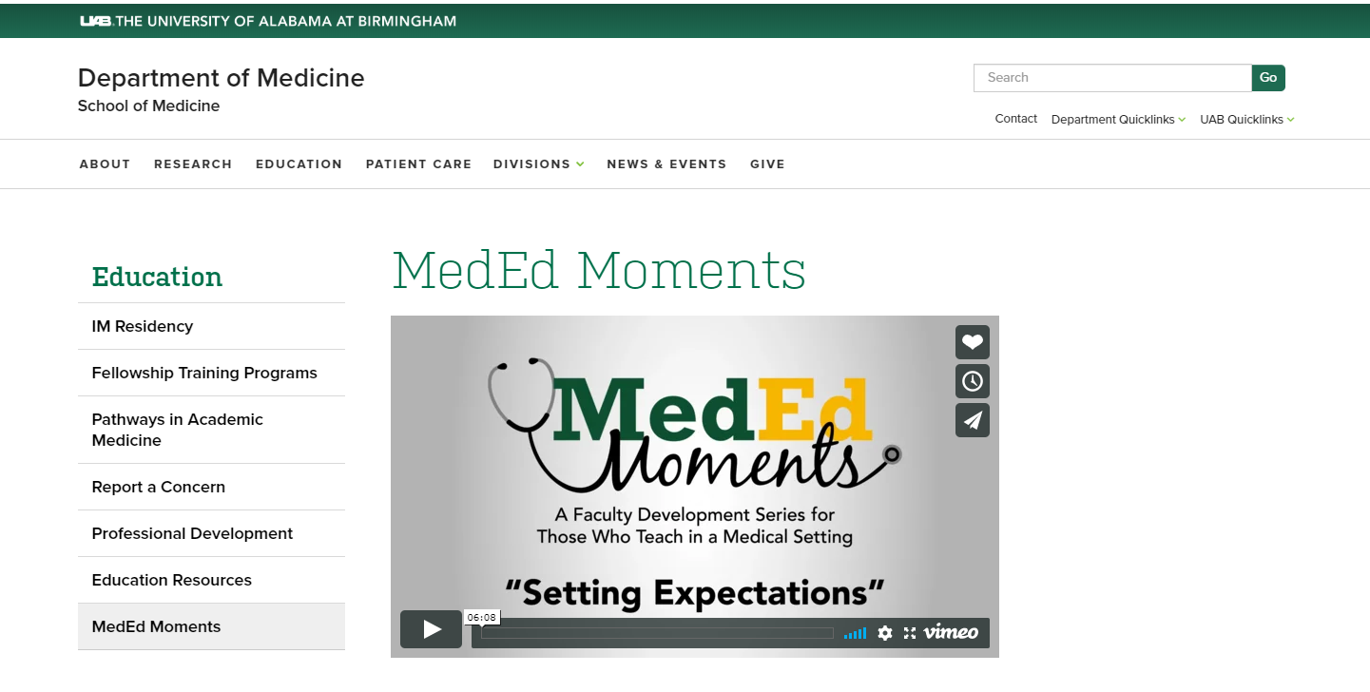
Objectives were…
By the end of this session, you will be able to:
Discuss the importance of setting expectations for all participants
Create a document describing their expectations for learners on clinical rotations.

