Slide 1
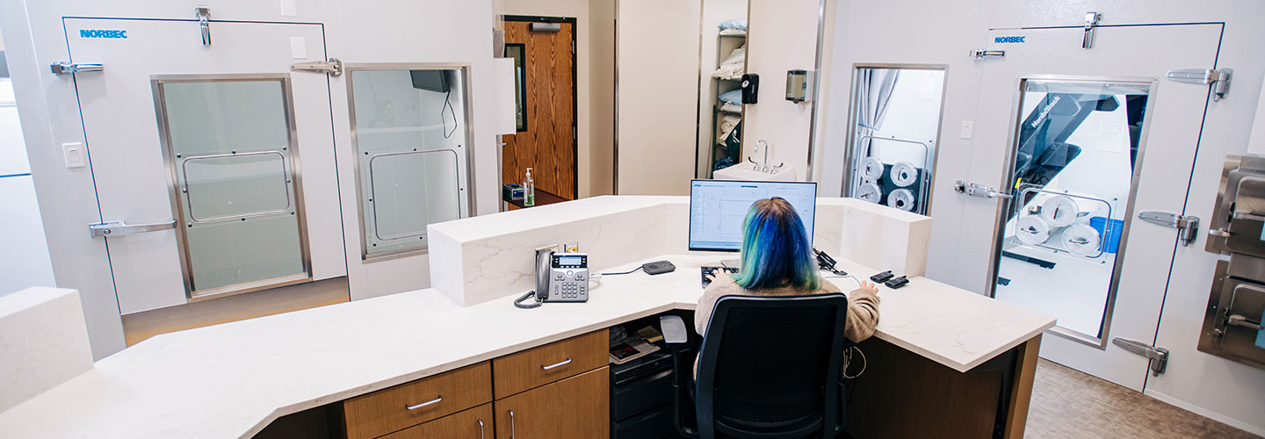


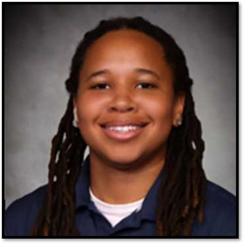


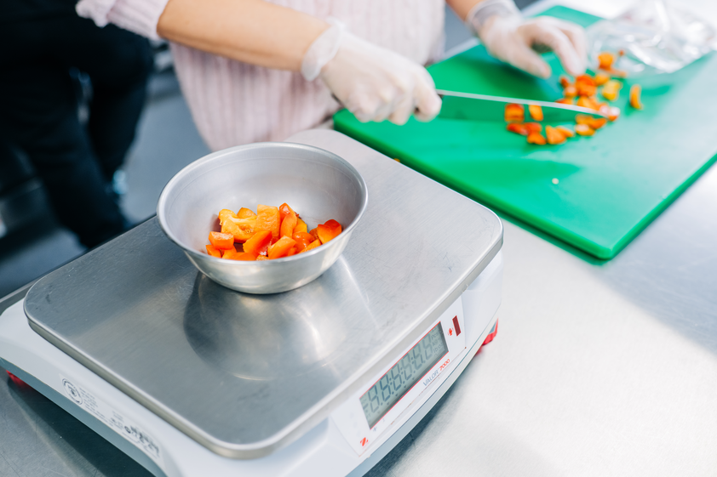
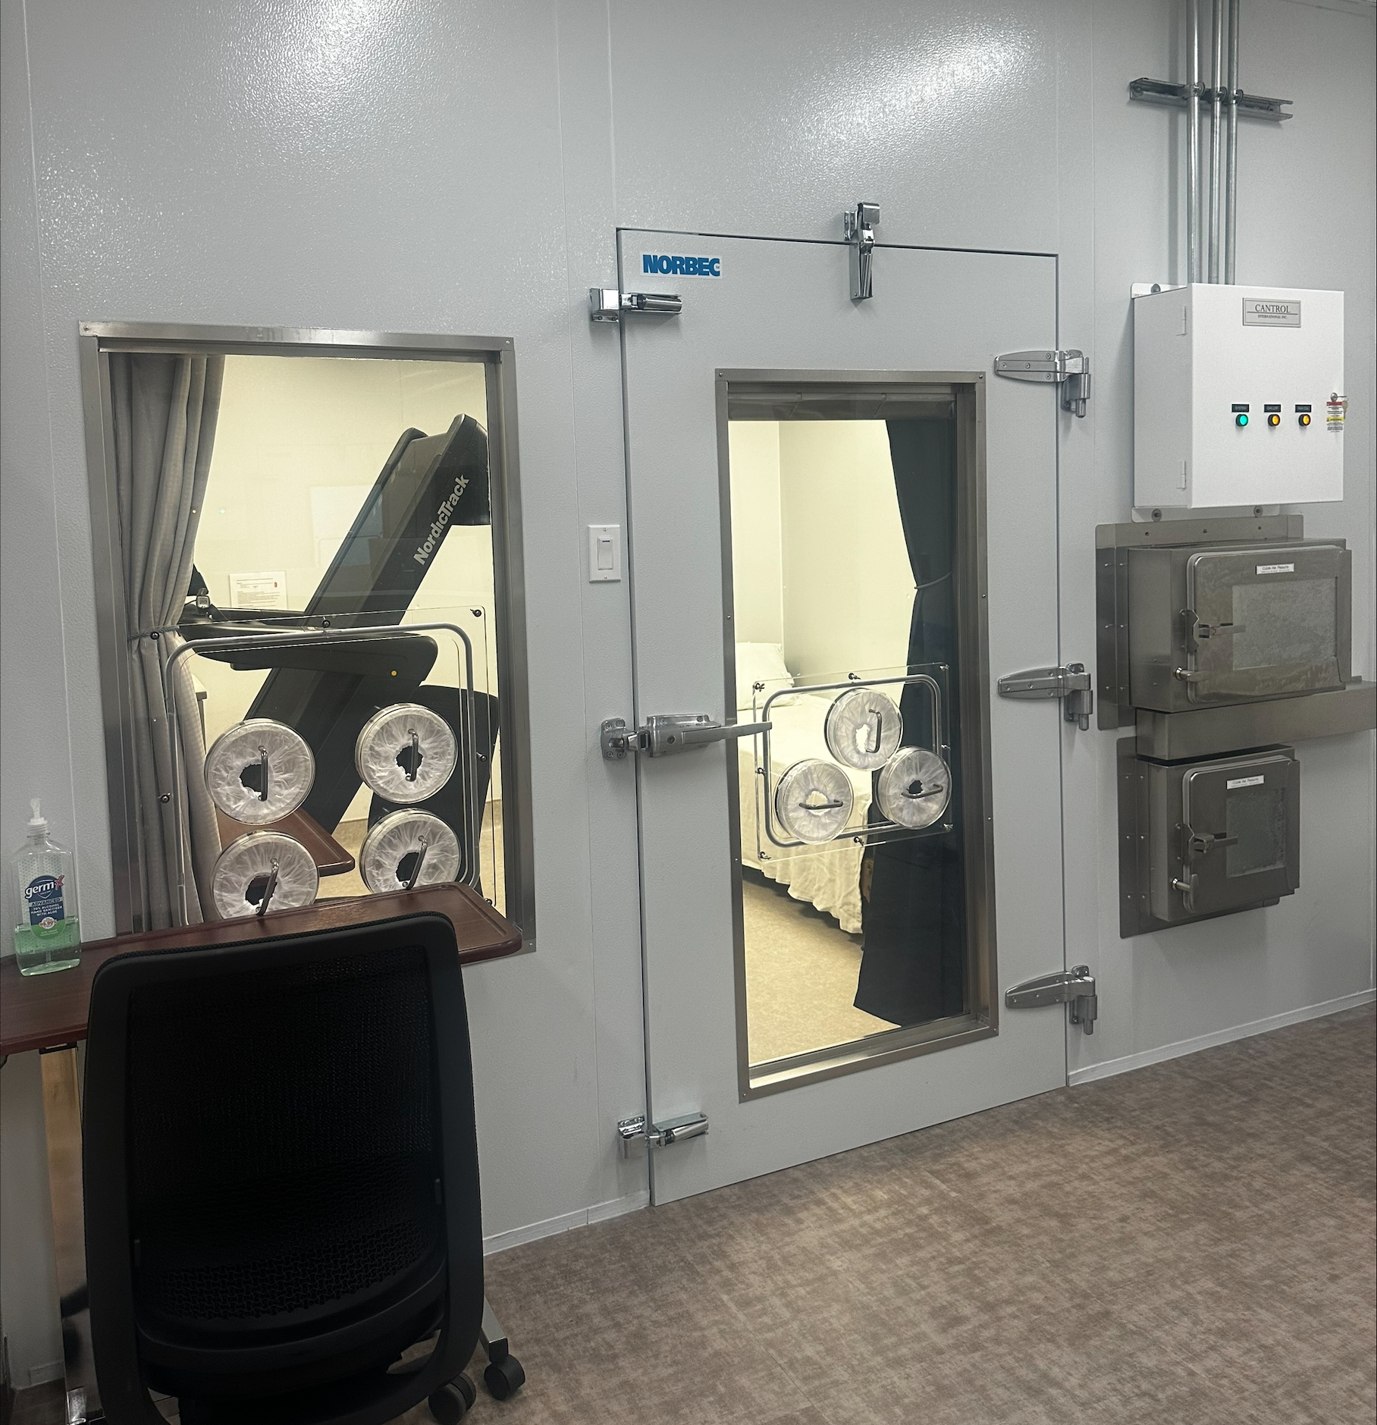
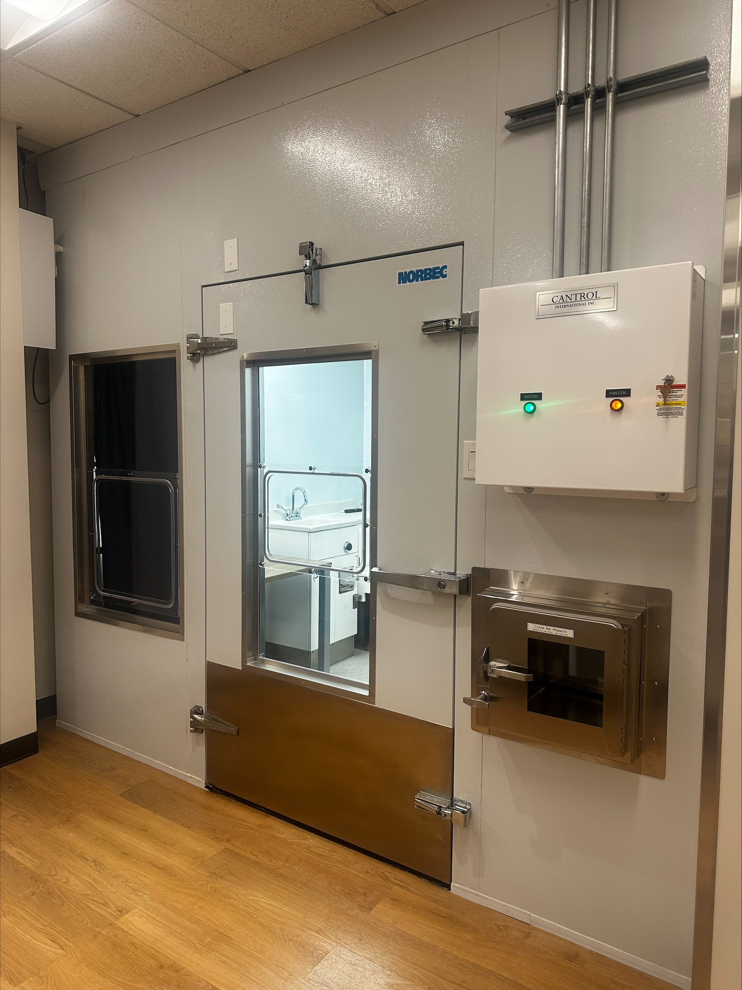
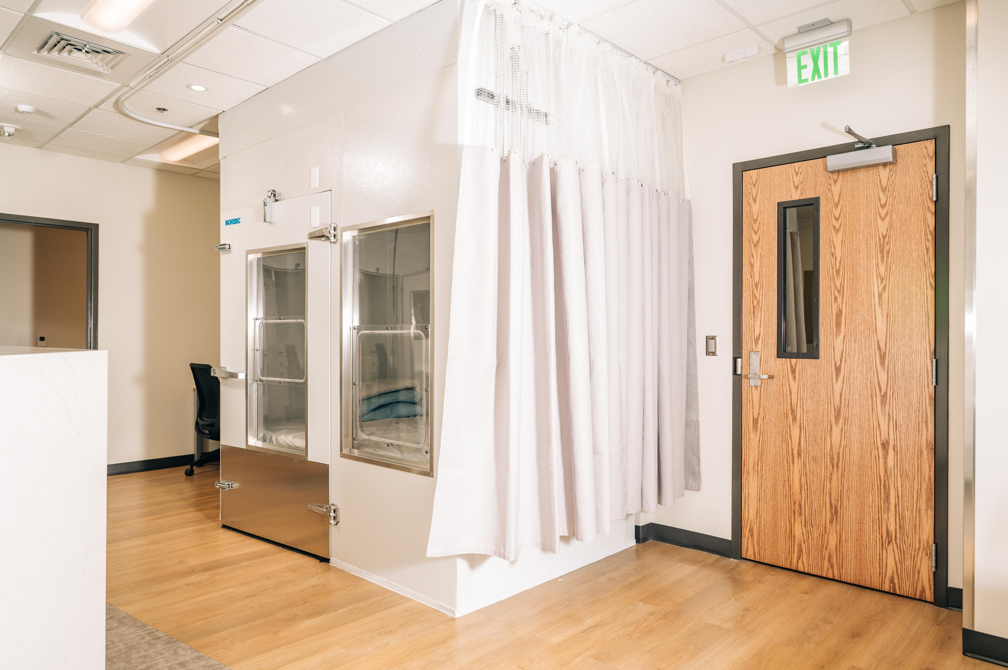
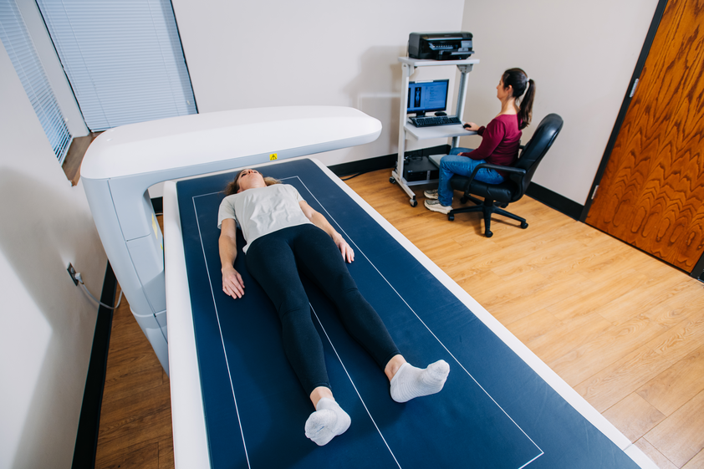
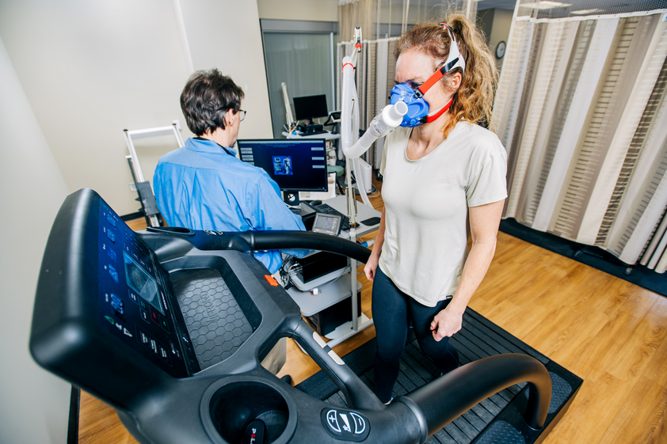
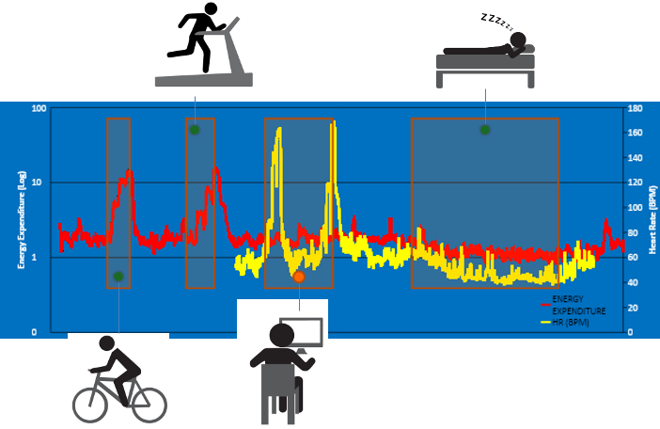
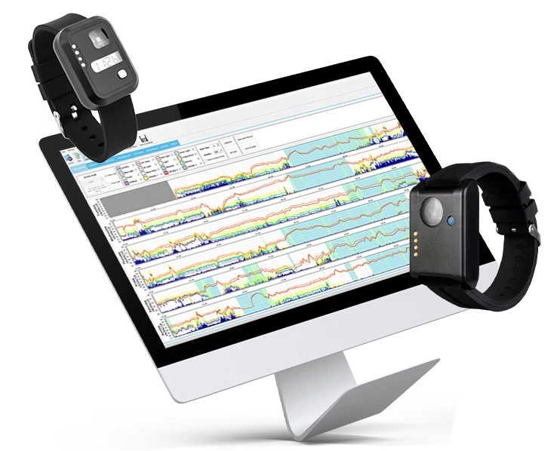
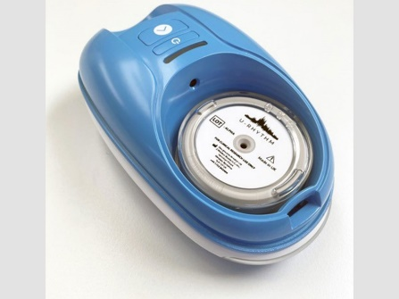
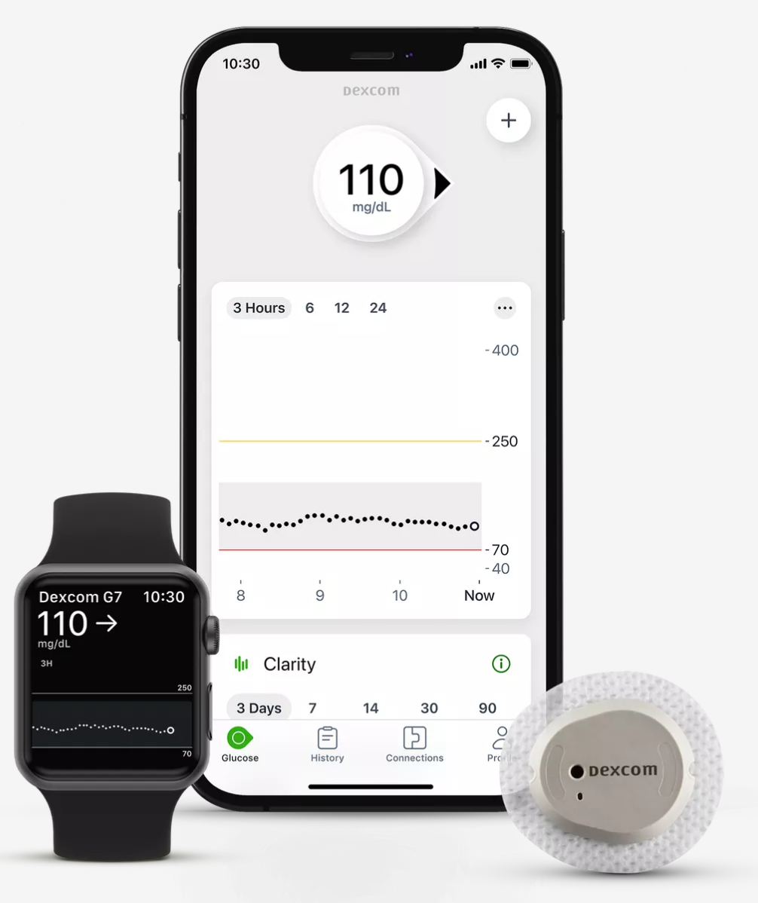
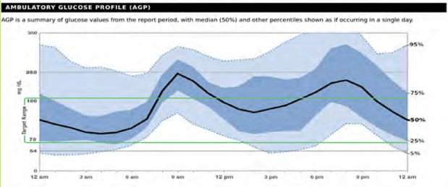
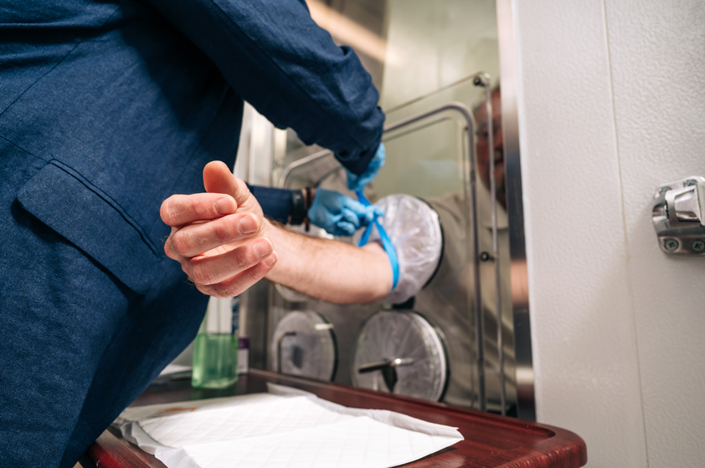
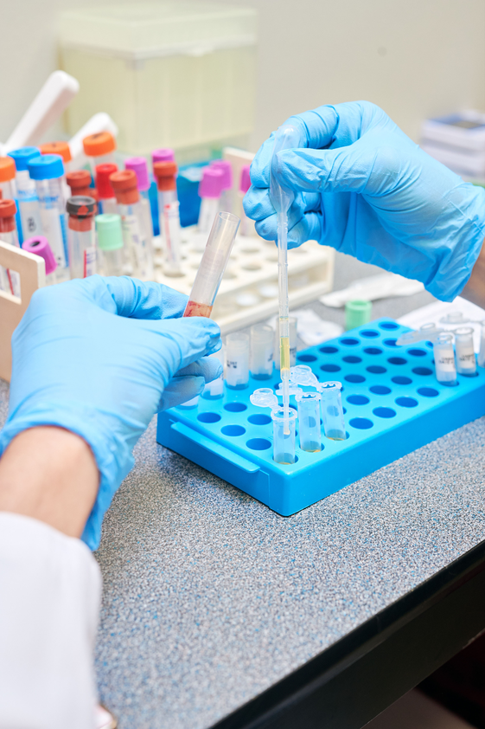
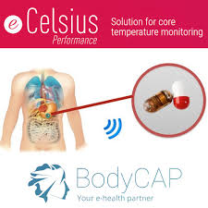
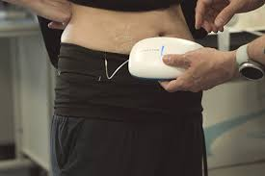
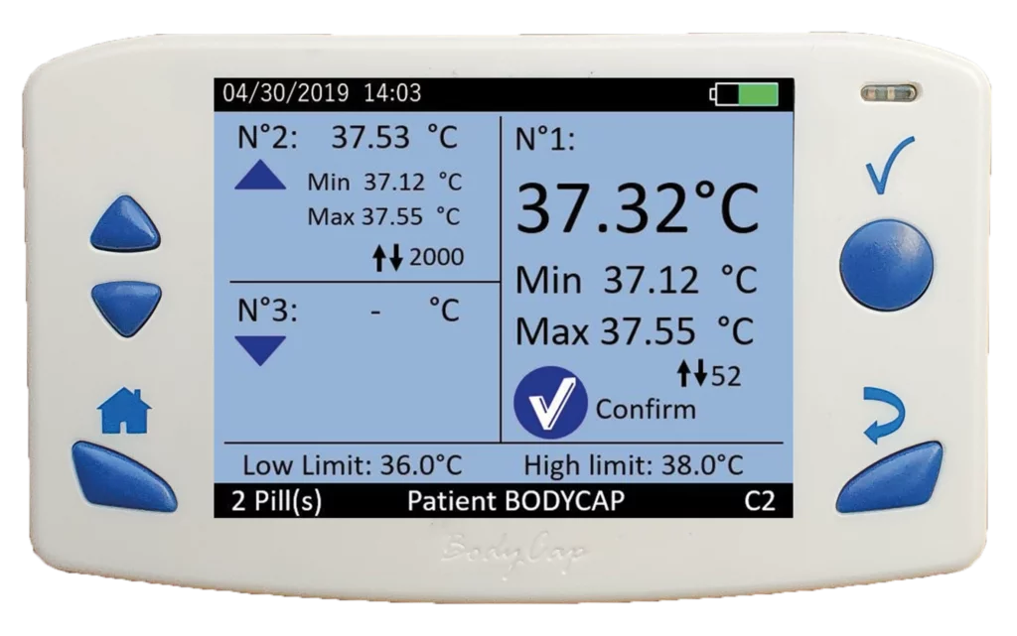
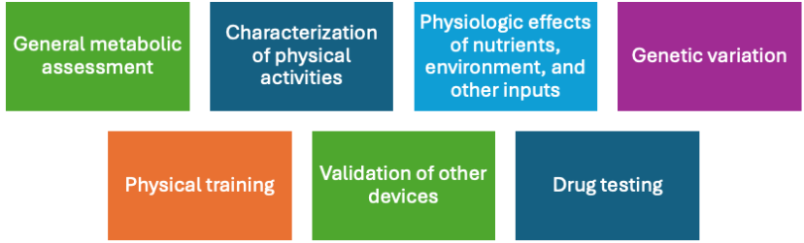
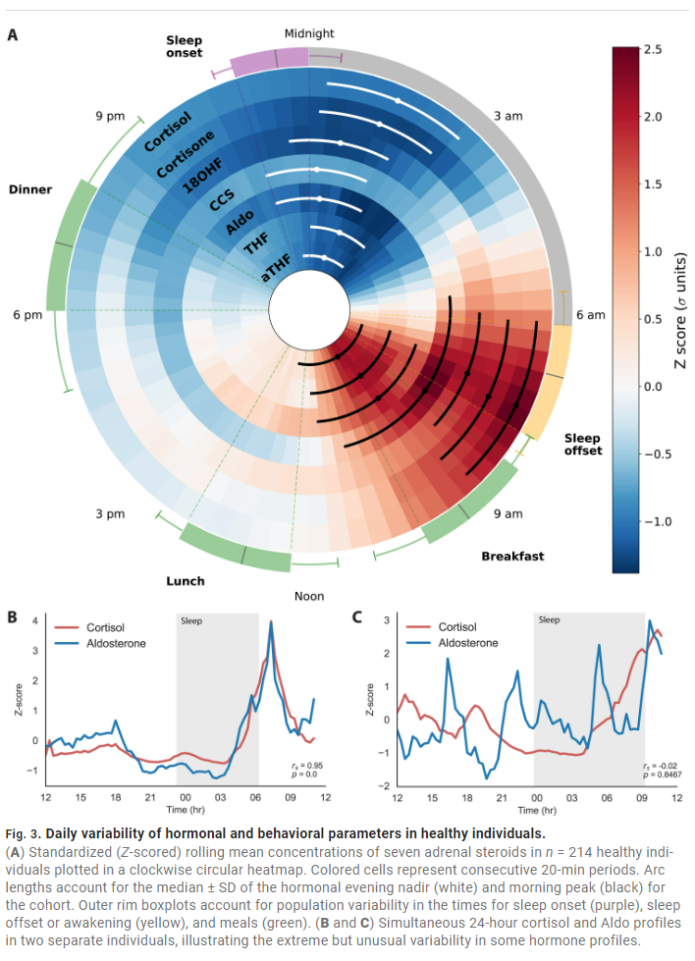
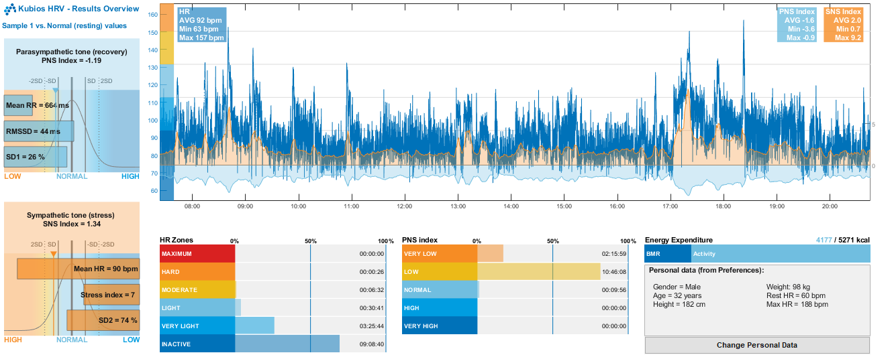
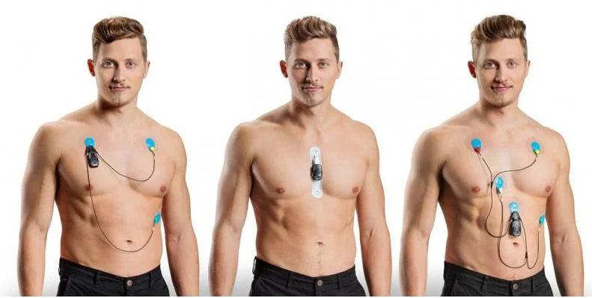
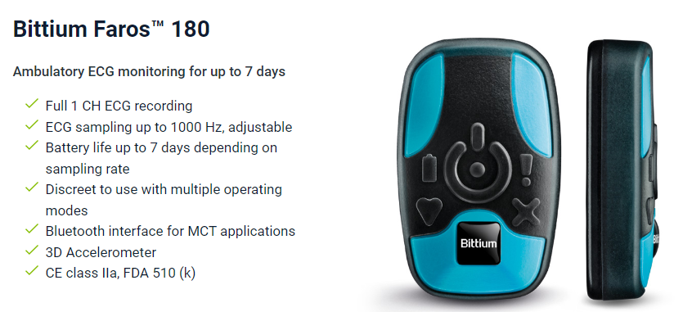
Whole Room Indirect Calorimetry Suite
CORE SERVICES
Department of Nutrition Sciences, School of Health Professions, University of Alabama at Birmingham
Supported by the NIH National Institute of Diabetes and Digestive Kidney Diseases 5P30DK056336-24 and 1S10OD036278-01
Chris Colvin, B.S; Bre McDonald M.S; Silvia Lopez B.S, Kathryn J. Whyte, PhD M.S RDN (Core Director)
Overview
Core Collaboration
Current/Planned Studies
Indirect Calorimetry: Measurement of respiratory gas exchange (VCO2/VO2)
Meet the Nutrition Team!
Expert registered dietitians with specialized metabolic research training
Precision diet formulation enabling controlled macronutrient manipulation
Pharmacy-grade meal preparation ensuring accurate energy balance measurements
KetoWEI
Controlled diet intervention investigating effects of ketogenic versus low fat diet on energy expenditure and appetite after weight loss
CHAMPS
Testing the reliability and repeatability measurements across multiple stays in whole-room indirect calorimeters (metabolic chambers).
Sub-studies:
Validation Studies
Infusion Studies
Deep Phenotyping
Acute Modulatory Role of Whole Grape Polyphenols on Metabolism and Metabolic Flexibility
Integration of mitochondrial respiration and tracing substrate appearance and clearance
Wearable Technology
Validation of research-grade and commercial wearables
Physical activity trackers
Sleep quality/duration
Continuous Glucose Monitoring
Exercise and Body Composition Anyone?
Meet the Chambers
Large- 27m³ (adult, 24-hour studies)
Flex- 6m³ (acute, 1-4-hour studies; e.g., exercise test, resting energy expenditure, meal test)
Medium-16m³ (pediatric, 24-hour studies; adult, short-term studies)
Advanced imaging techniques including the Dual-Energy X-ray Absorptiometry (DEXA) scanner allows for precise body composition analysis
Collaboration with UAB's exercise physiology team eneables comprehensive fitness assesment including VO₂max testing, substrate utilization, and exercise efficiency measurements
Clinical Markers and Phenotyping
Comprehensive blood biomarkers including lipid profiles, metabolic hormones, and glucose markers
Sample collection and repository allows for longitudinal profiling across study interventions
Whole Room Calorimeter Uses
Notes:
Subjects can move freely and stay for extended periods of time in the rooms, which are equipped with amenities such as a bed, television, exercise equipment, and ports to allow for the pass through of meals, medications, and blood sampling, when applicable.
These systems help researchers better understand human metabolism, design more effective health interventions, leading to better health outcomes.
Whole-room indirect calorimetry provides measurements of human energy expenditure and substrate utilization, both long-term (24-hour) and short-term (1–6-hour), for research studies.
Used to determine the effects of weight loss and weight loss medication on whole-body metabolism and its components
Ability to measure:
Total energy expenditure over 24 hours
Diet-induced thermogenesis
Exercise efficiency
Substrate oxidation
Resting energy expenditure
Sleeping energy expenditure

