Slide 1

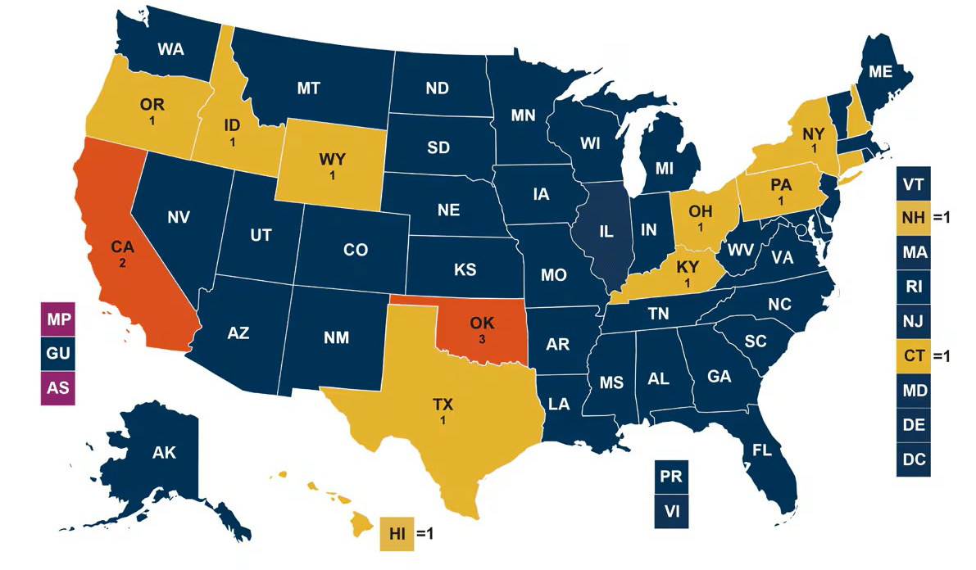

T-MSIS Data & Research Core (DRC) at UAB
Harnessing National Medicaid Data to Advance Health Outcomes & Policy Research
Claims
Analytics
Insights
Policy impact
What is the T-MSIS DRC?
Launched in Spring of 2025
University-wide resource for national Medicaid & CHIP claims data
Supports multi-state health services & policy research
Secure access, expert analytics & collaboration support
The Power of T-MSIS Data
50-state Medicaid/CHIP coverage
75+ Million beneficiaries per year
Billions of longitudinal claims
T-MSIS DRC Services
Study design consultation
Support for Data-Reuse Applications
Cohort building & variable creation
Statistical analysis & interpretation
Grant & manuscript support
Unique Advantage
Early mover advantage with research using T-MSIS data
Team expertise in advanced analyses of big healthcare data
Strong connections with Medicaid Data Learning Network (MDLN)
Strong departmental support (Health Policy & Organization)
Current Research Focus
Diabetes & obesity
Behavioral health & substance use
Maternal & child health
Rural health & access disparities
Health outcomes & policy evaluation
Ongoing Projects
HRSA/DHHS: Postpartum care transitions
UAB pilot: Cannabis policy & pain management
Foundation Grant: LARC & birth spacing
CMS/Medicaid: Evaluation of maternal & child health programs
Part of funded Center grants like TOP-UP (HRSA)
Internally Funded: Risk factors for delayed diagnosis of diabetes
Multiple journal articles, manuscripts under review & conference presentations
Meets all data quality targets
Meets some data quality targets
Meets most data quality targets
Does not submit T-MSIS data
WHAT IS IN ADMINISTRATIVE CLAIMS DATA?
Demographics: Age, race, ethnicity, location
Place of service: Outpatient, inpatient, ED, telehealth
Diagnoses: ICD codes for primary & secondary conditions
Procedures: CPT/HCPCS codes for services provided
Prescriptions: National Drug Codes (NDC) for medications
Providers: Physician NPIs & facility types
Costs: Payments made by state Medicaid programs
Scan Me
Contact us: Julie McDougal: jmcdouga@uab.edu | Dr. Pia Sen: bsen@uab.edu | Visit: https://tinyurl.com/TMSISDataUAB

Slide 2








T-MSIS Data & Research Core (DRC) at UAB
Harnessing National Medicaid Data to Advance Health Outcomes & Policy Research
Core Team Members
Diverse team with expertise in
Health Economics
Health Policy & Health Outcomes
Econometrics & Quasi-Experimental Studies
Epidemiology
Cost-effectiveness & Comparative-effectiveness
Health Administration & Management
Maternal & Child Health
Manuscripts/Presentations
Prevalence of pediatric diabetes in Medicaid population, 2016-2021
Characteristics of pediatric patients who receive a new diagnosis of diabetes in the ED setting
Geographic differences in postpartum visits & diabetes screening among women enrolled in Medicaid experiencing gestational diabetes during pregnancy
Poster presentations at AcademyHealth (June 2025)
Core Team Members
Bisakha “Pia” Sen, PhD
Professor & Blue Cross Blue Sheild Endowed Chair in Health Economics
Core Director
Julie McDougal, MAE
Program Director II
Hao Zhang, PhD
Assistant Professor
Core Deputy Director
Ye Liu, DrPH
Assistant Professor
Common Research Barriers with T-MSIS Data
Very high initial costs
Our Solutions
Cost-sharing model
Lengthy procurement
Steep learning curve
Complex data management
Secured CMS approval
Experienced research team
Full analytical support provided
David Becker, PhD
Associate Professor
Theo Giannouchos, PhD
Assistant Professor
Pradeep Sharma, MS
Scientist II
Jillur Rahim, MA
Statistician II
Scan Me
​
Contact us: Julie McDougal: jmcdouga@uab.edu | Dr. Pia Sen: bsen@uab.edu | Visit: https://tinyurl.com/TMSISDataUAB

