Slide 1

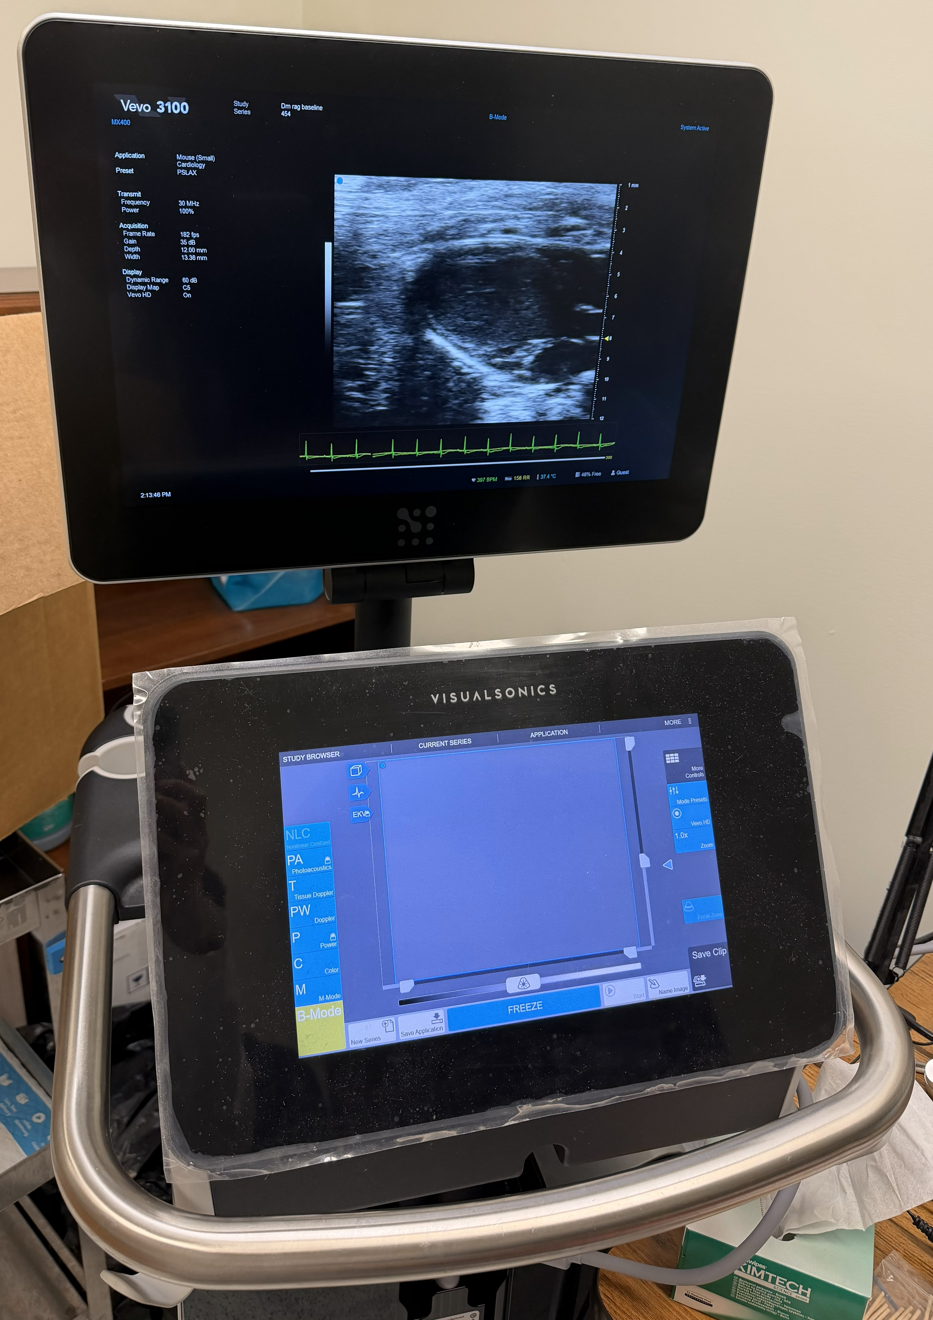
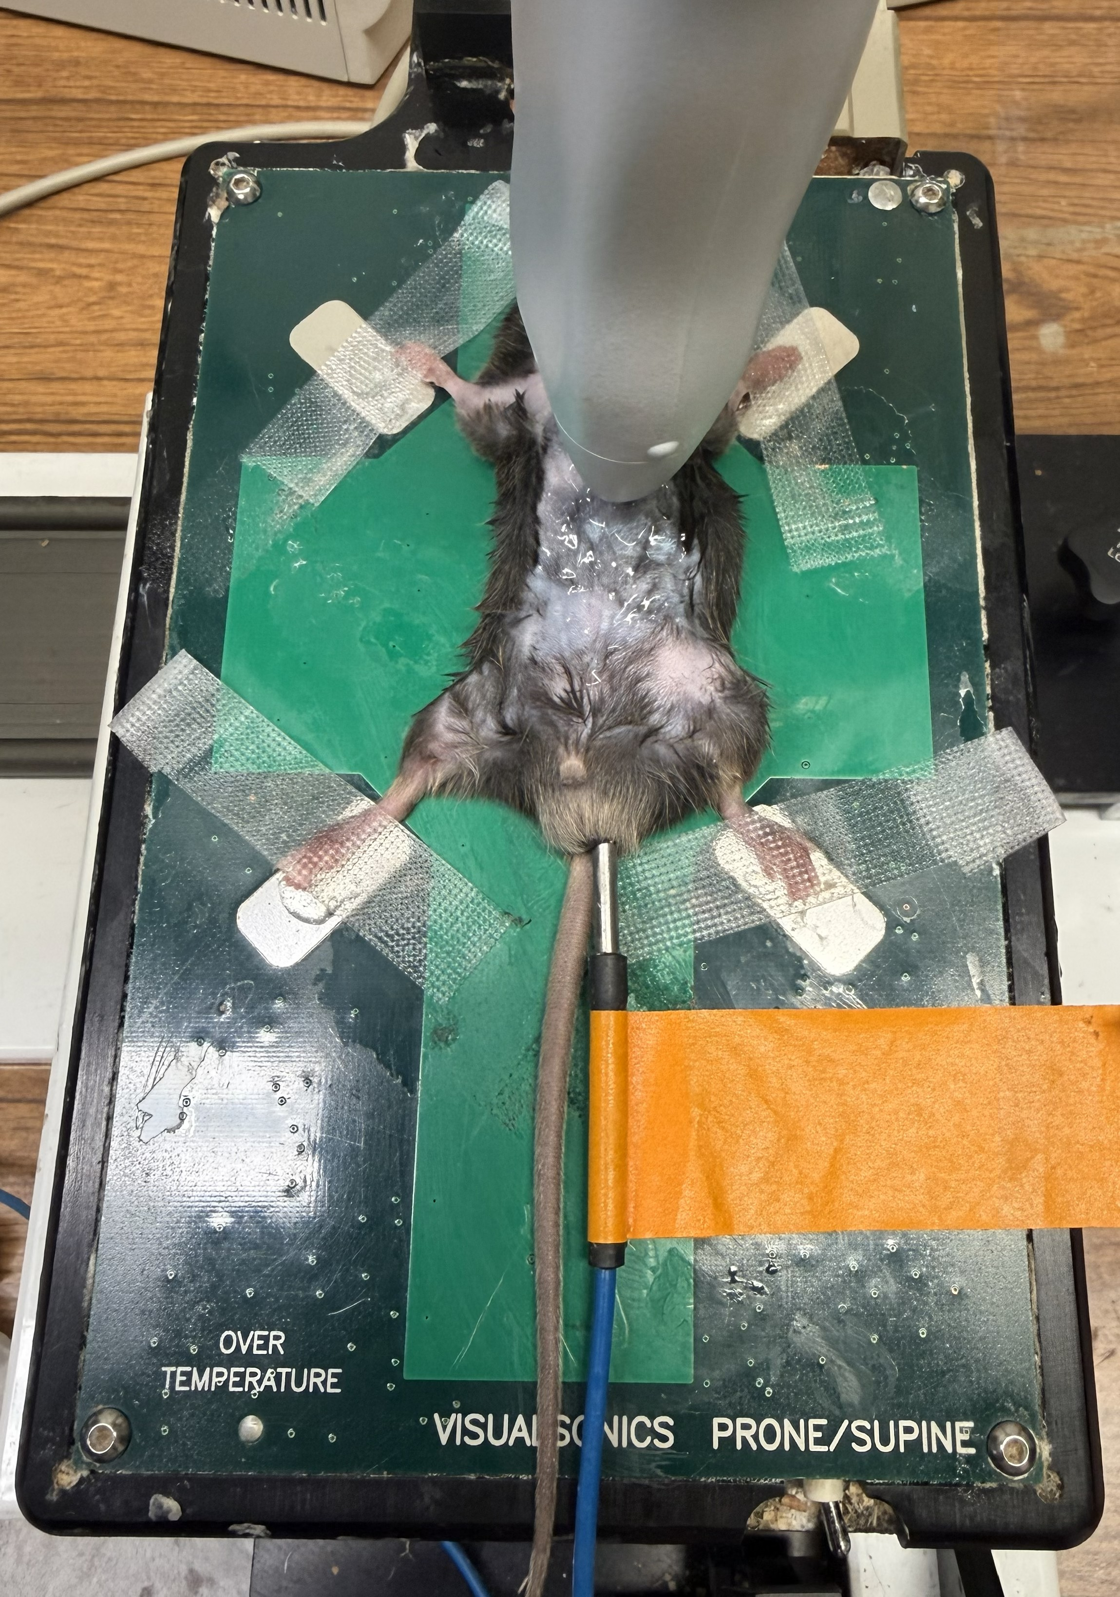
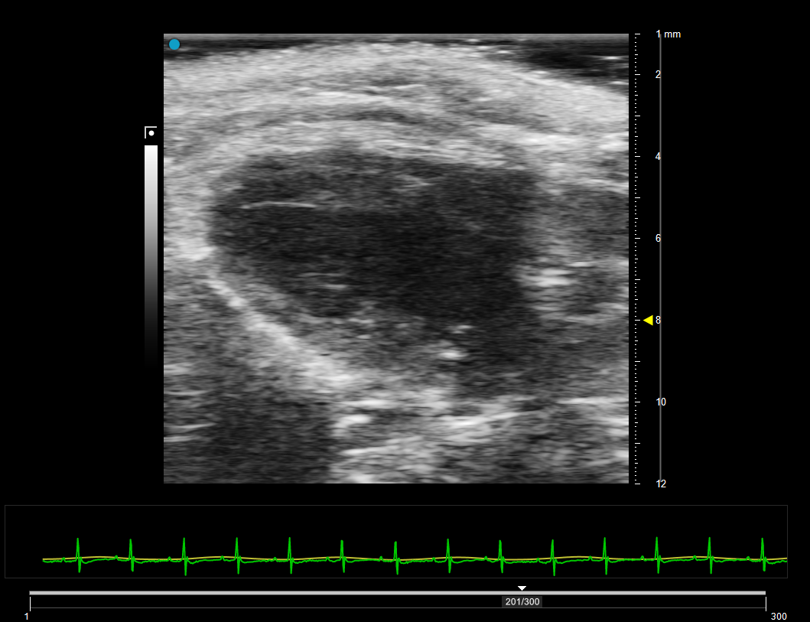
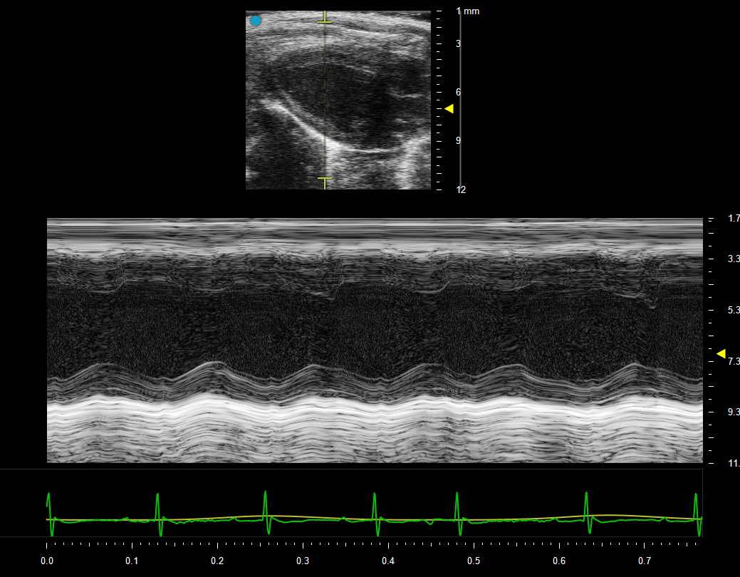
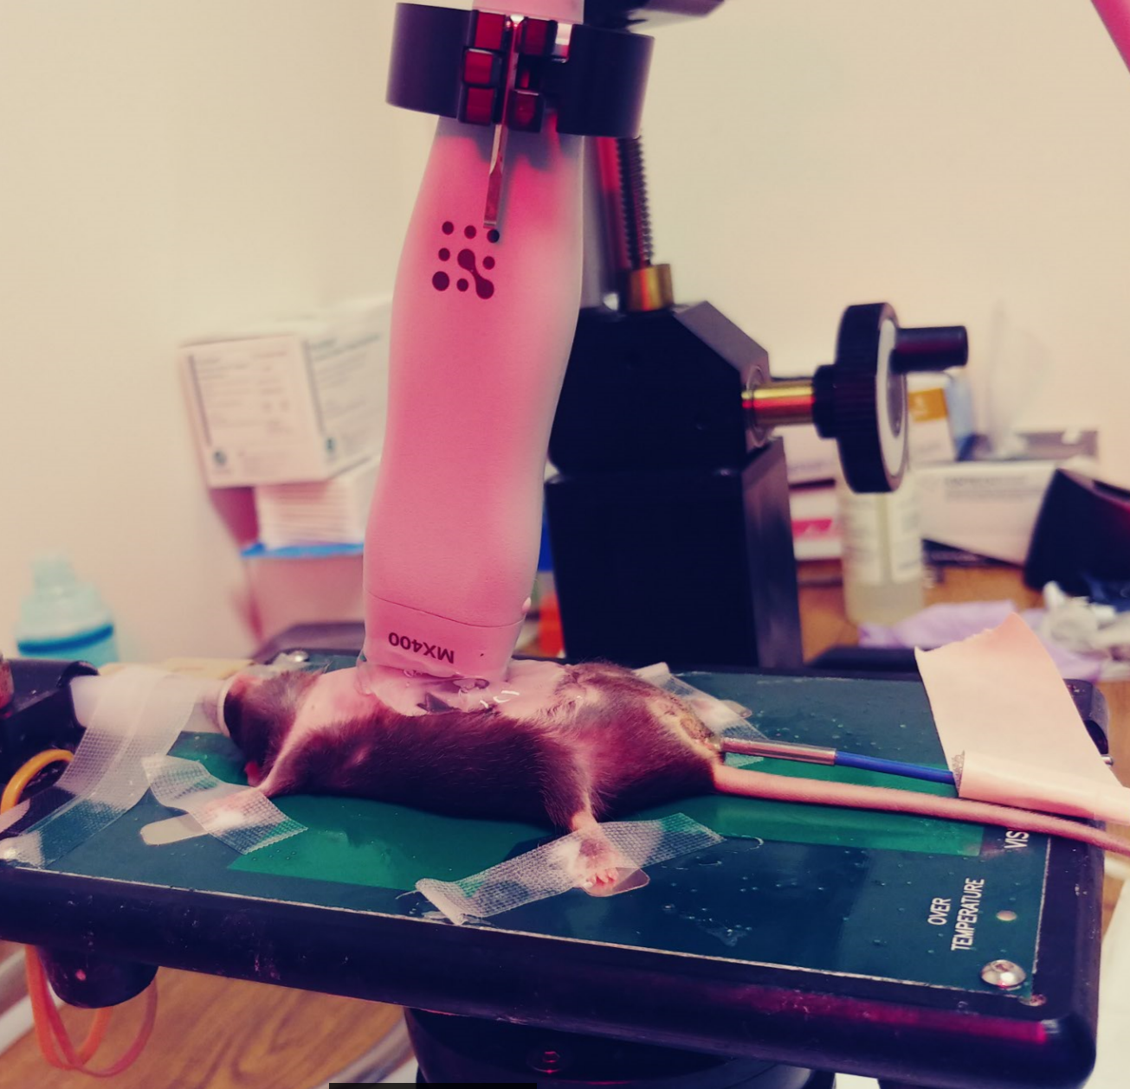
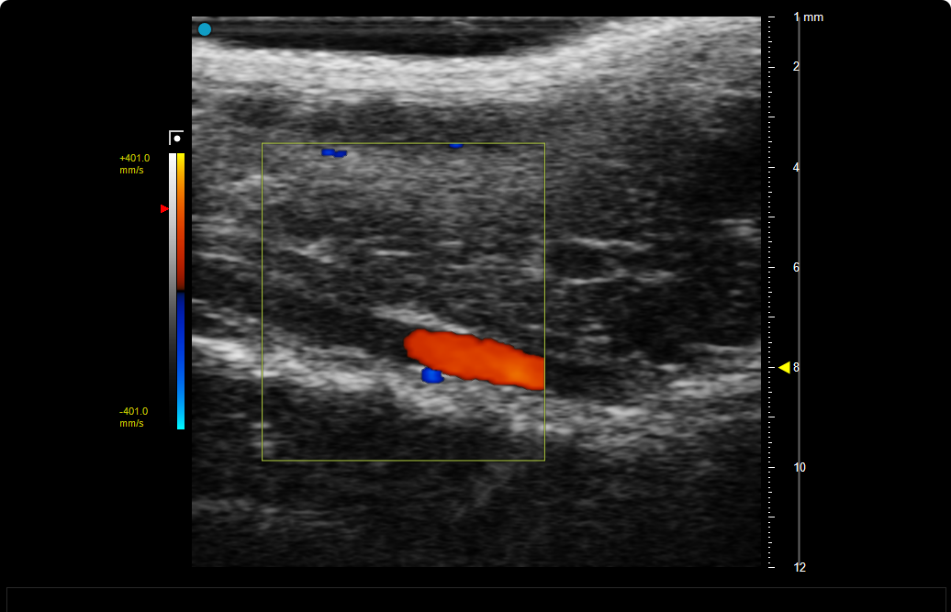
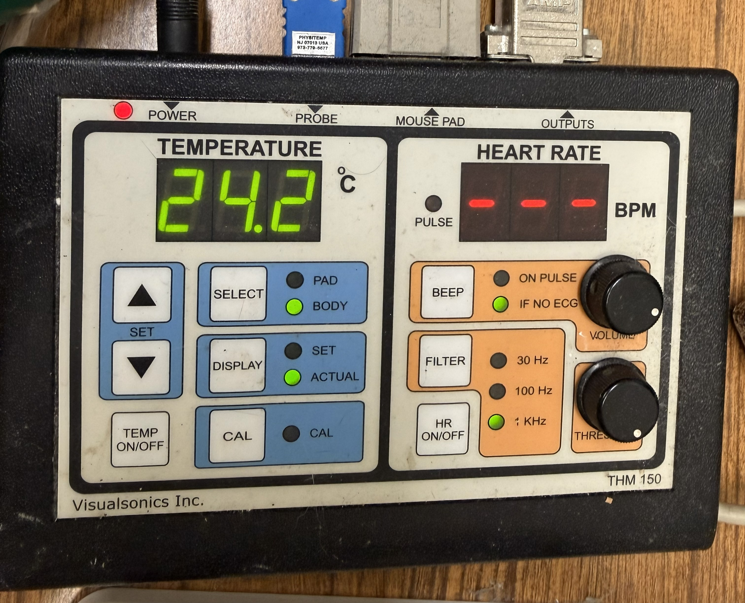
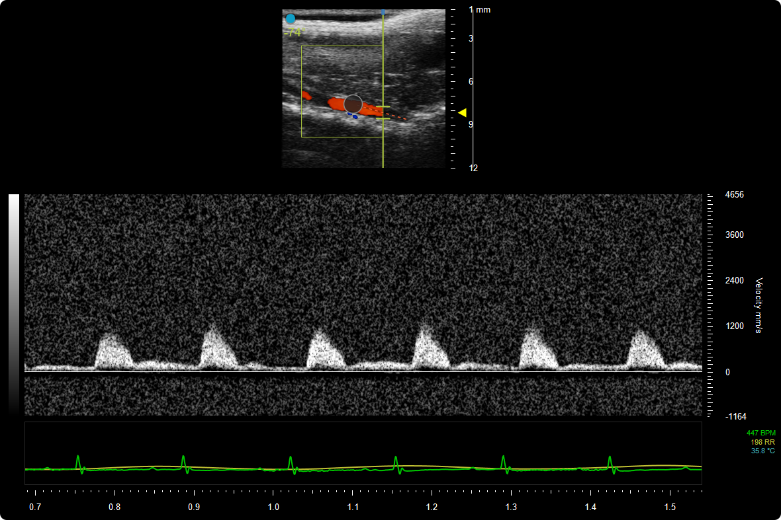
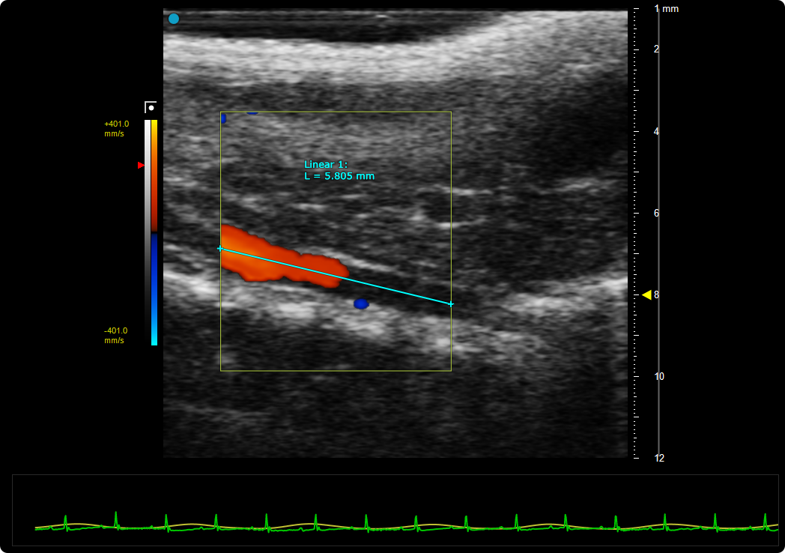
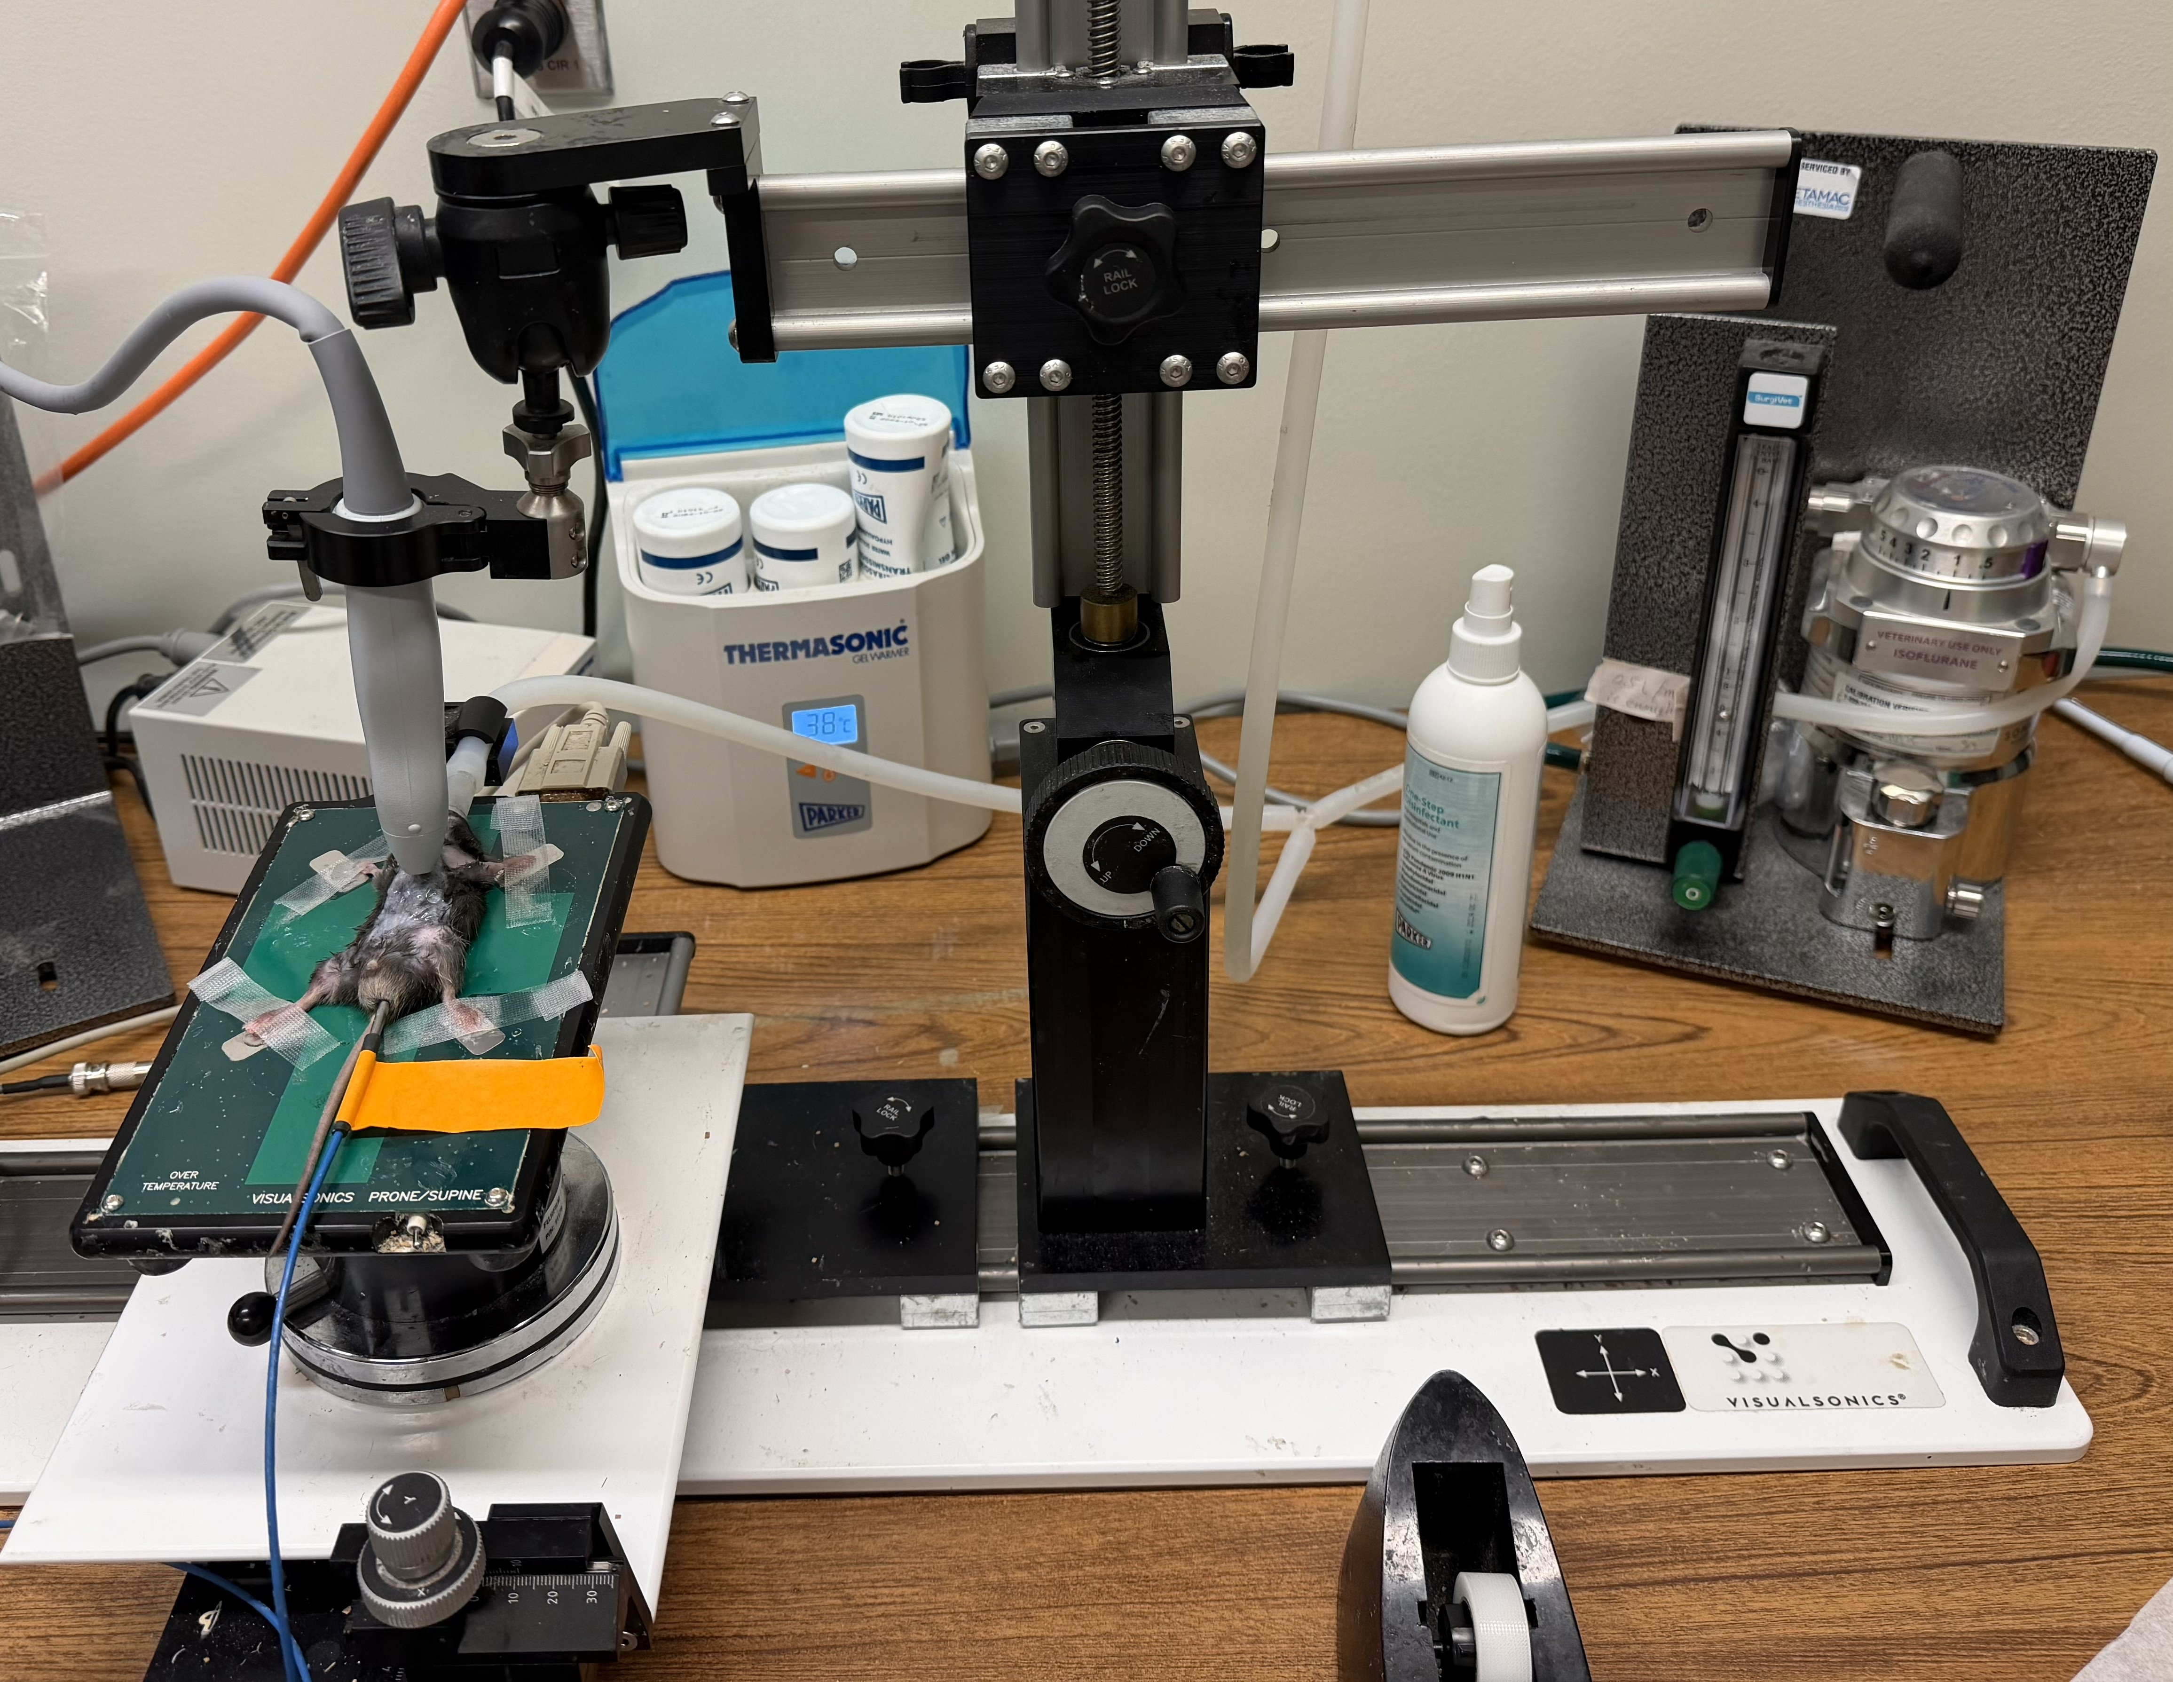
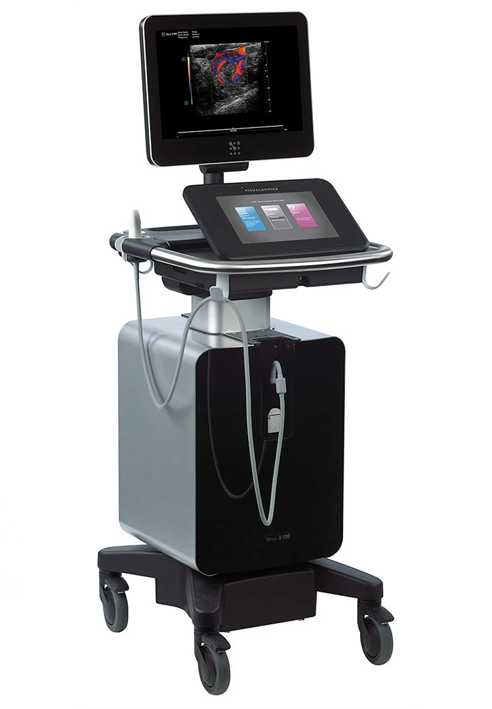
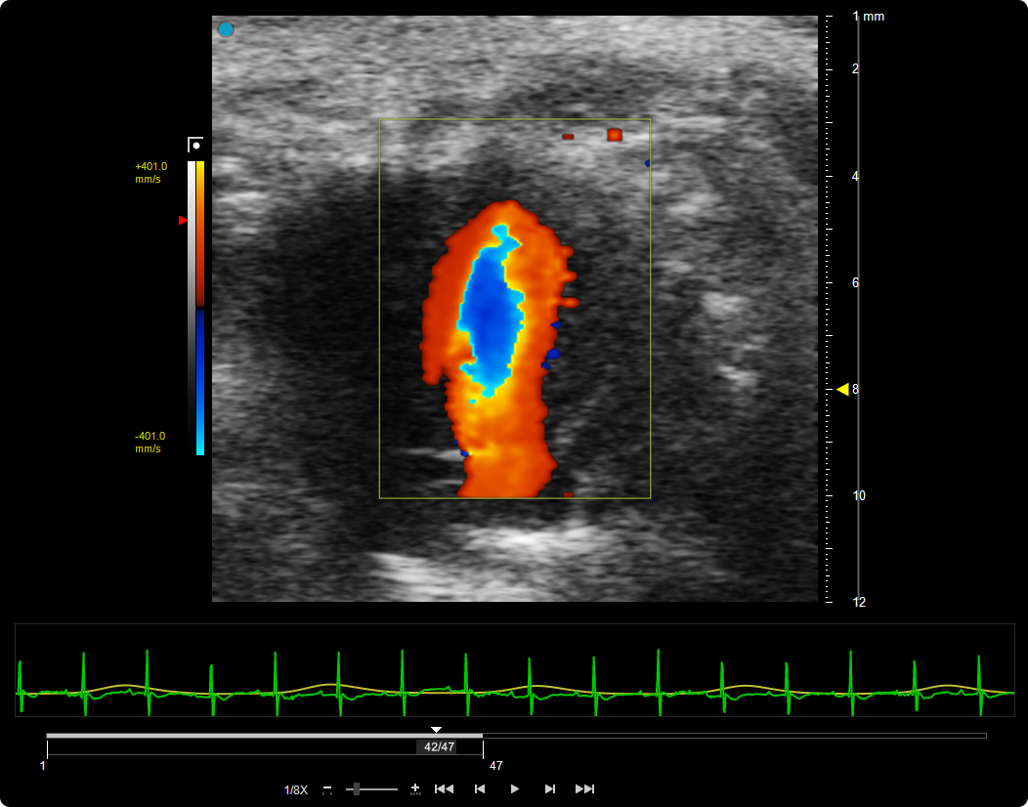
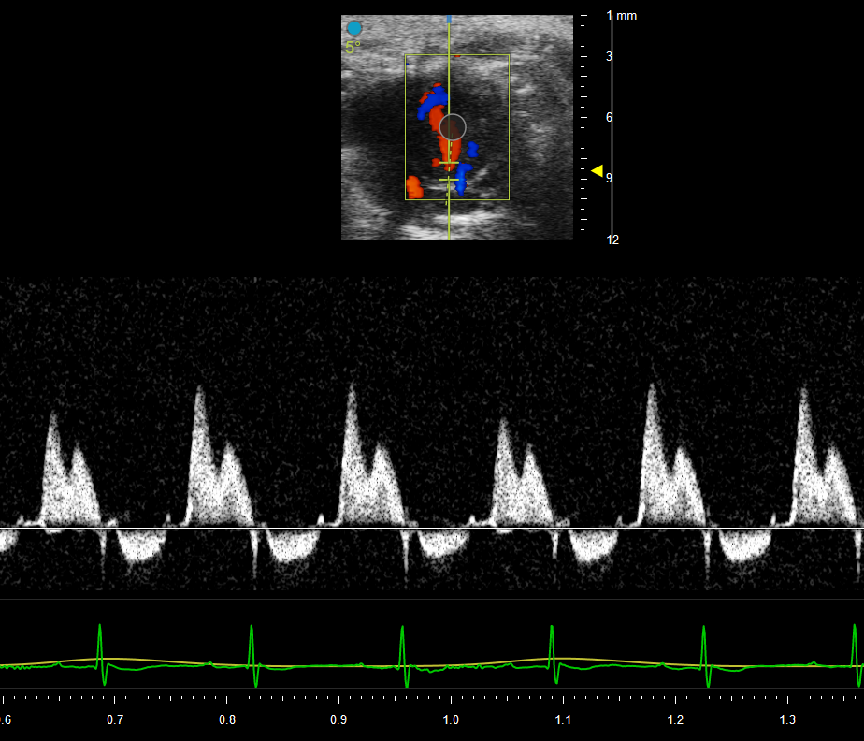
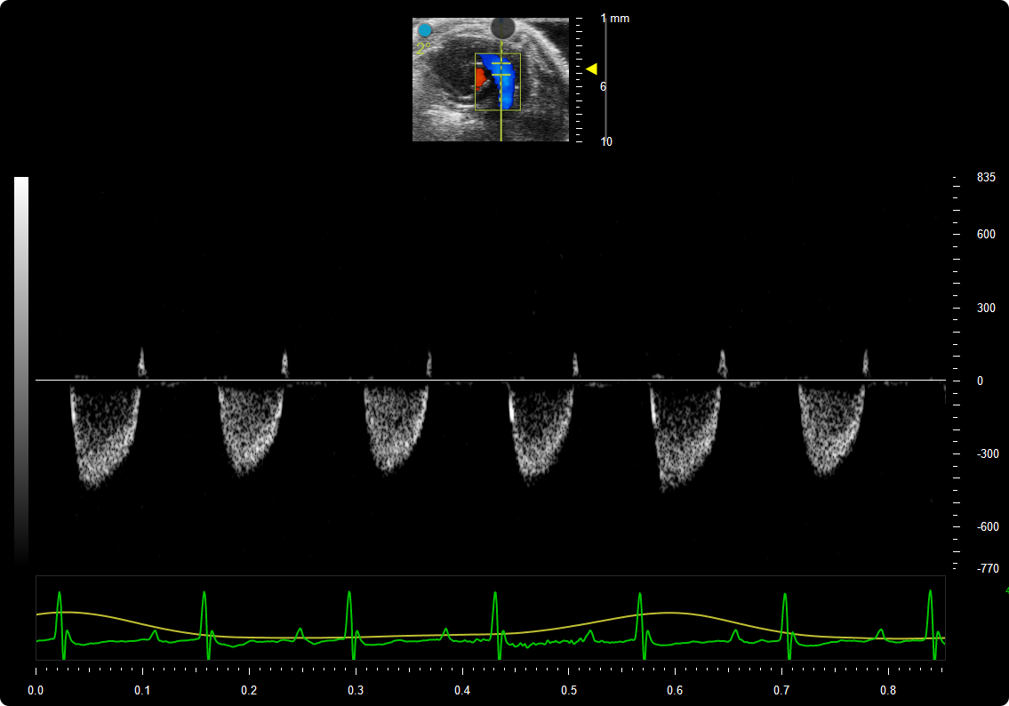
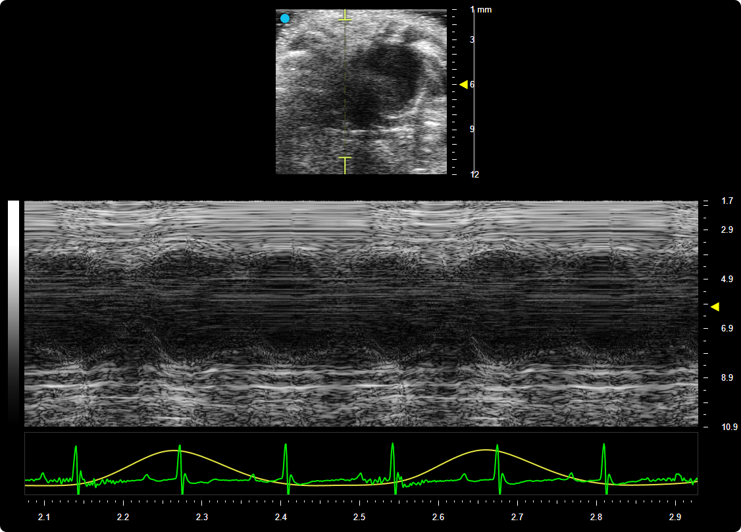
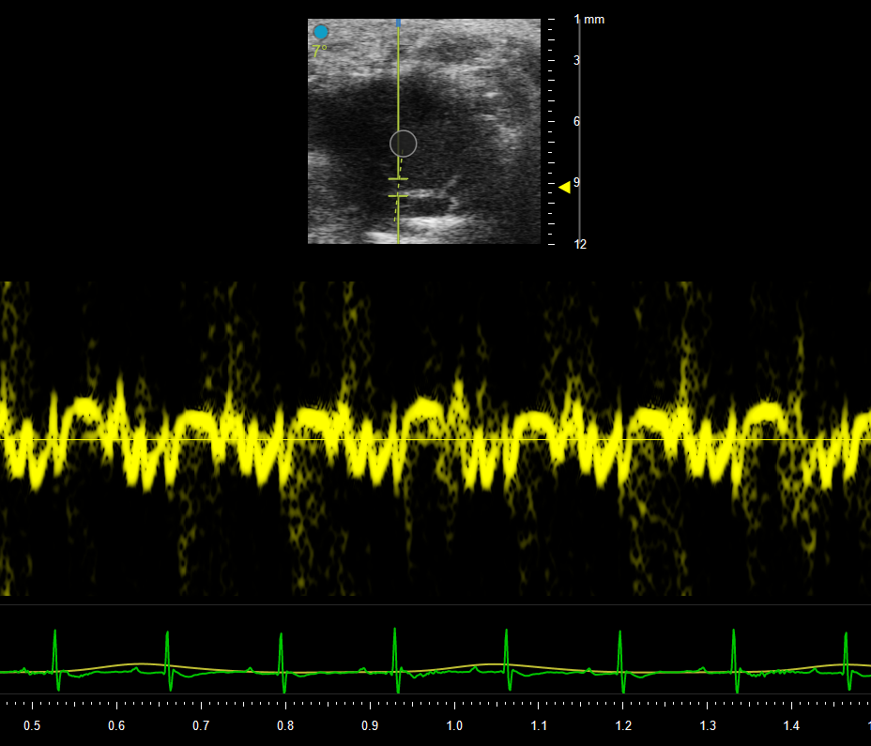
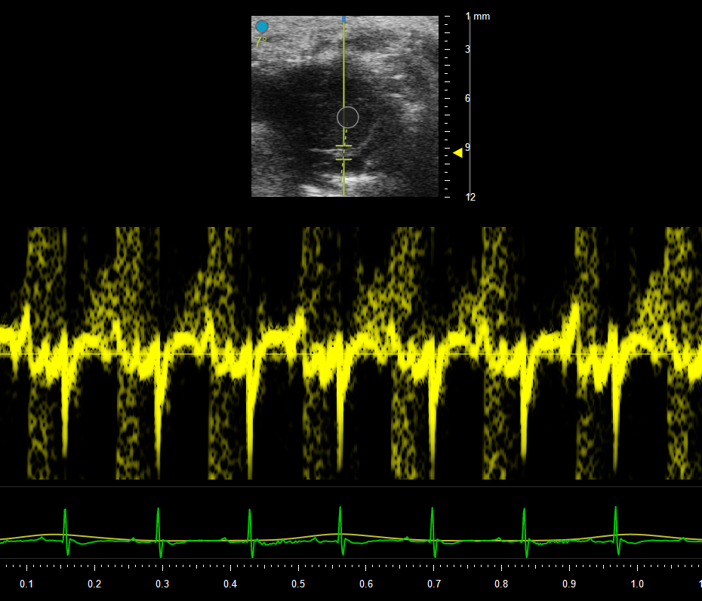
Small Animal Echocardiography (ECHO) Core
Department of Medicine, Division of Cardiovascular Disease, Comprehensive Cardiovascular Center (CCVC)
Introduction
Workstation
Left ventricular systolic function measurements
Aortic pulse wave velocity measurements
With support from the Comprehensive Cardiovascular Center (CCVC) and the Division of Cardiovascular Disease, the Small Animal Echocardiography (ECHO) Core of UAB was established in 2017. The Small Animal ECHO Core has served more than 20 principal investigators and their projects. The Small Animal ECHO Core has generated numerous publications and grant applications.
Abdominal aorta B-mode with color Doppler
Core Equipment
Left ventricular long axis B-mode (left) and M-mode (right). LVEF can be measured using either images.
Left ventricular diastolic function measurements
We have a highly capable VEVO 3100 ECHO machine.
Mice: an MX400 variable frequency (20-46MHz) probe, a temperature-controlled platform with EKG monitoring for mice.
Rats: an MX250 variable frequency (15-30MHz), a temperature-controlled platform with EKG monitoring for rats.
An anesthesia machine.
Abdominal aorta pulse wave Doppler (left) and distance (right).
Right ventricular function measurements
Apical 4 chamber view (left) and mitral valve pulse wave Doppler (right).
Services
Pulmonary artery outflow pulse wave Doppler (left) and Tricuspid annular plane systolic excursion measured by tricuspid annular M-mode (right).
We can measure cardiac systolic and diastolic function, pulse wave velocity, and customized protocols to meet the investigator’s needs. The Small Animal ECHO Core has a dongle to use the comprehensive VEVO software for data analysis.
We provide full service and self-run service after training.
Contact
Director: Min Xie, MD, PhD
Staff: Jin He, MD, Lihao He, MD, Yunxi Chen, MD, MS.
Email: mousecardiocore@uabmc.edu
Mitral valve tissue Doppler (septal, left; lateral, right).

