Slide 1
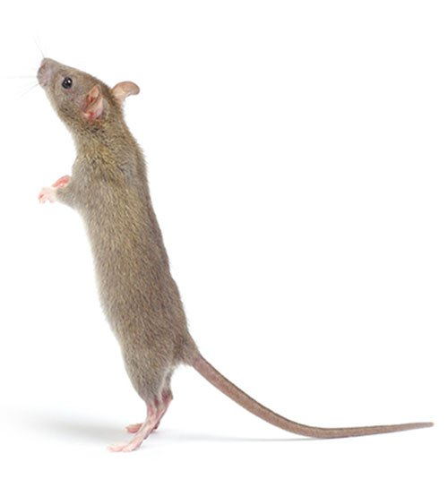
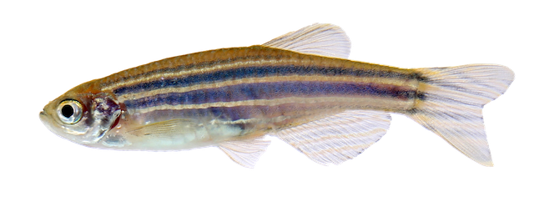
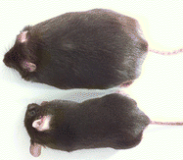
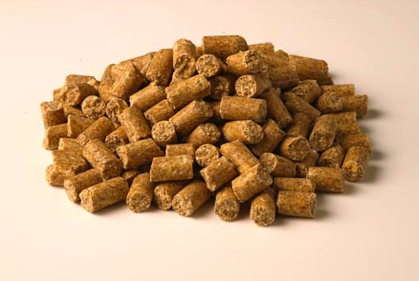
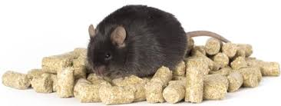
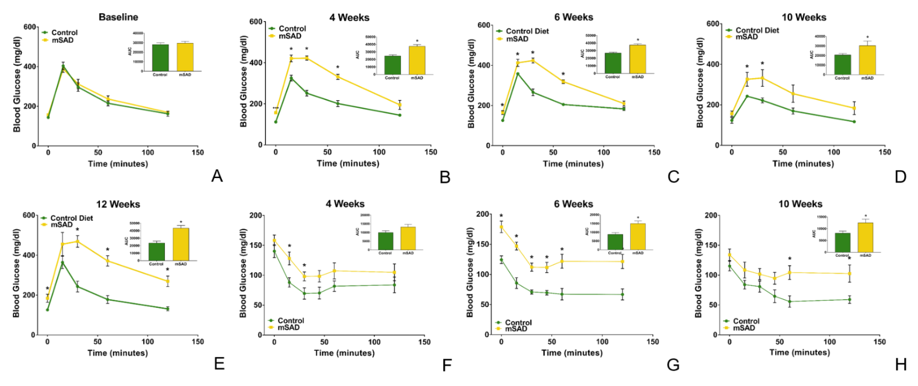
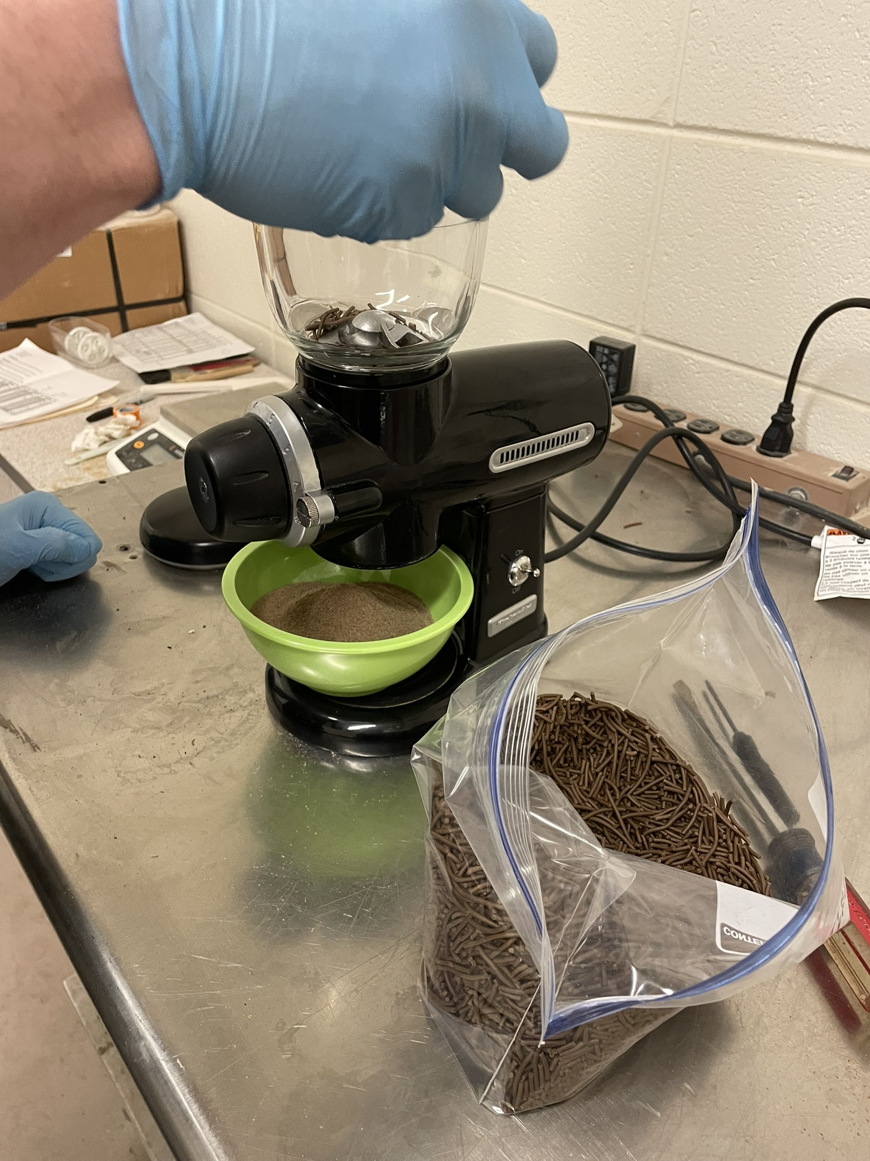
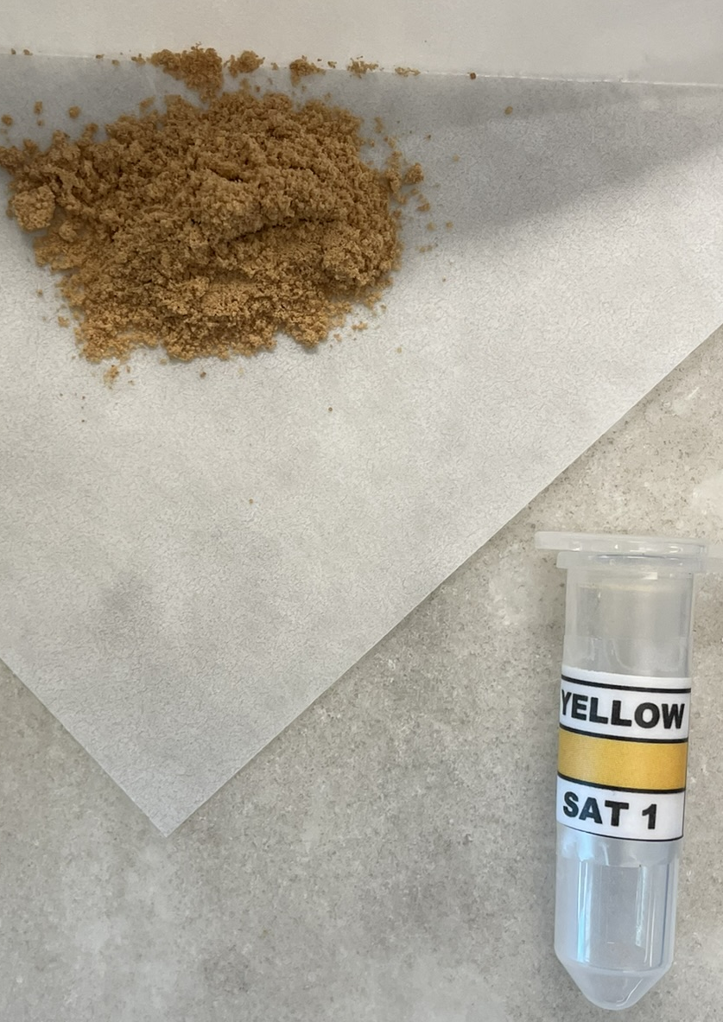
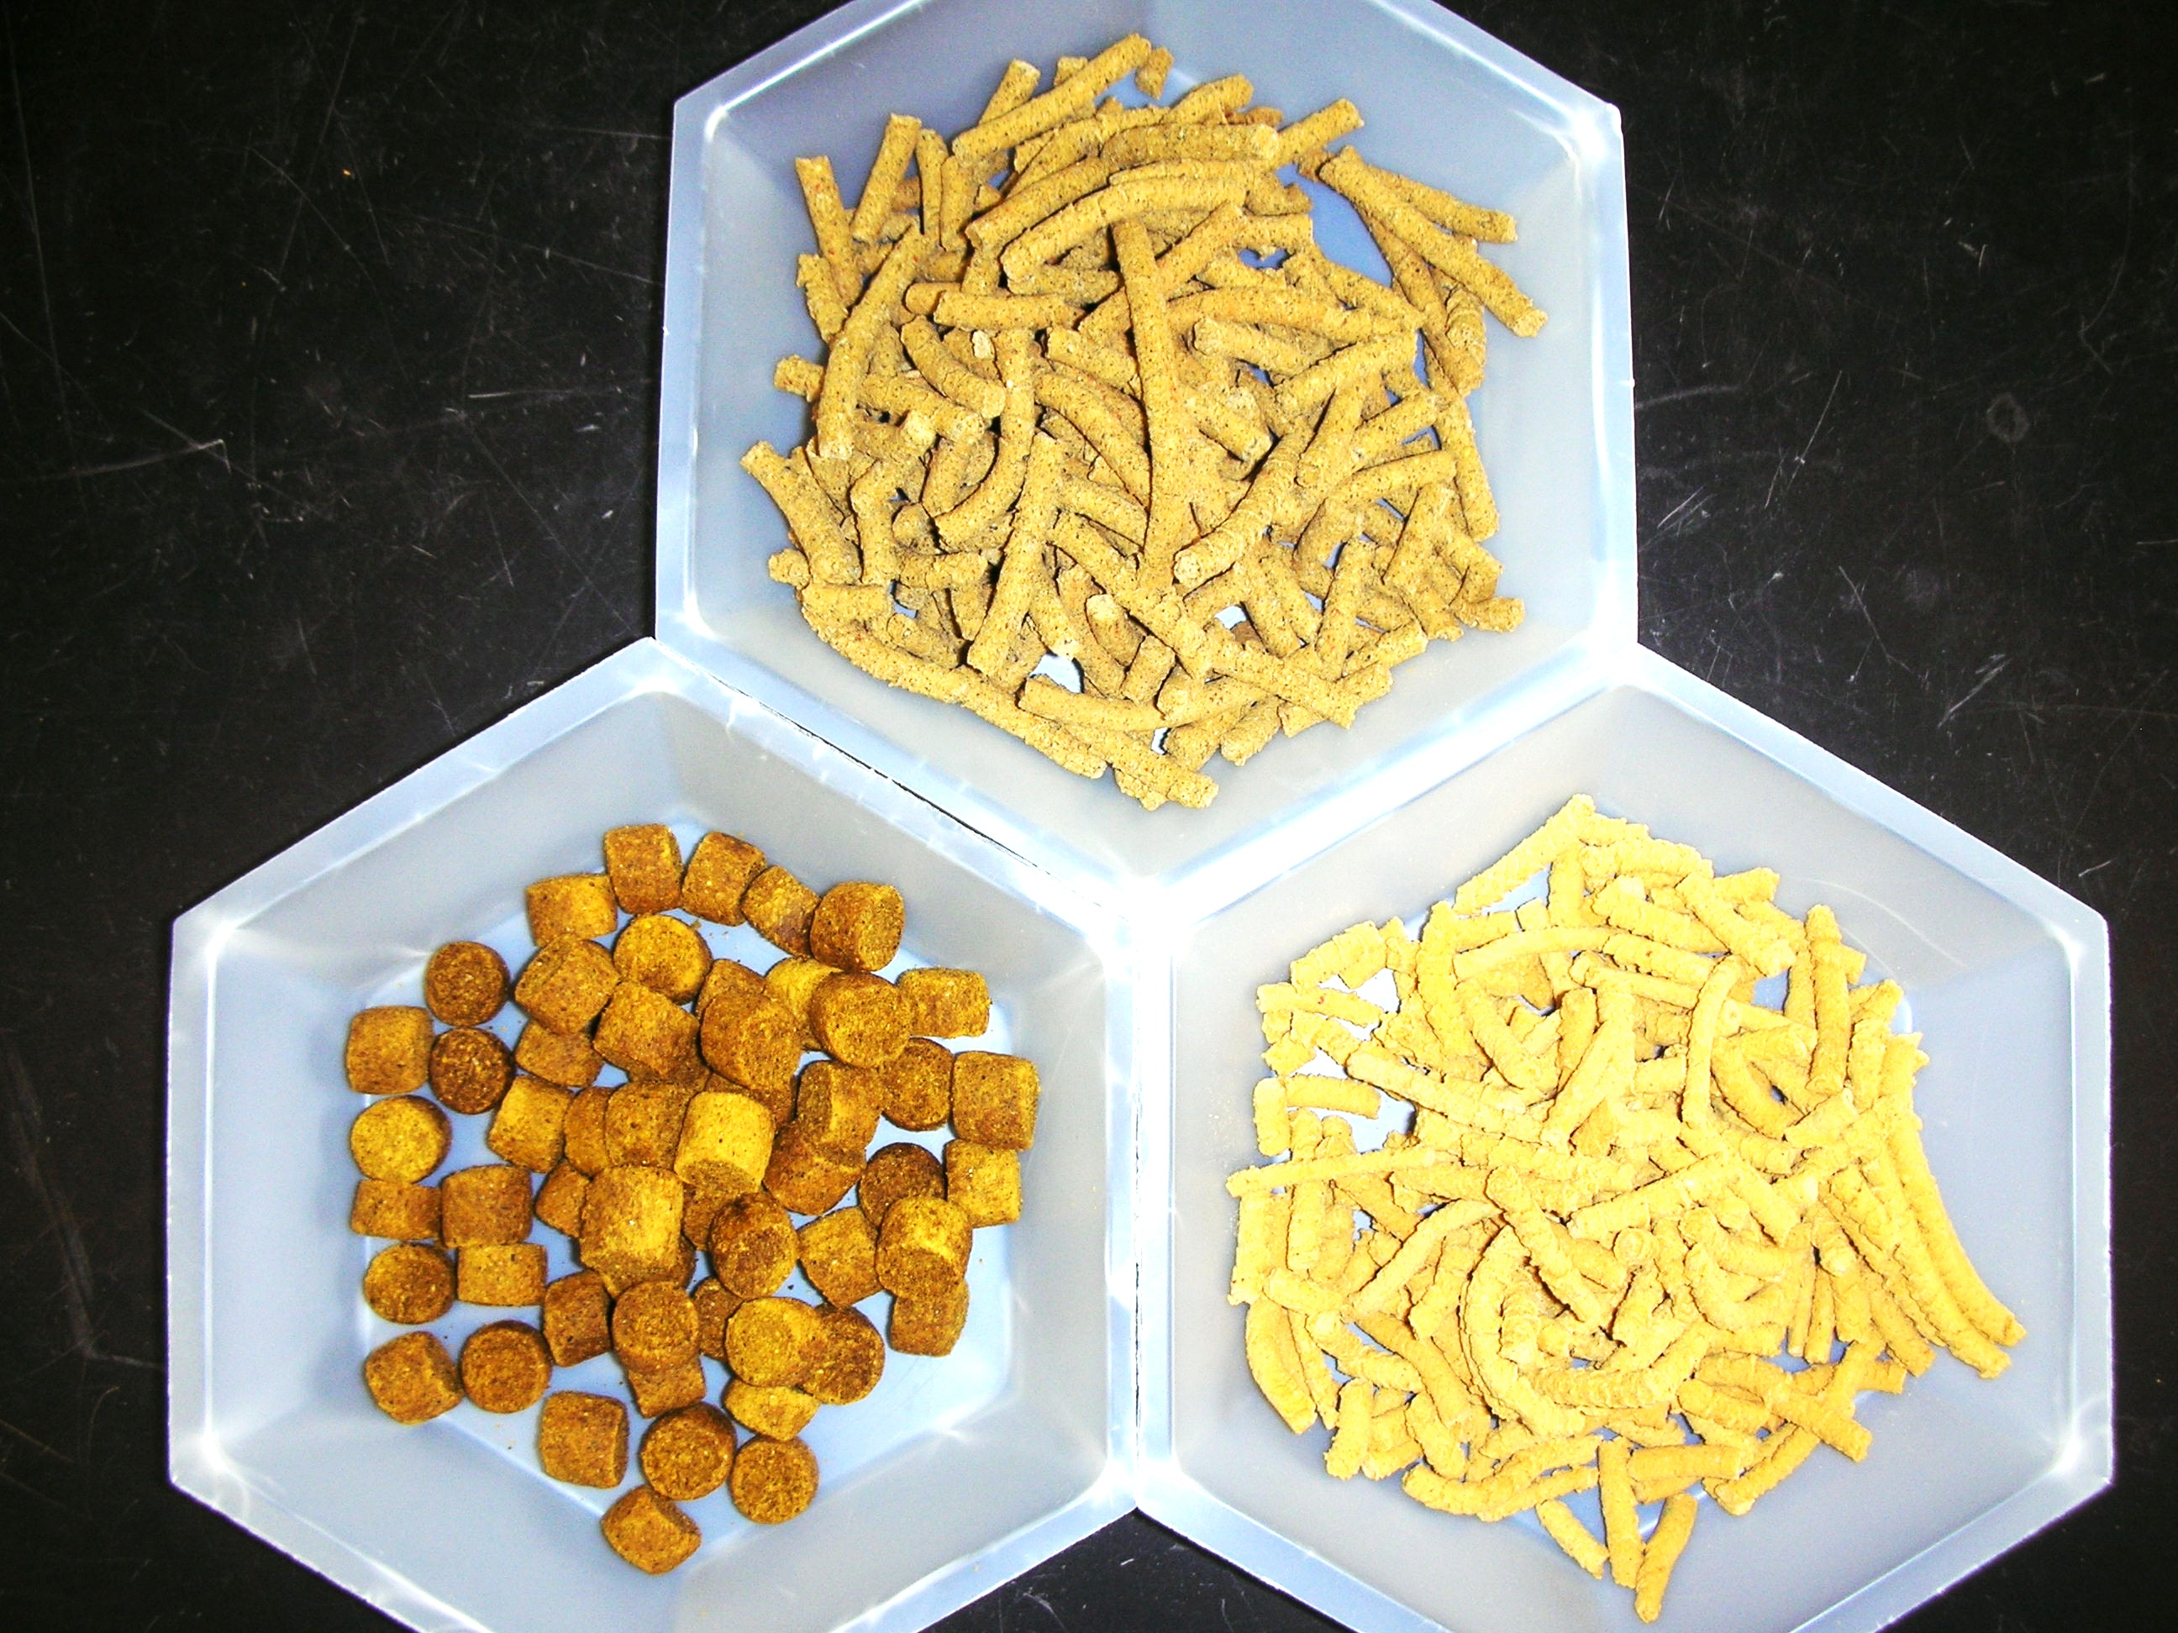
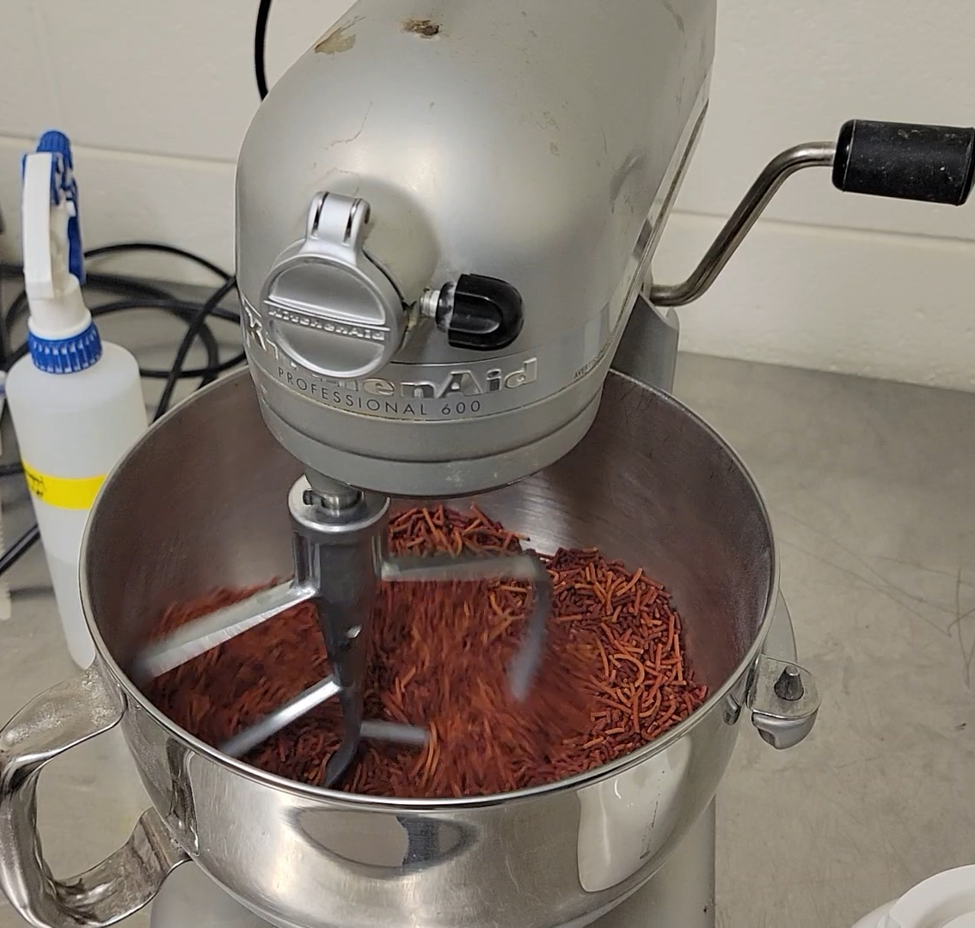
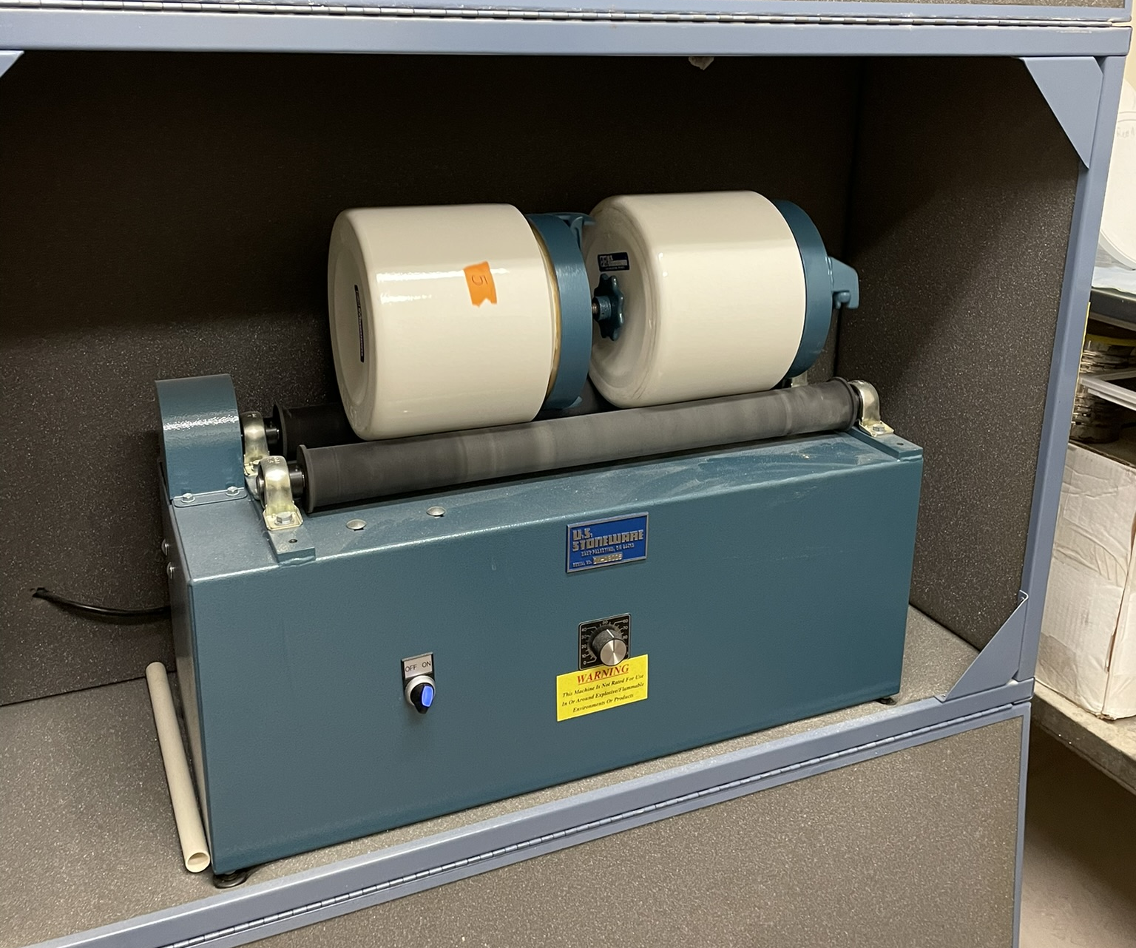

Is Diet Affecting Your Research Outcomes?
Laboratory Animal Nutrition Core (LAN)
The Challenge
“Over half of the manuscripts submitted to the Journal of Nutrition have inadequate or inappropriate nutritional experimental design”
Dr. Teresa Davis, Editor-in-Chief Emerita
Journal of Nutrition
The lack of understanding of nutrition and the continued use of unsuitable research diets in many animal models will limit our ability to translate timely knowledge concerning the onset, progression, and management of human disease.
Services: Diet Consulting
Murine Diets
The LAN will initially consult with investigators concerning experimental design and nutritional requirements at no charge. We can assist in the formulation of specific diets, particularly those which contain pharmacologic or nutraceutical compounds.
Custom diet needs may include:
Addition or removal of specific nutrients or bioactive food components
Altered proximate nutrients (protein, lipid, carbohydrate)
Diets that promote or influence disease onset and progression
  Diet-Induced Obesity
  Diabetes
  Fatty Liver Disease
  Inflammatory Bowel Disease
  Cancer
  Hypertension
  Anxiety/ depression
Dietary interventions
Plant-based diets
We can formulate custom diets along with appropriate controls for murine models. Our modified standard American diet (mSAD) promotes obesity and glucose intolerance (shown below).
The Goal
To increase the relevance of lab animal research by
providing nutritional information, diet formulation, and diet production for standard reference diets, reference diets, and experimental diets, in a variety of animal models, as well as to expand our understanding of the importance of diets in experimental design.
Effect of mSAD on Body Composition and Metabolic Health in C57BL/6J Mice
History
The Lab Animal Nutrition Core (LAN) was established in 2019 to study, advise, formulate, and produce lab animal diets for standard and novel animal models with translation to human health. The LAN is directed by a team of comparative animal nutritionists led by Dr. Stephen Watts, Professor of Biology at UAB.
Resources
The LAN maintains a diet preparation facility with capacity for:
refrigeration storage of ingredient and diet stocks
Precision measurement of dietary ingredients
Extrusion and milling for production of extruded, pelleted, and ground diets of various dimensions.
Services: Diet Preparation
Diets can be as produced with or without irradiation or autoclaving, depending on the application. Typical diets are produced in 1-3 kg minimums; however, larger or smaller quantities can be requested. Specialty ingredients, bioactive food components, nutraceuticals, or pharmacological agents are priced according to market, or can be provided by the investigator.
LANTERN
A new generation of standard reference diets (SRDs) is essential to enhance the integrity of research associated with the use of laboratory animal models in the study of human disease. The Laboratory Animal Nutrition Taskforce for an Education and Research Network (LANTERN) was formed to provide constructive and implementable recommendations for updating and enhancing standard reference diets (SRDs) for multiple laboratory animal models. Such enhancements are intended to increase the rigor, statistical power, transparency, replicability, interpretability, and integrity of laboratory animal research. UAB is a lead institution in this initiative, which is described in the publication https://www.sciencedirect.com/science/article/pii/S0022316625008156
Core Users
Core services are available to UAB investigators and other institutions. Past and current clients include the following:
UAB investigators in the Department of Surgery, Psychology, Nutrition Sciences, Neuroscience, Biology, Pediatric Surgery, Cancer
USDA and USDA Egg Nutrition Council
Texas A&M University
NIH Xiphophorus Genetic Stock Center at Texas State University
The University of Utah
Children’s Boston Hospital
Harvard University
Duke University
Dartmouth Cancer Center
University of Colorado Anschutz School of Medicine
Auburn University
The Zebrafish International Resource Center, University of Oregon
NIH/NHGRI
NIH/NIMH
Various industry partners
Website:
uab.edu/norc/cores/animal-models/lab-animal
Contacts:
Dr. Stephen A. Watts sawatts@uab.edu
Jeff Barry jbarry@uab.edu
Dr. Jeri Brandom jbrandom@uab.edu

