Slide 1

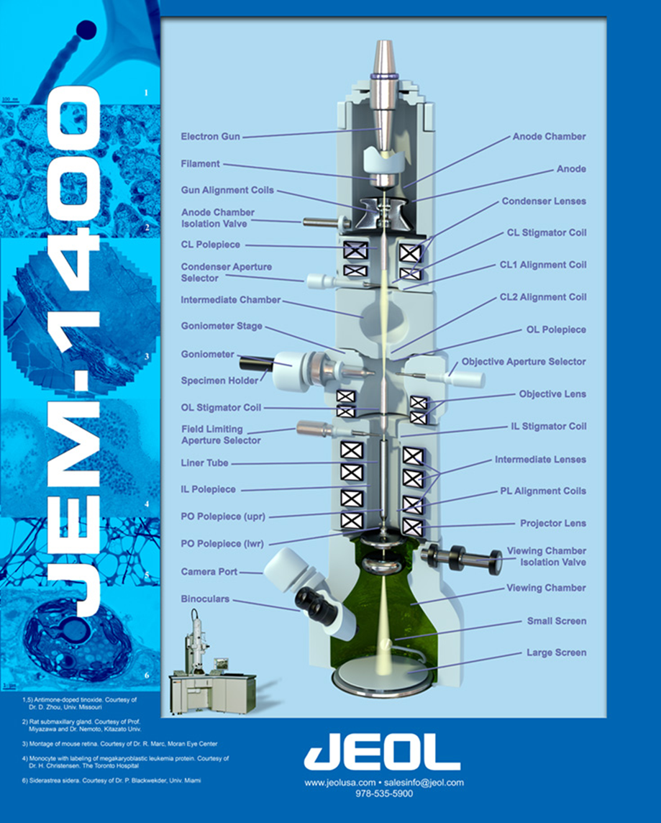
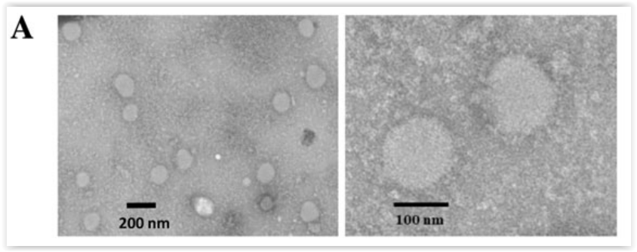
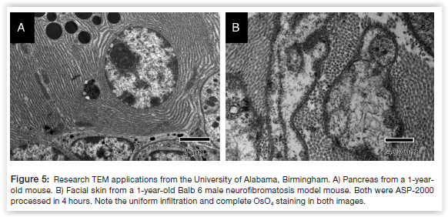
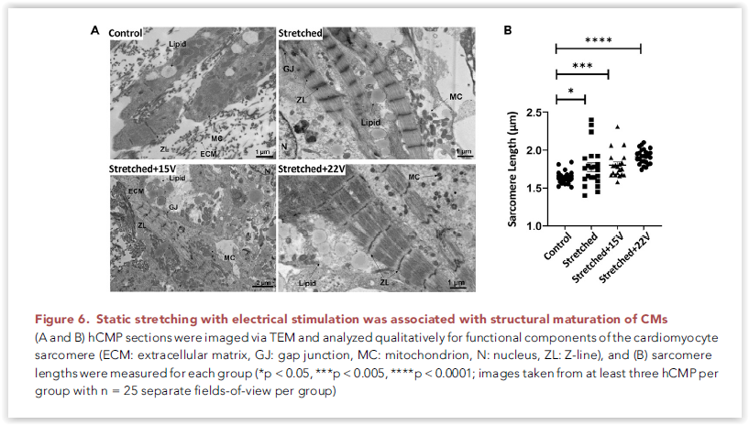
HIGH RESOLUTION IMAGING FACILITY INSTITUTIONAL RESEARCH CORE PROGRAM ELECTRON MICROSCOPY
Transmission Electron Microscopy
Scanning Electron Microscopy
The Transmission Electron Microscopy Laboratory in the shared HRIF Institutional Core provides access to conventional transmission electron microscopy and associated sample processing services. Experienced technical specialists in the HRIF are available to assist at each imaging experiment stage.
Coming Soon to HRIF – March 2026
JEOL JSM-810 Field Emission Scanning Electron Microscope (FE-SEM) with New Quorum Sample Coater & Dedicated Prep Space
High-resolution surface imaging with enhanced contrast, stability, and throughput supporting advanced materials science, nanotechnology, and biological SEM applications.
Training and access details coming soon.
JEOL 1400 FLASH TEM with AMT NanoSprint43 Mk-II CMOS Camera
Embedded AMT NanoSprint43 CMOS Camera
7915 x 5436 pixels with 8.2 μm square pixels at the phosphor
4-5X digital zoom without pixilation
High Voltage range 20-120 kV
Typically operated at 80-120kV
Magnification range 18.5x-650kx
Sample size is 3mm support discs
Electron source: Lanthanum hexaboride (LaB6) crystal.
Fully motorized eucentric 5 axis side entry goniometer stage can be tilted to ±60°.
Selected Publications from HRIF TEM
Si Y, Kim S, Zhang E, Tang Y, Jaskula-Sztul R, Markert JM, Chen H, Zhou L,
Liu XM. Targeted Exosomes for Drug Delivery: Biomanufacturing, Surface
Tagging, and Validation. Biotechnol J. 2020 Jan;15(1):e1900163.
doi: 10.1002/biot.201900163. Epub 2019 Oct 20. PMID: 31595685.
Figure 2. Characterization of cancer-targeted exosomes.
A. Transmission electron microscope (TEM) image.
Goodman Steven L , Benson Emily K, Flint Noah A, Dye Louis E, Chimento Melissa F,
Phillips Edward, Percival Jeffrey W, Kidd Grahame J. Creating Efficient Workflows
for Electron Microscopy Laboratories with Automated Specimen Preparation, Microscopy
Today, Jan 2024, https://doi.org/10.1093/mictod/qaad108
Sample Preparation Services
Full-Service Electron Microscopy Facility
We provide end-to-end specimen processing through imaging, with initial and ongoing consultation. Our services include: • Specimen processing, embedding, and heavy-metal staining • Thick sectioning (500 nm–1 µm) to identify regions of interest for ultrathin sectioning • Ultrathin sectioning (~70 nm) with staining for routine or serial TEM imaging • Negative staining of isolated organelles, macromolecules, viruses, and related samples • TEM imaging with hands-on training for independent users, enabling reduced fees and faster turnaround • Access to advanced automated processors, including the Micro Innovations ASP2000 and the Leica EM TP bulk sample processor
Pretorius D, Kahn-Krell AM, LaBarge WC, Lou X, Zhang J. Engineering of
thick human functional myocardium via static stretching and electrical
stimulation. iScience. 2022 Feb 4;25(3):103824. doi: 10.1016/j.isci.2022.103824.
PMID: 35243219; PMCID: PMC8873611.
HRIF Sponsors
UAB Institutional Research Core Program (IRCP)
Comprehensive Cancer Center (P30 CA013148)
Lightsheet - S10 OD032341
Veteran’s Administrative Hospital Research Division
HSF-GEF
Alexa Mattheyses, PhD
Director
(205) 975-0680
mattheyses@uab.edu
Melissa Chimento Associate Director
(205) 934-1926
mchimento@uab.edu
Ed Phillips
Research Associate
(205) 934-1926
ephillips@uab.edu
Alison Margolies
Scientist I
(205) 934-1926
kamargo@uab.edu
To schedule time on a microscope or to schedule a training session with an HRIF specialist, visit us at: www.uab.edu/HRIF

