Slide 1


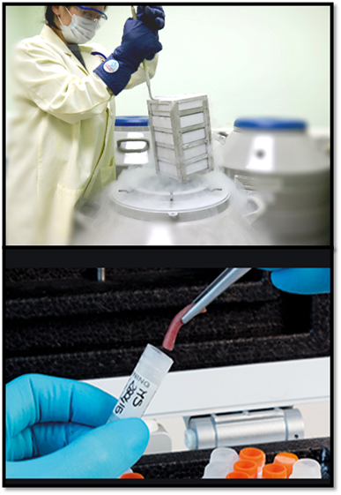
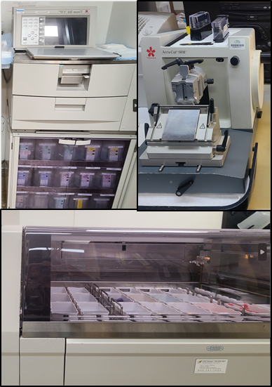
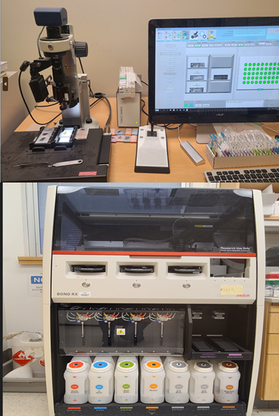
UAB Tissue Biorepository-Pathology Core Research Lab
Directors: Sameer, Al Diffalha, MD & Upender Manne, MS, PhD - Co-Director
Program Director: Dezhi Wang, MD, MBA
Structure, Services, and Operation
Specific Services Offered to the UAB Community
The UAB Tissue Bioreposity (UAB TBR), formerly the UAB Tissue Collection and Banking Facility, will provide support to translational and basic research.
The UAB TBR constitutes the Biorepository (tissue procurement and archiving) and the Pathology Core Research Laboratory (routine & advanced histology services) units. We ensure that provision of human tissues for research meets ethical and regulatory requirements and that patient welfare is protected.
We operate as a bioresource of UAB and provide remnant human tissues from routine surgical resections, autopsies, and other clinical procedures. Specimens include fresh, frozen, in RNAlater, fixed (formalin or of your choice), or as paraffin blocks, or tissue slices on slides, as requested by the investigator.
The UAB TBR assures investigators have access to human tissues that are collected following standard operating procedures, quality control (QC), and quality assurance (QA), and follows the Best Practice guidelines of the national (NCI/NIH) and international (ISBER) biorepository organizations/agencies.
Additionally, specimens will be collected, processed, stored, and supplied according to investigator-specific requirements/protocols. The UAB TBR links the Investigators with pathologists according to their sub-specialties.
Tissue Biorepository: The UAB TBR now focuses exclusively on meeting the needs of UAB investigators through prospective procurement, or via identification of previously banked frozen and/or FFPE samples.
Tissue Procurement Shared Resource (TPRO): As a Shared Facility of the UAB O’Neal Comprehensive Cancer Center (OCCC), the facility prospectively collects and/or provides banked remnant tissue samples from routine surgical resections and autopsies for OCCC members, as well as providing support of clinical trials.
Pathology Core Research Lab (PCRL)/Histology: The UAB TBR/PCRL includes research histology labs that can provide routine histology services for human as well as animal tissues. Services include preparation of paraffin-embedded blocks, paraffin-embedded slides, frozen sections and plastic-embedded procedures. Immunohistochemistry (BOND Rx or Manual), construction of tissue arrays (TMA) , and multiplex immunoassays are also available via PCRL.
Banking: The UAB TBR can serve as a repository for special project tissue banking. The TBR can serve as the repository for your collection, and/or our trained personnel can assist with the collection, processing and distribution of samples for your project. Repositories are tailored to meet investigator and protocol needs
Protocol Support: The UAB Tissue Biorepository provides support for UAB research clinical trial protocols utilizing tissue handling activities. Support can include procurement of tissue, transport, handling, processing, storage, shipping/distribution and clinical data management.
Tissue Collection & Banking
Routine Histology
Advanced Histology (TMA/IHC)
Rationale and Value-Added
Provides a wide-range of specimens (e.g., benign, diseased, neoplastic, normal) from multiple sources (e.g., surgery, autopsy, clinical pathology).
Has supported studies that have resulted in publications as follows:
>4000 publications; of these ~1750 appeared in very
high-impact journals
>50 (since 2013) describe significant discoveries and developments
Value-Added aspects include:
Centralization of services
Quality control
Customized patient and molecular information
Education of investigators, mentoring and expert consultation
Optimized state-of-the-art, cost-effective tissue banking
De-identified specimens
Support for IRB applications
Advanced histology services, including TMA construction
Digital slide scanning for research
Contact Information
Request our services via the link : https://sites.uab.edu/tissuebank/requesting-services
Contact the front office by phone: (205) 934-6071
Contact the procurement team by group email: TBRNotification@uabmc.edu
Contact the histology team by group email: PCL-TBR Histology Group PCLTBRRequest@uabmc.edu
Contact Digital Slide Scanning group email: DigitalPathRes@uabmc.edu
Stop by office: UAB Tissue Biorepository, Ziegler Research Building, Room 449, University of Alabama at Birmingham, 703 19th Street South, Birmingham, AL 35294

