Slide 1

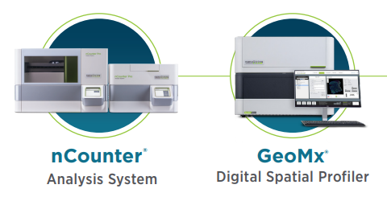
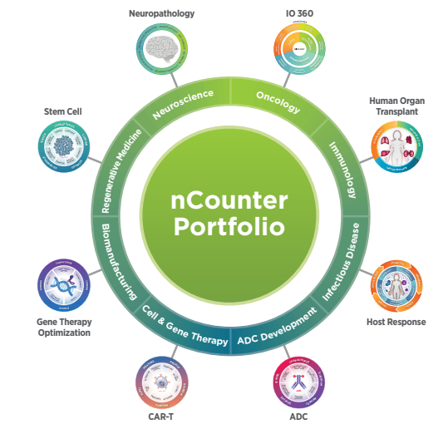
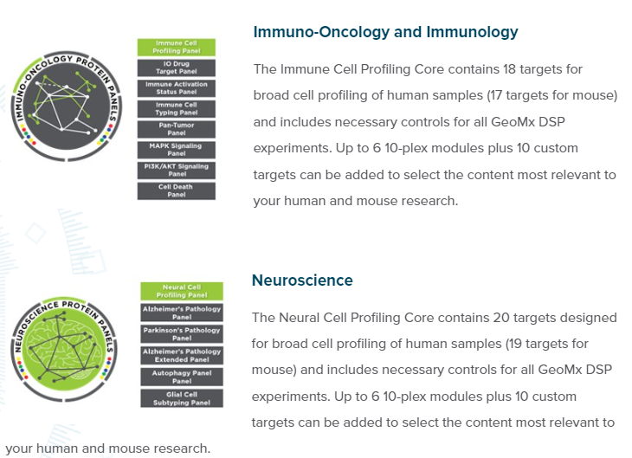

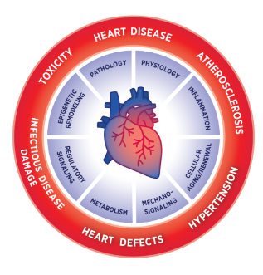
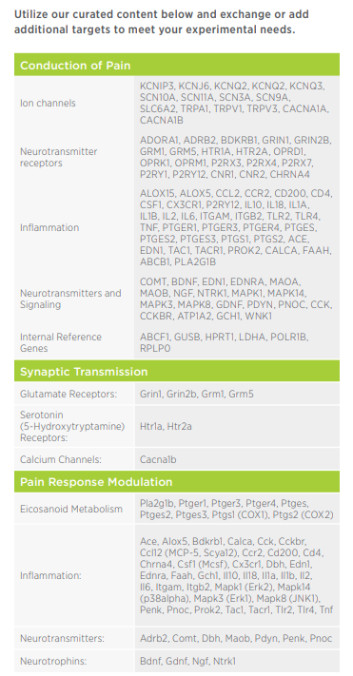
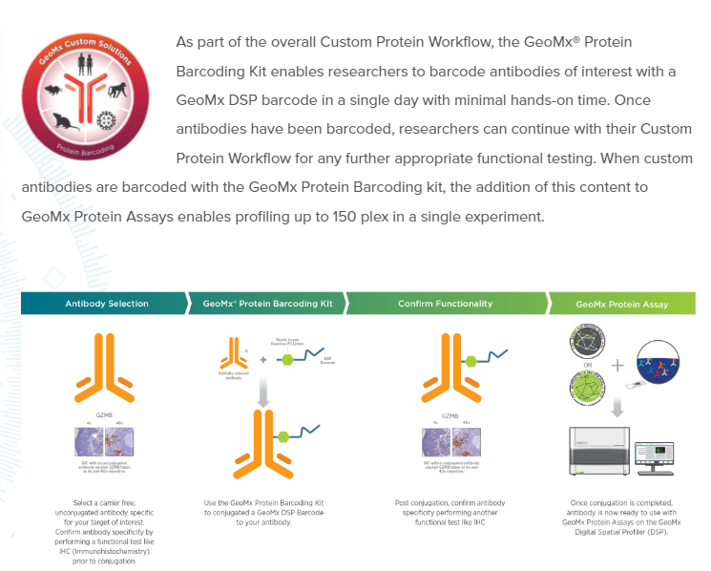

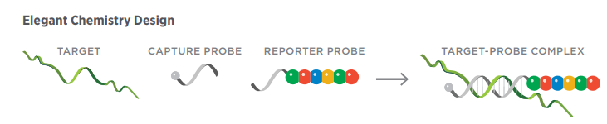
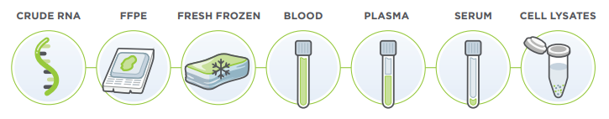
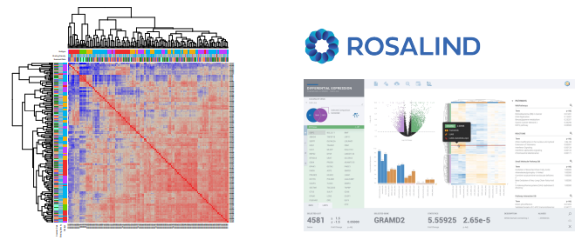
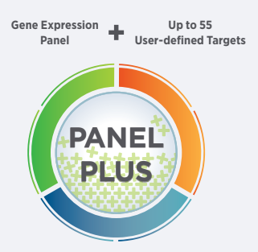
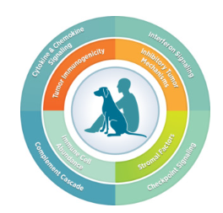
UAB NanoString Laboratory
Director: Christopher Willey
Contact: Jianqing Zhang jianqing@uab.edu
Tel: phone: 975-2881
http://www.uab.edu/medicine/radonc/en/nanostring
http://www.nanostring.com/lifesciences
Introduction
Nanostring nCounter platform enables the profiling of hundreds of gene
targets simultaneously (up to 800) with high sensitivity and precision,
in most sample including even decades-old formalin fixed paraffin embedded (FFPE) tissues, without the need for amplification steps except in single cell or low input experiments.
NanoString offers a suite of intuitive analysis tools that enable you to
gain insights from your data. nCounter Advanced Analysis, a free, wizard-based add-on to nSolver for deeper data insights based on robust R statistics, examine experimental trends, identify pathway-specific responses, and profile immune cell populations in shareable HTML reports. ROSALIND® Platform, A cloud-based system that enables scientists to analyze and interpret differential gene expression data without the need for bioinformatics or programming skills.
Pairing with GeoMx for spatial protein and RNA analysis enhance your nCounter data by adding spatial context: spatially profile expression of the whole transcriptome or targeted RNA and protein targets in distinct tissue structures and cell populations across FFPE or fresh frozen tissue sections.

