Slide 1




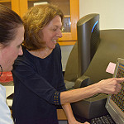
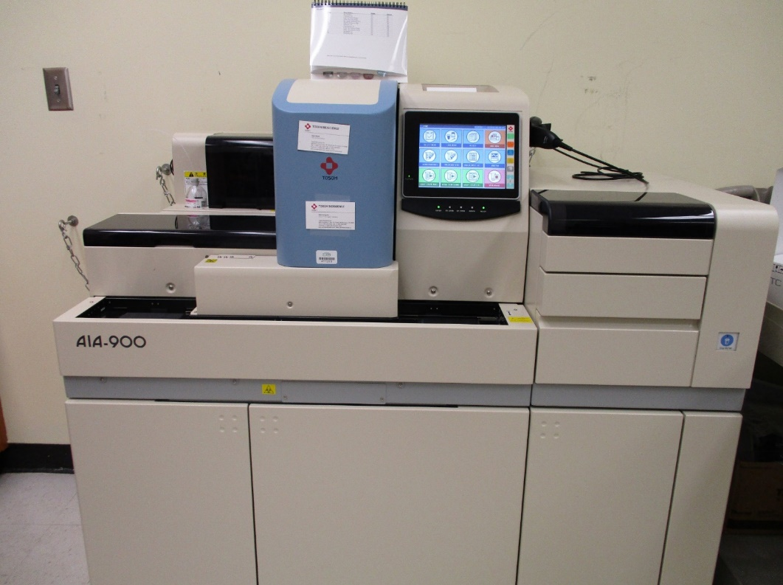
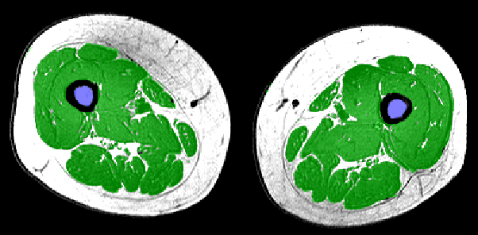
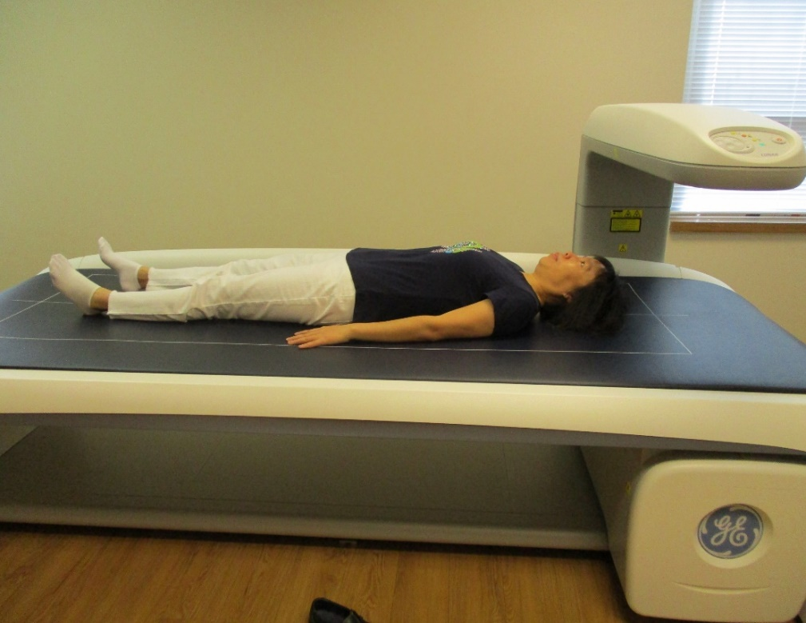
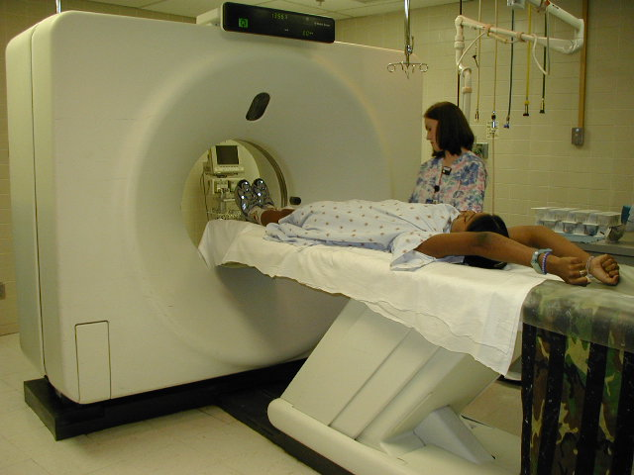
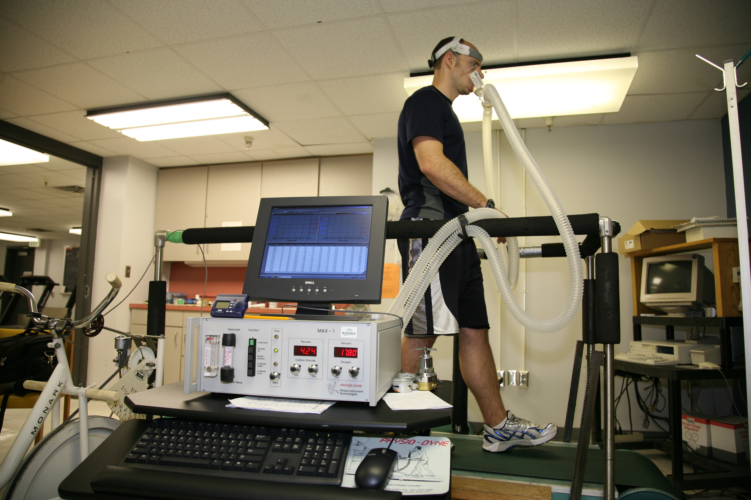
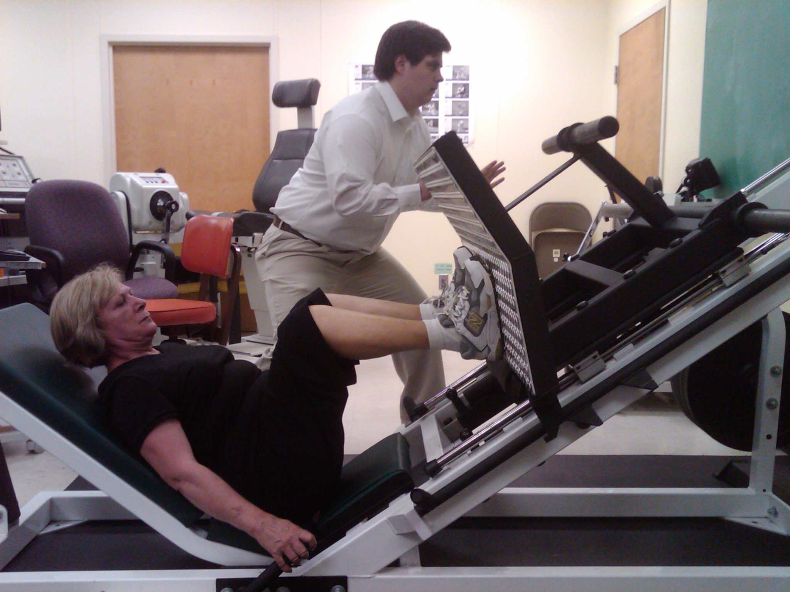
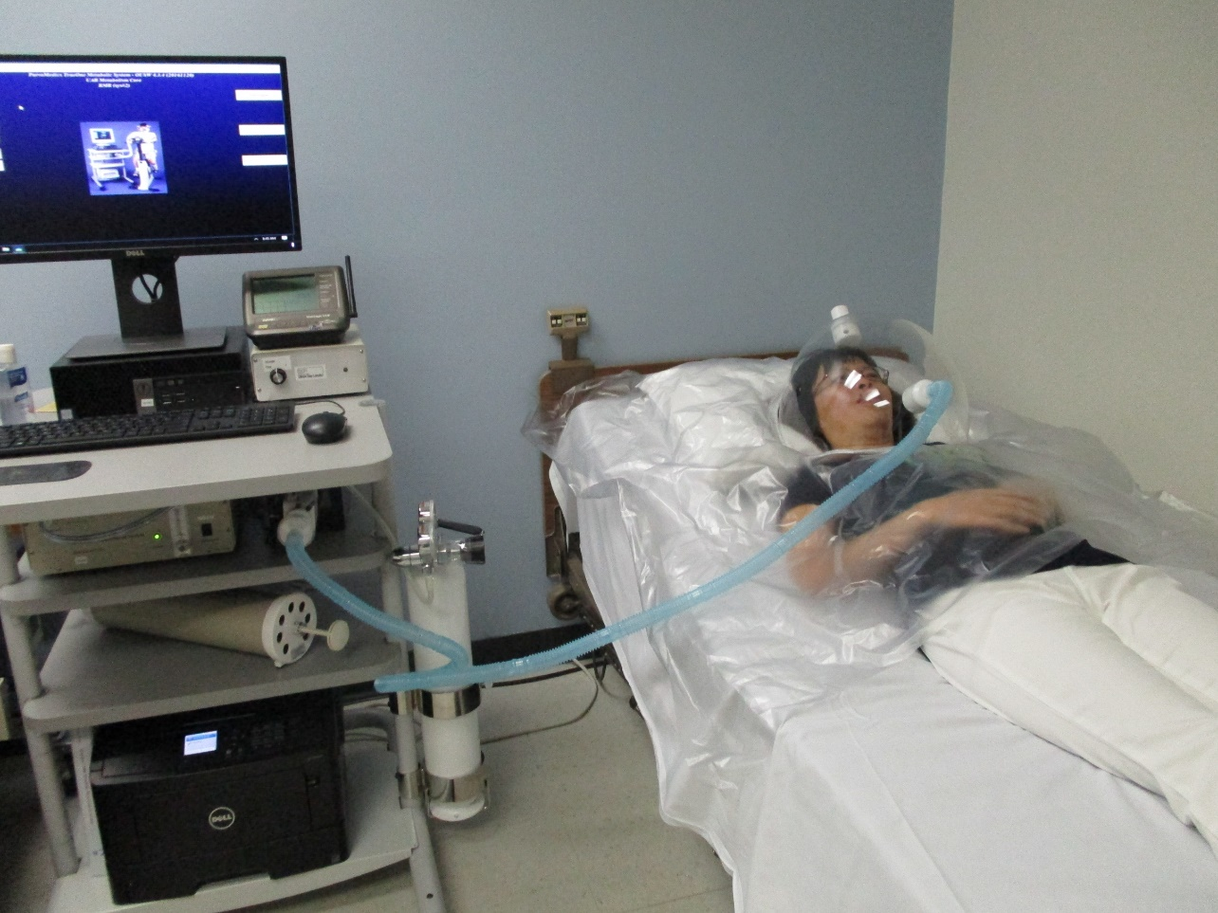
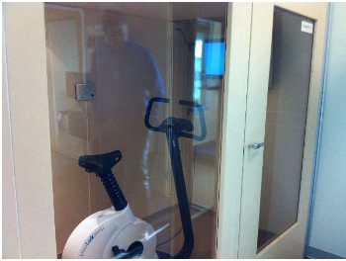
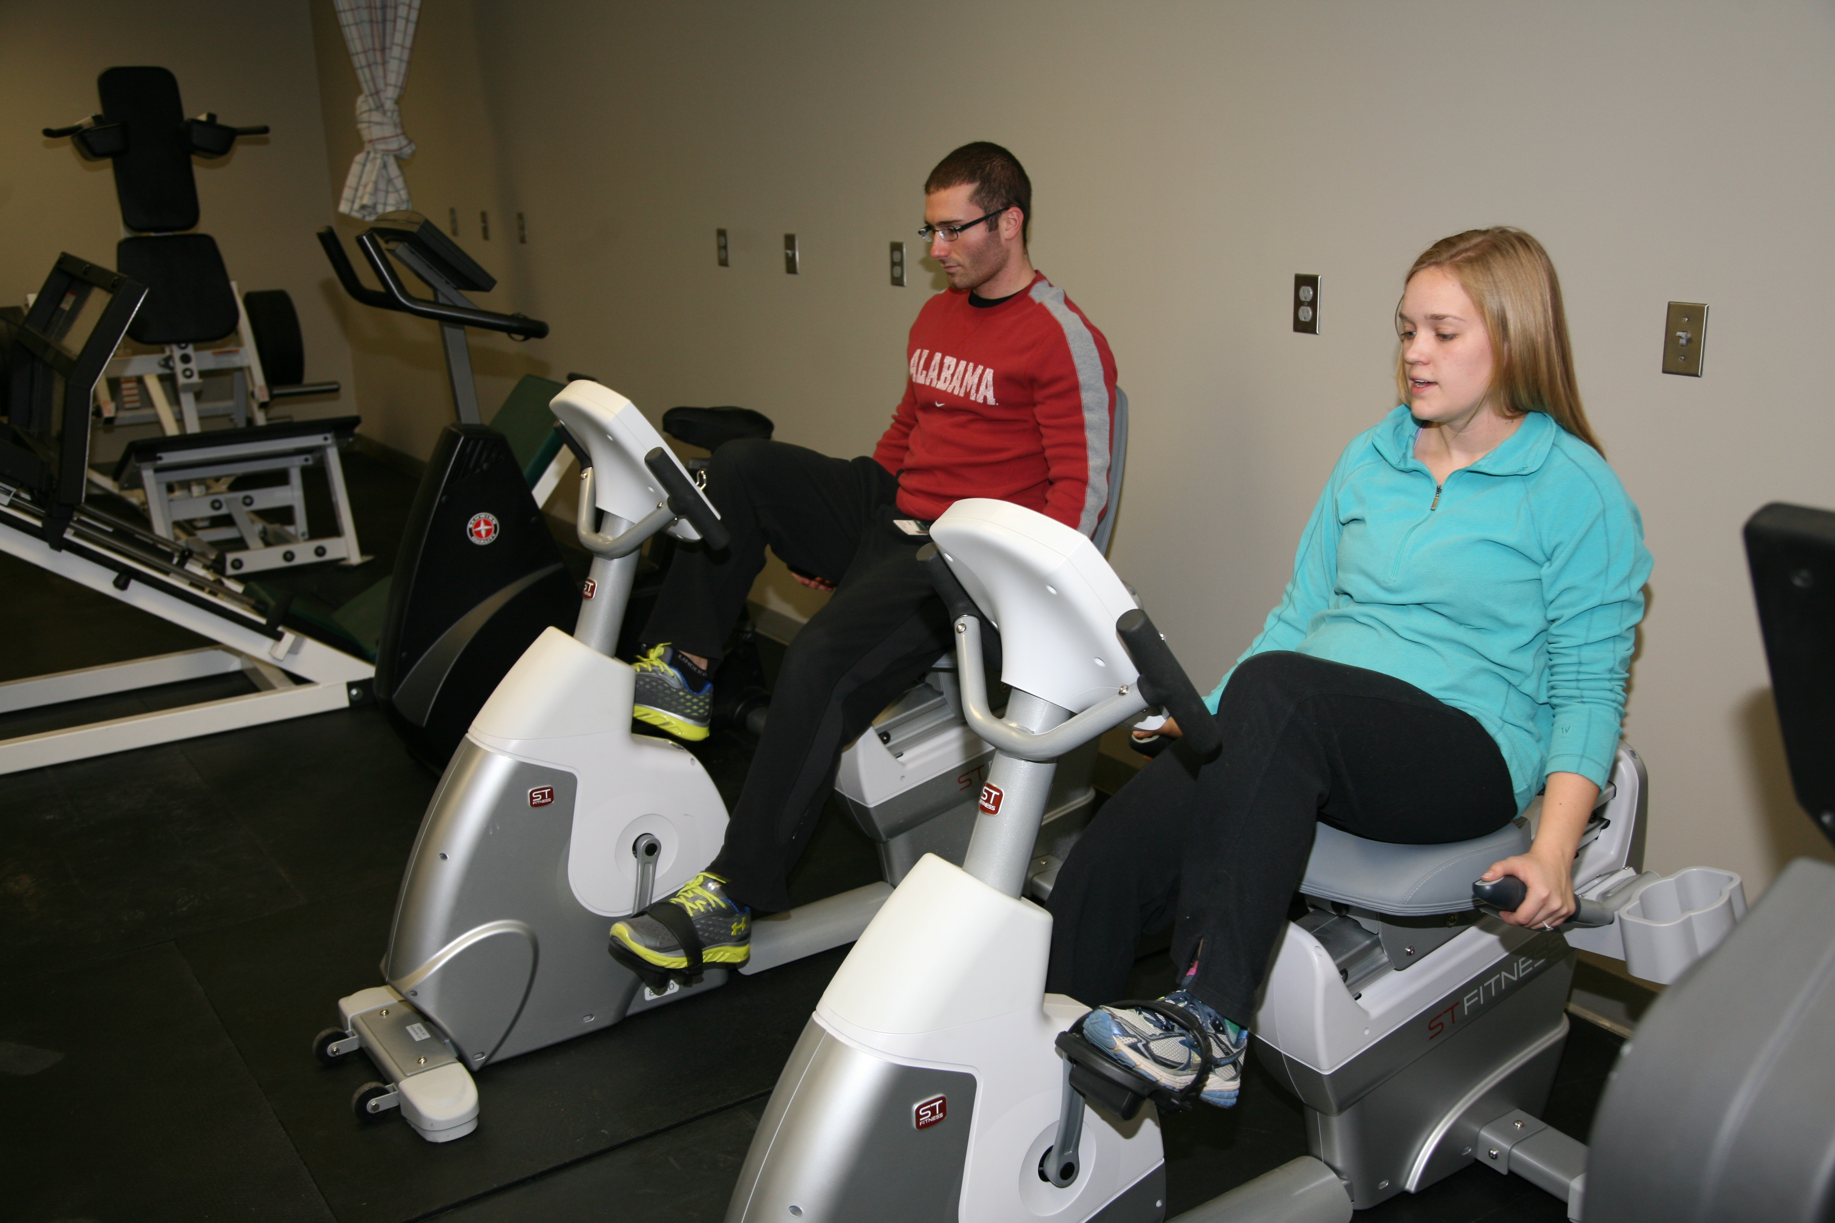
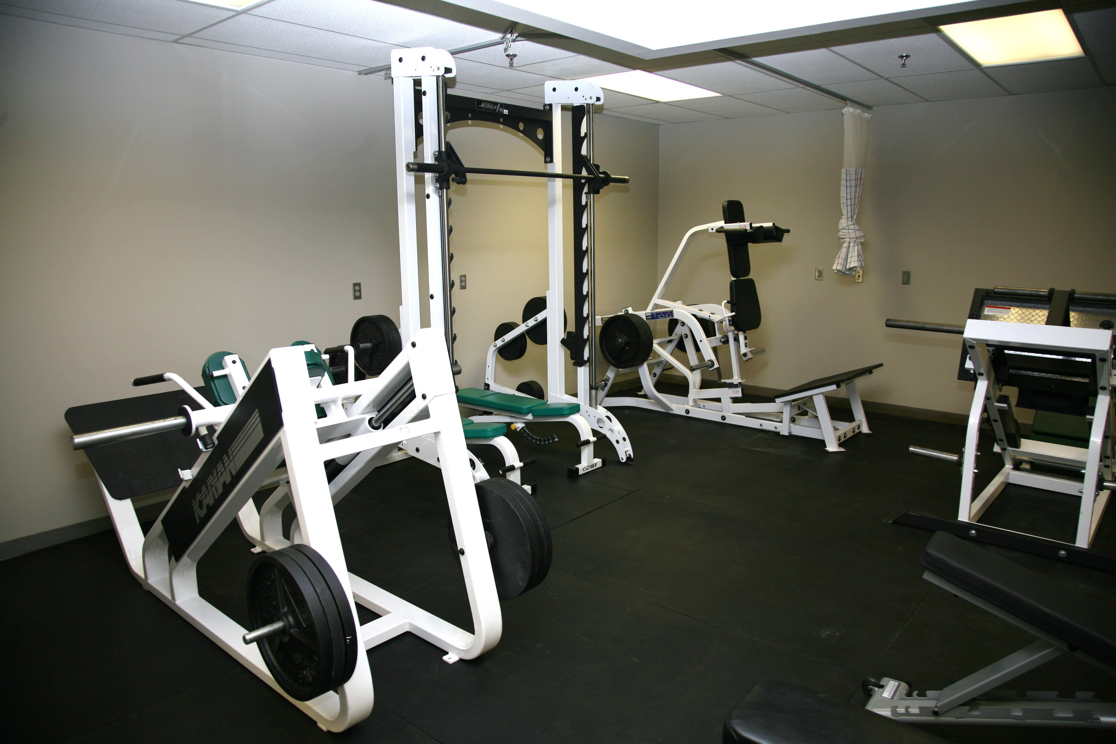
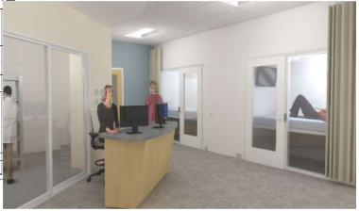
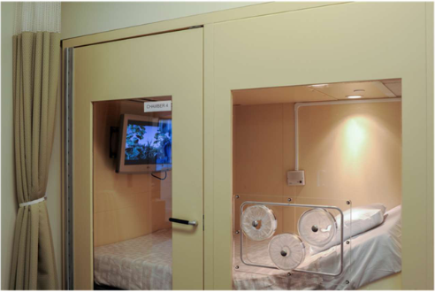

Metabolism Core
Institutional Research Core Facilities (IRCP)
I. Hormones/analytical
Hormones
Cytokines
Glucose
A1C
Lipids
Multiplex (MSD)
FDA certified analyzers
ELISA
RIA
Human/animal
III. Energy Expenditure
Doubly-labeled water
  Total energy expenditure
  Activity-related EE
  Free-living (2 weeks)
Indirect calorimetry
  Canopy: Resting EE
  Whole-room
    New, state of the art calorimetry chambers
      Flex room for short tests
      Large chamber for long daytime/overnight tests
      Pediatric chamber
    Total, resting, sleeping EE
    Substrate oxidation
    Exercise metabolism
    Postprandial metabolism
Physical Activity
VO2 MAX
Submaximal exercise testing
Strength tests
Functional testing
EMG measurement of ease during standing, walking, carrying
Supervised resistance or aerobic training for individuals or small groups
Accelerometry
Arterial elasticity testing
Hypoxia testing
Grant preparation assistance
Consultation with researchers
V. Body Composition
Dual-energy X-ray absorptiometry (DXA)
  Total fat, lean, bone mass
  Bone density
  Visceral fat
CT/MRI scan analysis
  Fat distribution
  Regional tissue composition
Total body water
BIA
II. Insulin sensitivity/secretion
Insulin sensitivity
  Intravenous glucose tolerance test (IVGTT)
  Mixed meal tolerance test (MMTT)
  Oral glucose tolerance test (OGTT)
  Mathematical modeling
β-cell response to glucose
  IVGTT, OGTT, MMTT
  Mathematical modeling
Core Personnel and Contact Information
Director: Dr. Barbara Gower
bgower@uab.edu, 934-4087
Analytical (Webb 337):
Heather Hunter hlhunter@uab.edu
Cindy Zeng
Nikki Bush
Jono Blackburn
Body Composition/Energy Expenditure:
Robert Petri (Webb 412)
Physical Activity (Webb
David Bryan dbryan@uab.edu

