Slide 1



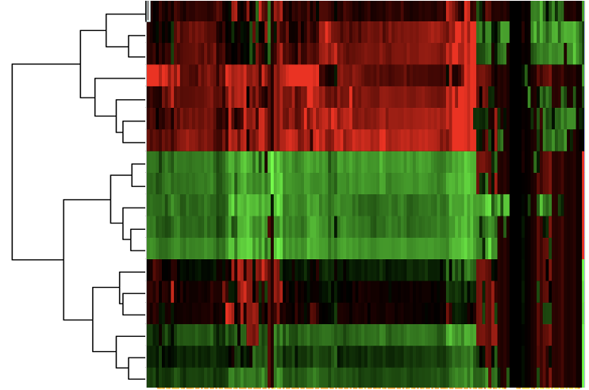
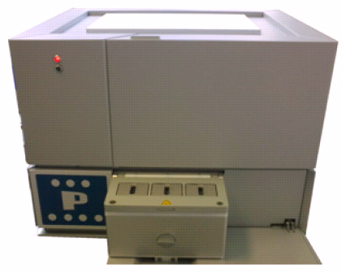
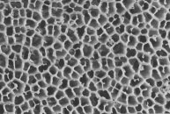
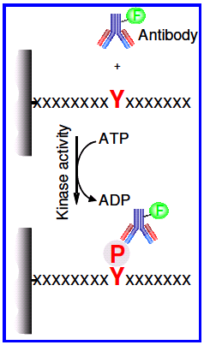
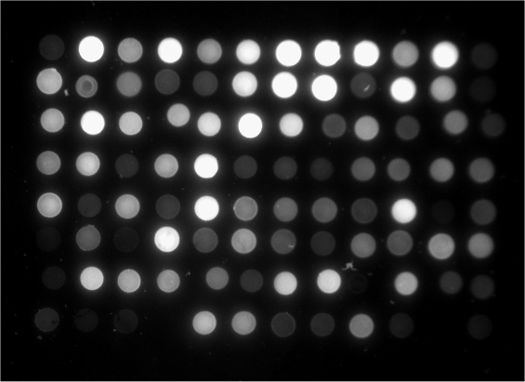

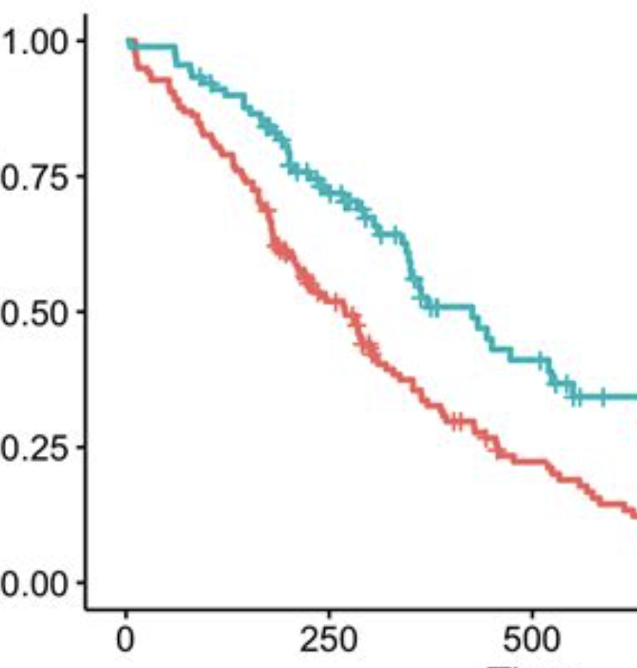
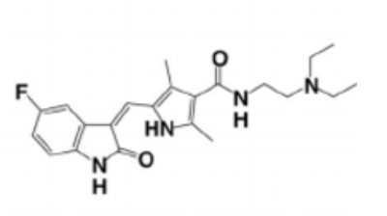

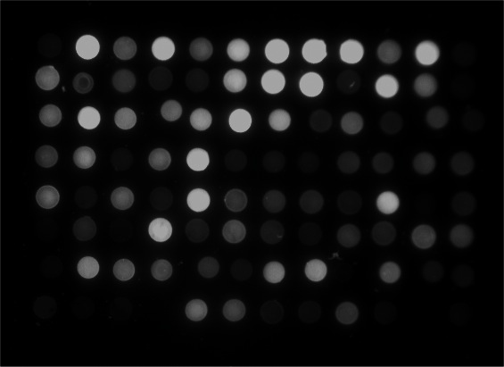
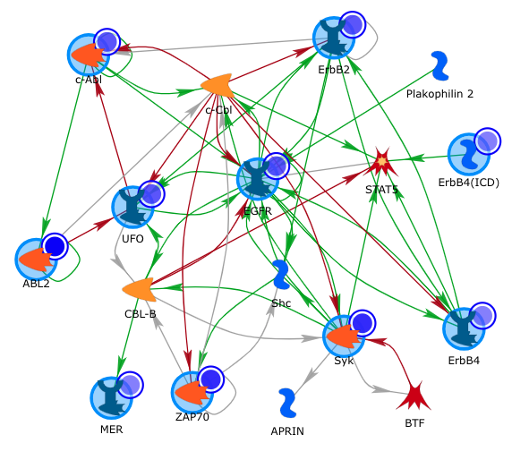
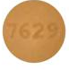
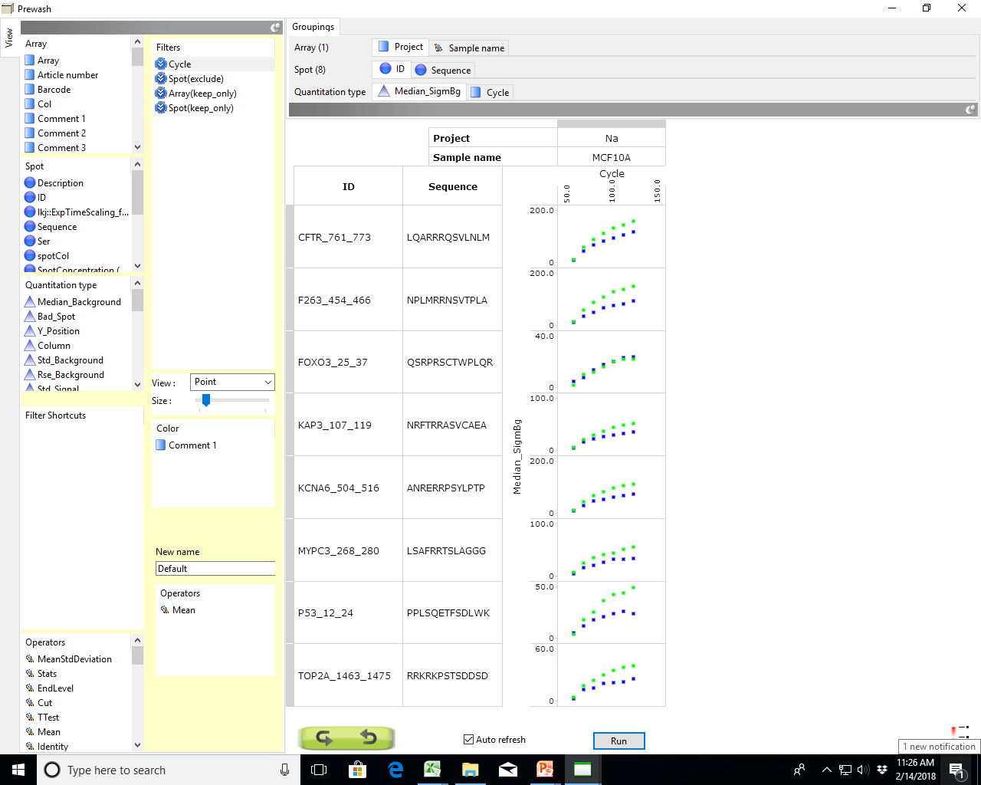
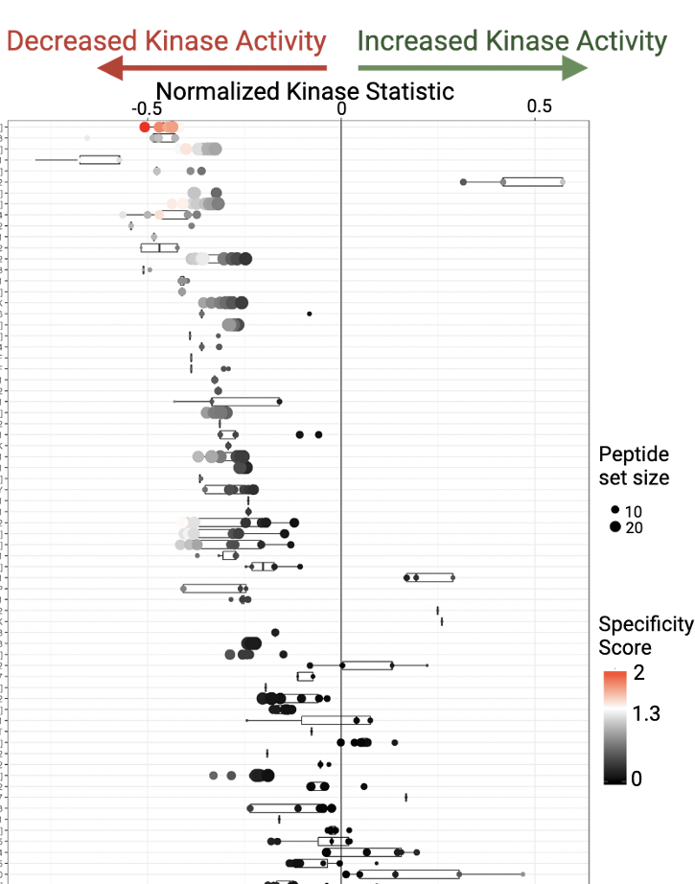
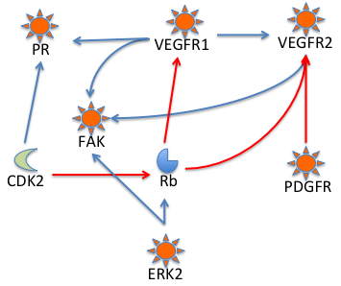
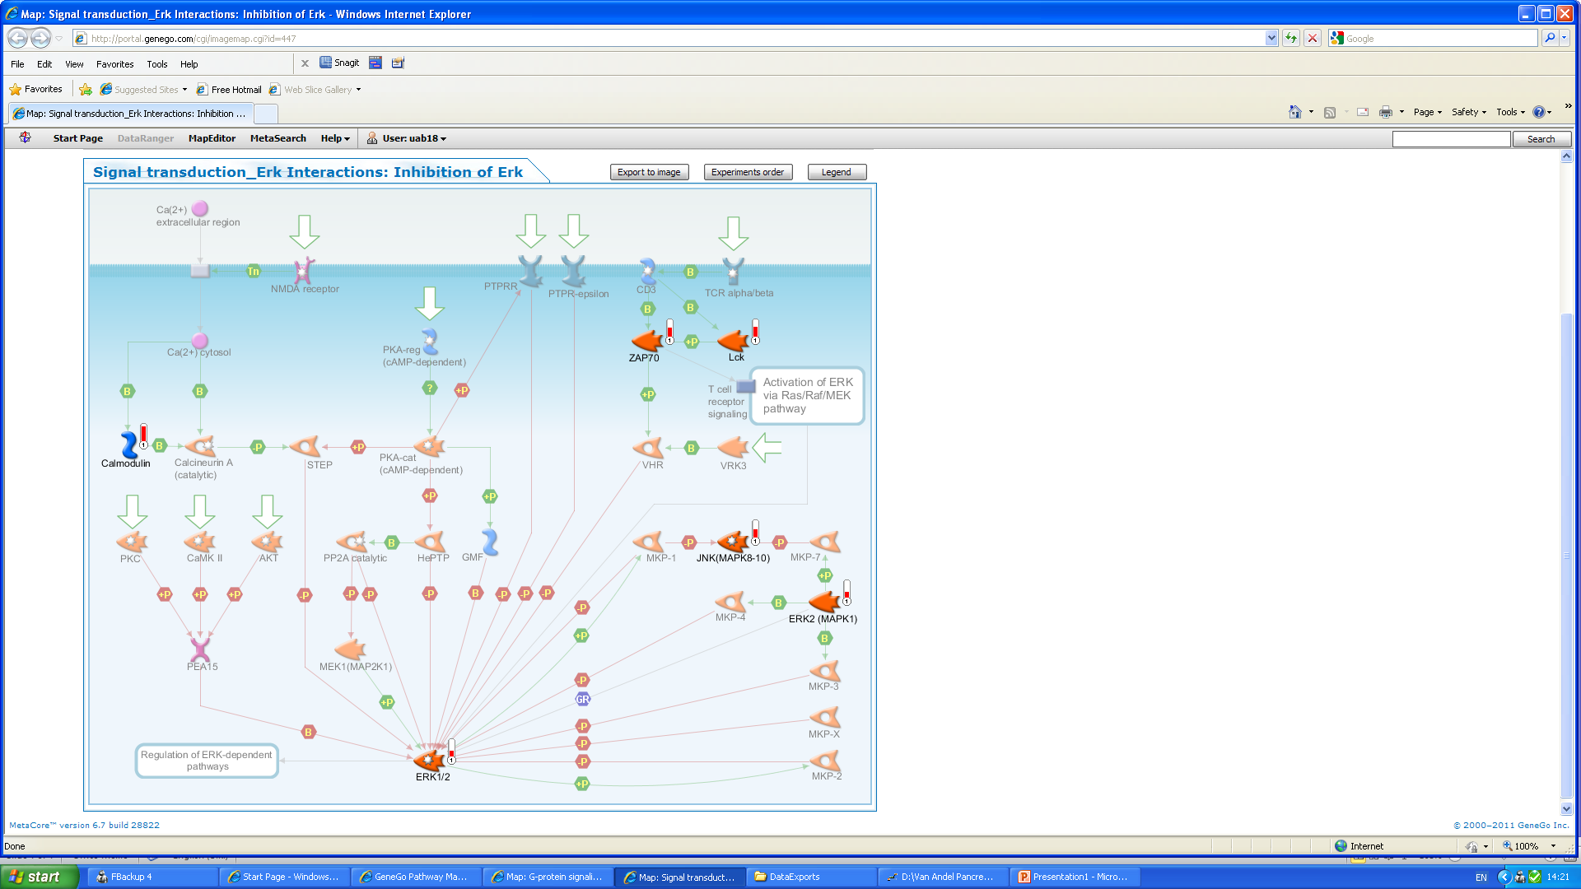
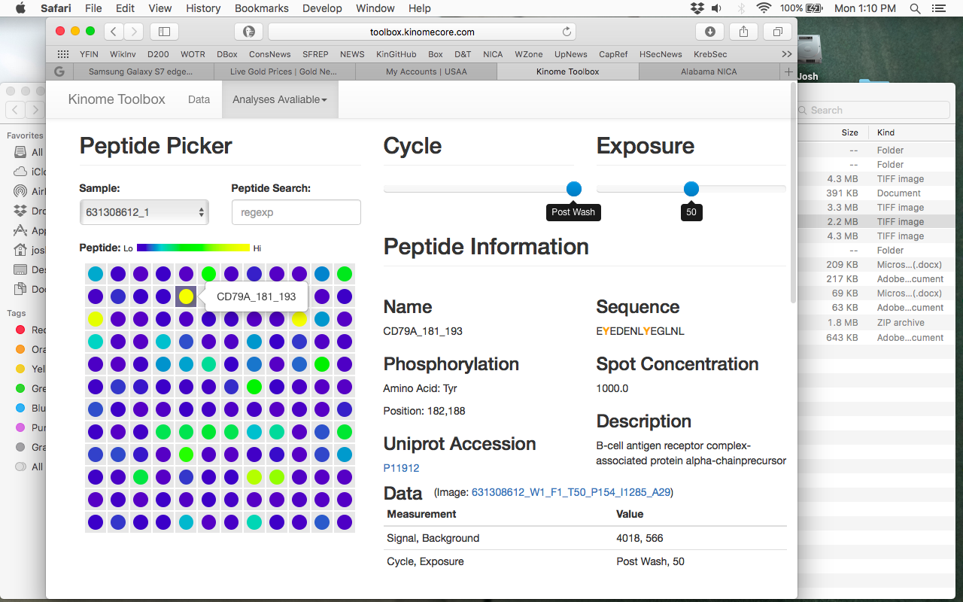
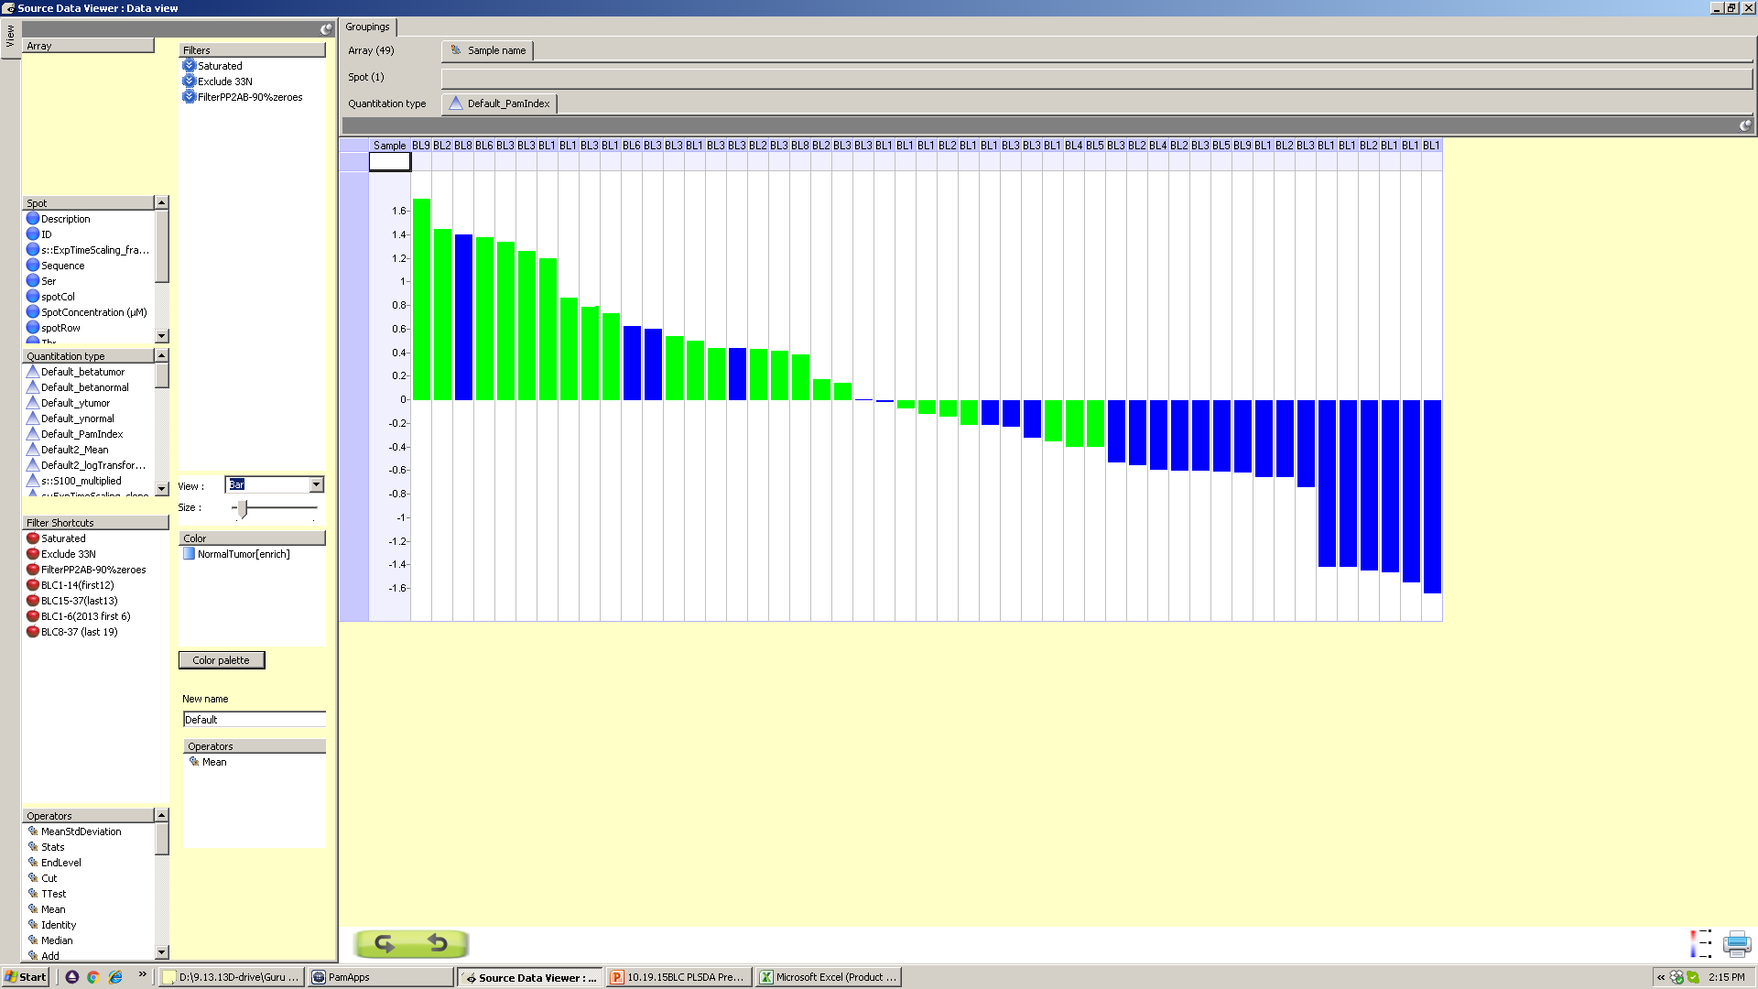


w w w . k i n o m e c o r e . c o m
Technical Director/ Planning:
Joshua Anderson, PhD
janders7@uab.edu
975-2790
Director:
Christopher Willey, MD, PhD
cwilley@uab.edu
What Can Kinomics Do?
Identify Kinase Signatures associated with
phenotype, genotype, etc.
Identify Kinase Targets for intervention and
molecular signaling.
Identify Kinase Responses post treatment
and compensatory signaling.
How Does It Work?
Kinomics Background
WT
Kinomics Array Platform
Kinomics is the study of kinase signaling within cellular or tissue lysates. Kinomics can help elucidate cellular signaling pathways altered by treatment (i.e. drug or condition change), or for comparison of different phenotypes (i.e. proliferative vs. non- proliferative). Our PamStation Kinomic Array platform measures the phosphorylation of up to 196 tyrosine or 144 serine/threonine kinase substrates that are imprinted on PamChip microarrays. Kinetic and steady state changes in individual peptide phosphorylation are imaged with FITC-phosphospecific antibodies, and signal is processed and quantified with BioNavigator software. Lists of altered peptides are then exported and analyzed for probable upstream kinases with tools such as Kinexus Phosphonet, as well as advanced Pathway Analysis and Network Modeling using GeneGo MetaCore.
lysate
KO
2) Targets
phosphorylated
3) Images
captured
PamStation®12
1) Lysate pumped
through array
~144-196 biomarkers/array
3D porous matrix with
~1000’s peptides per target
DRUG
Up to 12x samples per run
Fluorescent
Immunodetection
What Can It Tell Me?
Select Publications
respo
respo
respo
Raw Data
Altered Peptides
Upstream Kinases
Network Modeling
Example Findings
Drug X likely targets EGFR, SRC family signaling.
Gene X knockout cells have altered Erk response.
Drug Y induces JAK/STAT pathway signaling in resistant cells.
Drug Z resistant kinomic signatures, can be used to prospectively classify new tumors as resistant/sensitive.
Shen H, et al. Selective suppression of melanoma lacking IFN-γ pathway by JAK inhibition depends on T cells and host TNF signaling. Nat Commun. 2022 Aug 25;13(1):5013. Umbarkar P, et al. Fibroblast GSK-3α Promotes Fibrosis via RAF-MEK-ERK Pathway in the Injured Heart. Circ Res. 2022 Sep 16;131(7):620-636. Davenport ML, et al. miR-31 Displays Subtype Specificity in Lung Cancer. Cancer Res. 2021 Apr 15;81(8):1942-1953 Shinde A, et al. Spleen tyrosine kinase-mediated autophagy is required for epithelial-mesenchymal plasticity and metastasis in breast cancer. Cancer Res. 2019 Feb 7. Walker K, et al. Kinomic profiling of glioblastoma cells reveals PLCG1 as a target in restricted glucose. Biomark Res. 2018 Jun 14;6:22. Gilbert AN, et al. Generation of using 3D human biogel culture system and patient-derived glioblastoma cells for kinomic profiling and drug response testing. J Vis Exp. 2016 Jun 9;(112) Dussaq AM, et al. Mechanistic parameterization of the kinomic signal in peptide arrays. J Proteomics Bioinform. 2016 May;9(5):151-157 Anderson JC, et al. Kinomic alterations in atypical meningioma. Med Res Arch. 2015 Jul;2015(3) Isayeva T, et al. The protective effect of p16(INK4a) in oral cavity carcinomas: p16(Ink4A) dampens tumor invasion-integrated analysis of expression and kinomics pathways. Mod Pathol. 2015 May;28(5):631-53 Anderson JC, et al. Kinomic exploration of temozolomide and radiation resistance in Glioblastoma multiforme xenolines. Radiother Oncol. 2014 Jun;111(3):468-74 Anderson JC, et al. Kinomic profiling of electromagnetic navigational bronchoscopy specimens: a new approach for personalized medicine. PLoS One. 2014 Dec 30;9(12):e116388 Duverger A, et al. Kinase control of latent HIV-1 infection: PIM-1 kinase as a major contributor to HIV-1 reactivation. J Virol. 2014 Jan;88(1):364-76
+Drug
Score % Kinase
77.7 EGFR,JAK,
66.6 TRKA, SRC
55.5 PDGFR,LYN
control
Phosphorylation
Pathway Analysis
treated
Control
Time
Cluster Signature Analysis
Kinomic Toolbox: Online QC
Drug Response Prediction
PRICING
Price is per sample but sample number 4x, 8x,12x, etc. are required
PTK (Tyrosine Kinome Analysis) $450-$550 per sample
STK (Serine/Threonine Kinome) $450-$550 per sample
*external non-UAB clients incur an additional % cost
Please contact us for experimental design optimization.
Predicted Responder
Predicted NonResponder
responder
non-responder

