Slide 1
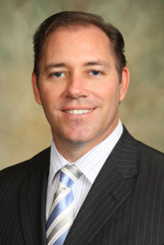
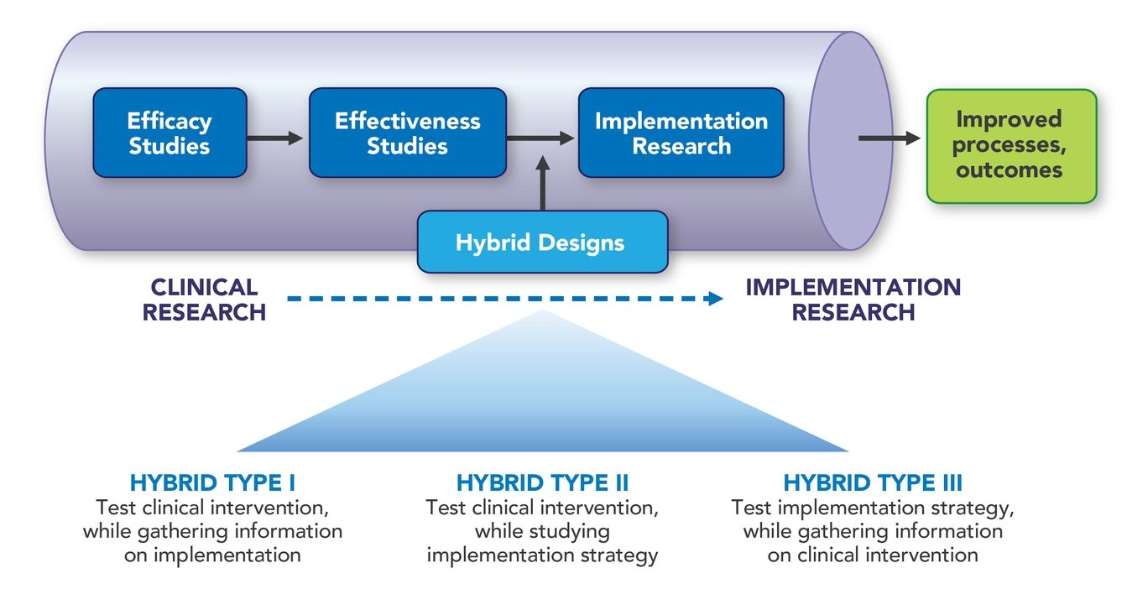
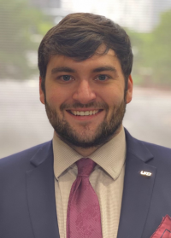
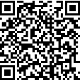
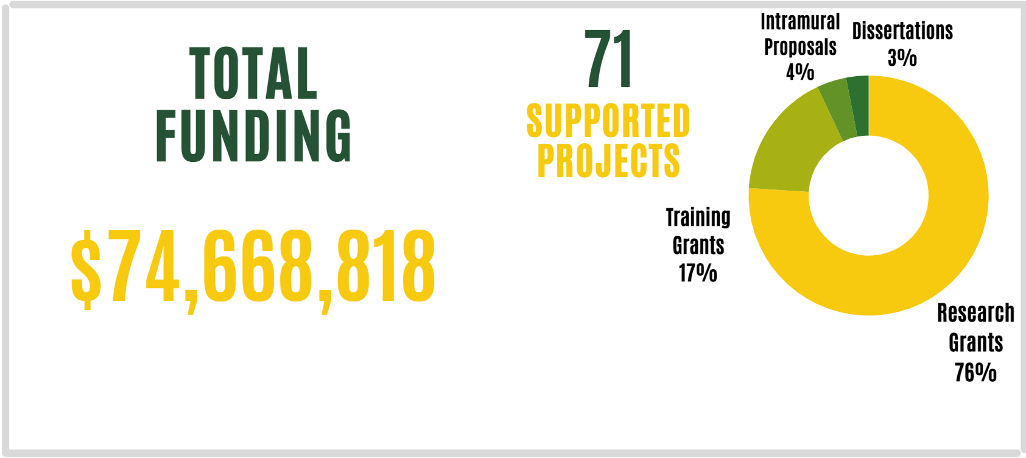


Dissemination, Implementation, & Improvement Science Core
We offer advice & consultations on:
D&I proposal aims
D&I frameworks, theories, and logic models
D&I methodological designs
D&I measures
D& analytic Strategies Quality Improvement processes
Community engagement strategies
About
A subsidiary of the COERE, the Dissemination, Implementation, and Improvement Science Core (DIISC) supports investigators pursuing extramurally funded research projects that examine how to implement and disseminate evidence-based interventions.
Contact:
Dr. Larry Hearld
Director, DIISC
Professor, Department of Health Services Administration
Use the Link: https://www.uab.edu/medicine/coere/about-implementation-science/diisc
Or
Reid Eagleson, MS, MEng
Program Manager, DIISC
CRCIII, Division of Infectious Diseases
Use this QR Code
Informal Happy Hour & Drop in Clinic
4:00 – 6:00 PM
First Thursday of Every Month
Lab Bar & Kitchen
The Hilton Birmingham 808 20th Street South
Birmingham, AL 35205

Slide 2

Recommendations
Viris adipisci repudiandae eu mea, quot possit hendrerit. Viris adipisci eu adipisci. Modus omittam at has, sint.
Modus omittam at has, sint nullam adipisci repudiandae eu adipisci.
DIISC
Dissemination, Implementation, & Improvement Science Core
Intro
Eos ex delenit iudicabit euripidis prima at delenit omittam has ad malis.
Modus omittam at has, sint nullam mediocrit ne eum sed mea brute.
Has ad malis adolescens has.
Brute oporteat ius eu.
Methods
Viris adipisci repudiandae eu mea, quot possit hendrerit per id, ius eu brute oporteat molestiae. In euismod.
Results.
Total Funding
$74,668,818
Insert
QR code here
Take a picture to download the full paper
uab.edu

