Slide 1

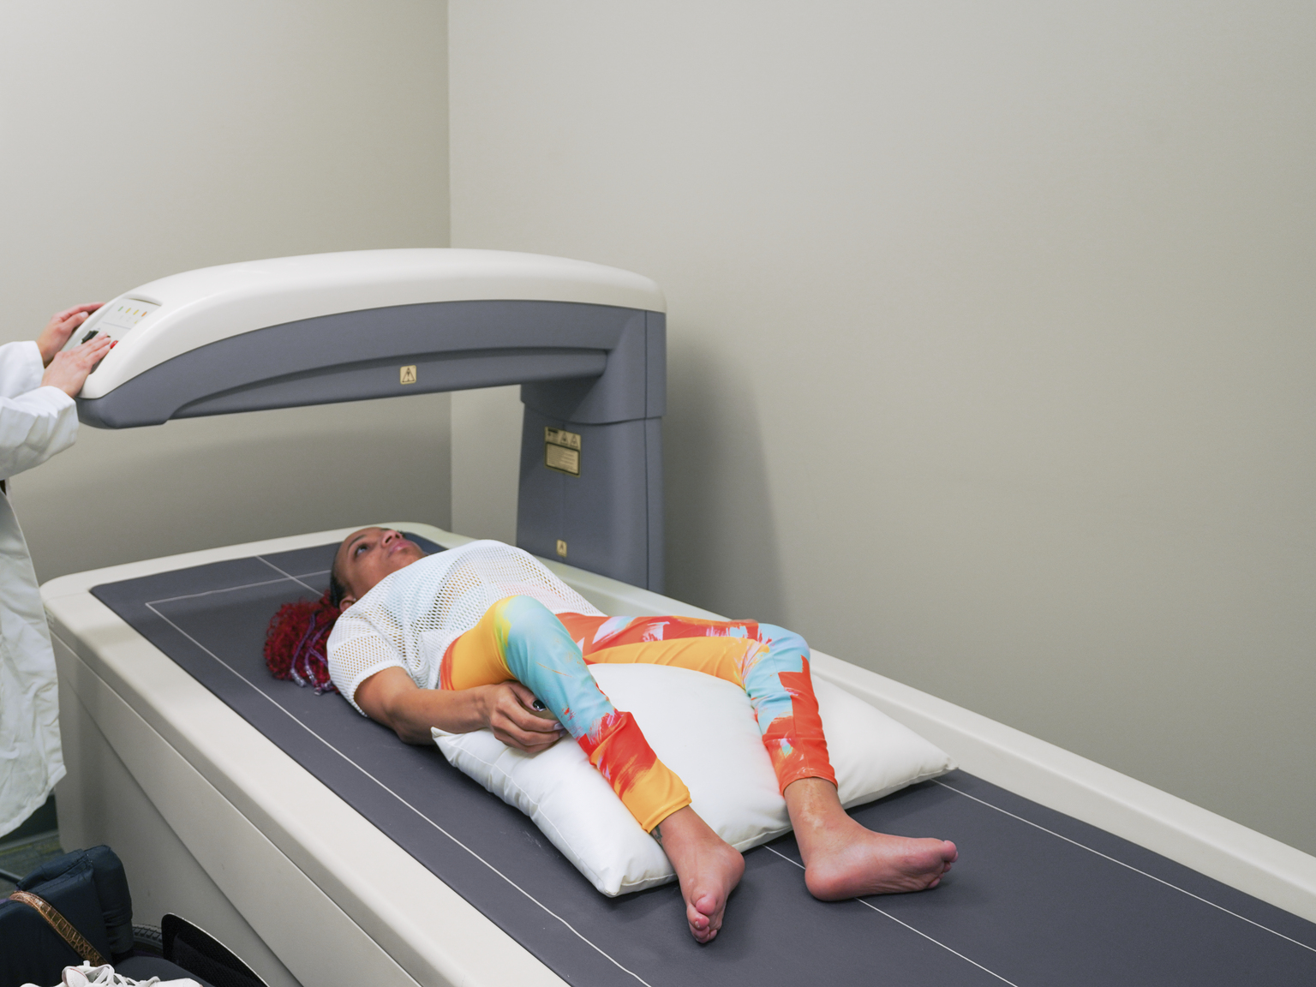
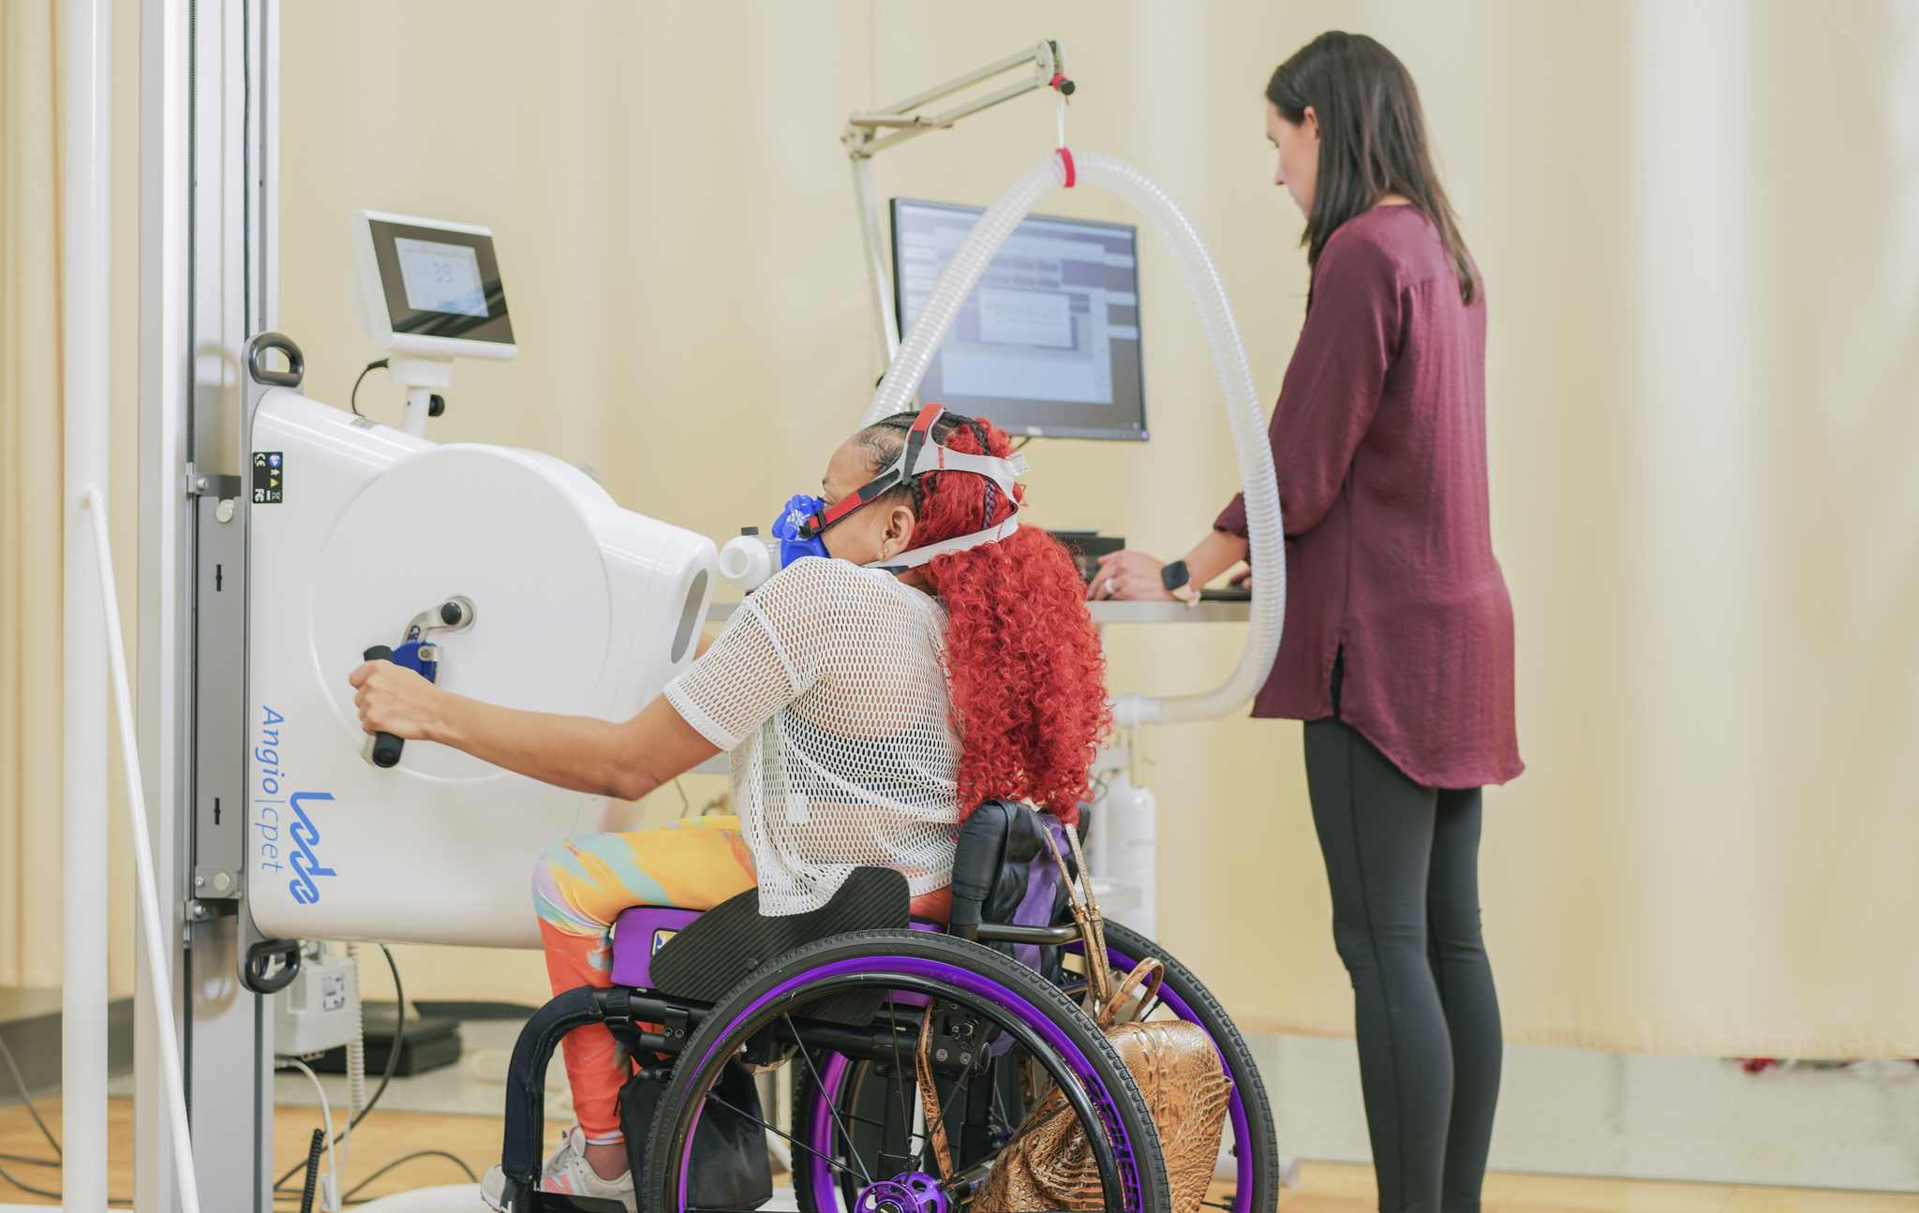
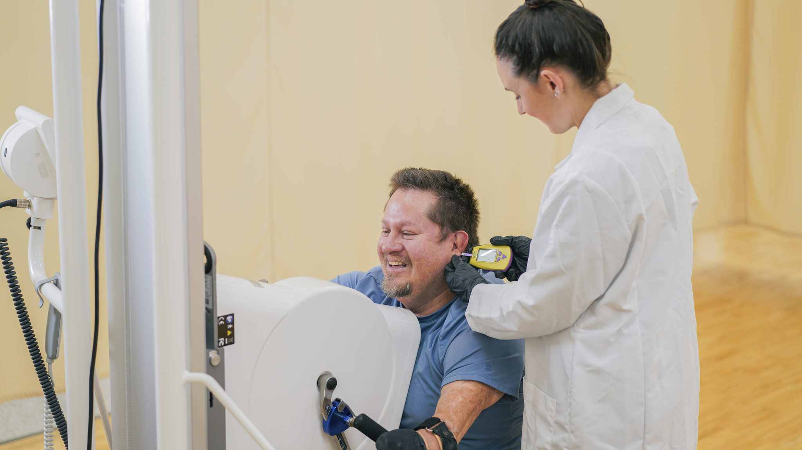
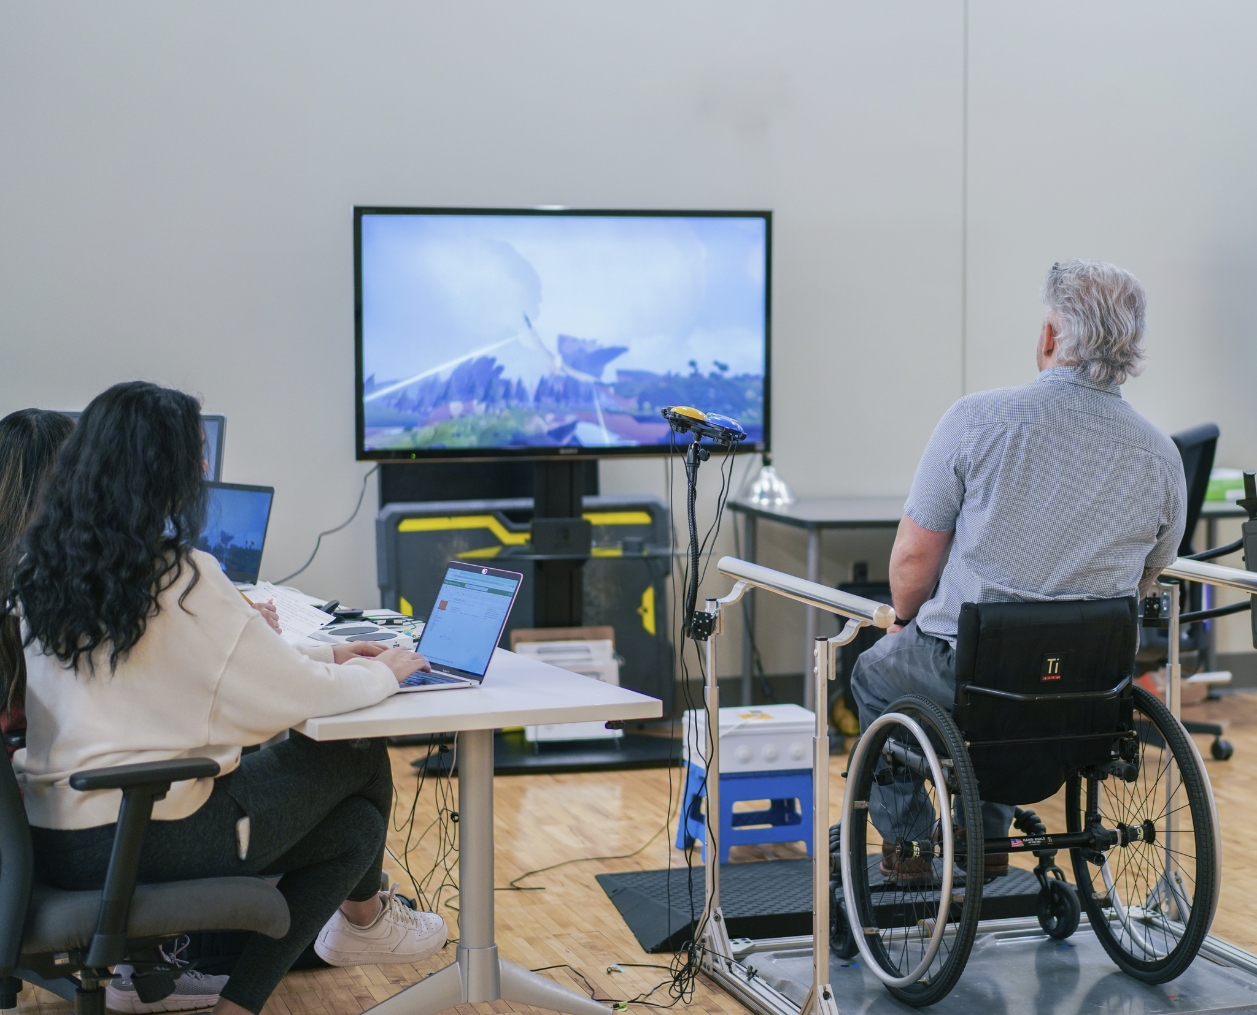

Adaptive Human Performance Laboratory
Director: Jim Rimmer, PhD
The Adaptive Human Performance Lab (AHPL) is a 3,000 square foot facility on the Lakeshore Foundation campus. The AHPL provides innovative and extensive services for exercise, nutrition, physical activity, and health assessment and interventions for research related to improving physical and psychological well-being of people with disabilities.
Phlebotomy Services
Venipuncture by trained phlebotomist
Centrifuging and aliquoting services
-80°C freezer for specimen storage
Capillary blood sampling
Maximal and Submaximal VO₂ Services
ParvoMedics TrueOne 2400– metabolic measurement system for cardiovascular submaximal and maximal exercise testing.
COSMED K5 - portable, wearable metabolic measurement system for indoor and outdoor lab-based and field-based exercise measurements.
Body Composition Services
DXA (Dual Energy X-Ray Absorptiometry; GE Healthcare Prodigy)
Gait Analysis Services
GAITRite (Platinum Plus Classic) – can be used with and without assistive devices.
Fitness Testing Services
Facilitate, lead, and monitor general fitness and exercise testing for people of all ages with and without a disability
Examples: 6MWT/6MPT, TUG, FGA, 5xSTS test
Supervised Exercise Training Services
Exercise or physical activity in-person or remote training programs for participants with disabilities supervised by staff members
Examples: Movement-to-music (M2M), PWR! Moves for PD, Active Video Games (AVG)
Contact Information
UAB WHARF at Lakeshore Foundation
Room 120
3810 Ridgeway Dr.
Birmingham, AL 35209
Alex Evancho, Lab Director, amelgin@uab.edu
Jim Rimmer, Director, jrimmer@uab.edu

