Slide 1
Center for Clinical and Translational Science
ClinicalTrials.gov: Guide to the New Modernized Site
Tamara Howard
Clinical Research Regulatory Coordinator III
ClinicalTrials.gov Administrator
Dunia Ritchey
Clinical Research Regulatory Coordinator III
ClinicalTrials.gov Administrator

Slide 2
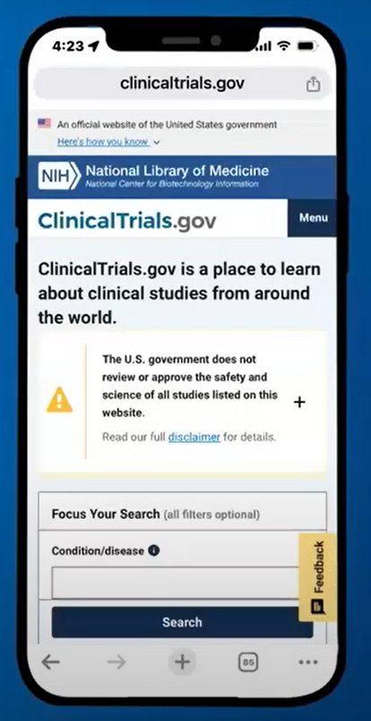

Slide 3
Beta View Now Live - Aug 28, 2024

Slide 4
Need an Account? Send an email to: CCTSClinicalTrials.govHELP@uabmc.edu
Please send the following information to email address above. We will set up an account for you.
(Fellows, Residents, and other visiting/temporary researchers must submit a protocol along with this request and note their mentor/supervisor.)
1. BlazerID:
2. Full name (i.e.: legal first and last name):
3. Your full job title (i.e.: Fellow, Coordinator, Professor):
4. UABMC or UAB email (most used):
5. Phone number:
6. Studies you need access to (NCT#) [if applicable]:
A reminder for the future: If you have faculty, fellows or residents leaving UAB, please have them transfer or complete his/her records in ClinicalTrials.gov prior to leaving.

Slide 5
ClinicalTrials.gov Beta Site Updates
Note:
The Modernized PRS is still under development, so users may see differences in their study records between the classic and modernized websites. If you find discrepancies, use the classic PRS to review the record and resolve any validation errors or warnings. Users should be sure to save their changes before switching between the two sites.

Slide 6
ClinicalTrials.gov Beta Site Updates
New:
Record List
The modernized Record List will open by default at log-in.
Added a pop-up to redirect users to the classic site if their records include Results, Delayed Results, and Study Documents sections. A single Open link will now open records that only include the Protocol Section in the modernized PRS.
Added menus and links to access content in the classic system, including:
A link to the Problem Resolution Guide for all users.
The About the Modernized PRS page now includes more user guidance and is available as an Adobe PDF file.
Protocol Section
Added an Edit toggle so users can turn on and off the ability to edit.

Slide 7
ClinicalTrials.gov Beta Site Updates Cont.
Improved:
Various styling changes, including spacing, icons, and pagination.
Now Available:
The modernized PRS (PRS Beta) will become the primary website for Protocol registration and submission.

Slide 8
Dashboard (Modified)

Slide 9
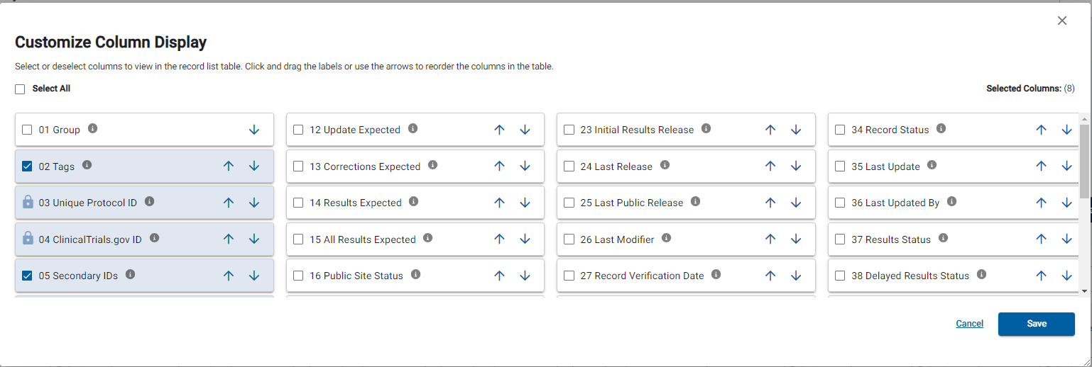
Customizing Columns
Title definition
Required, movable column
Move columns

Slide 10
Record Summary

Slide 11
Protocol Validation

Slide 12
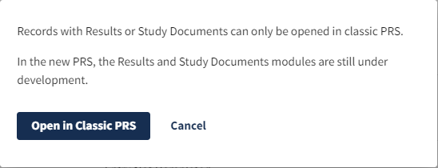
Review Comments
POP-UP for Results Section

Slide 13
Results Validation

Slide 14
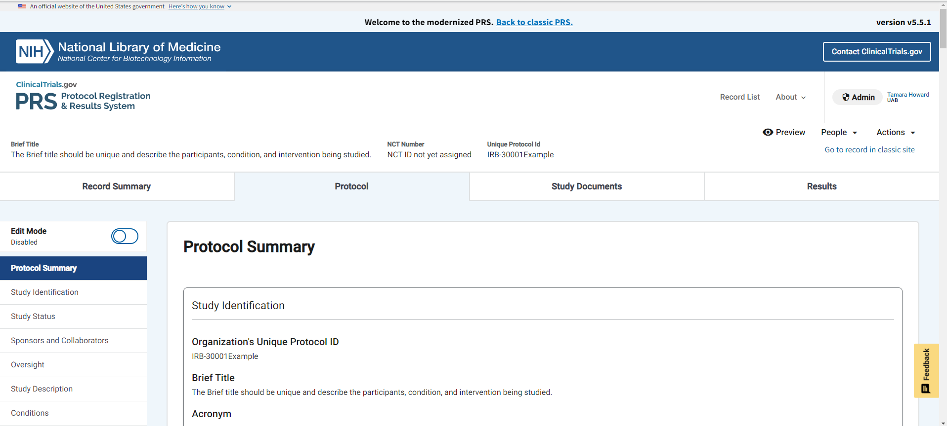
Protocol Summary
Notes:
The sub-sections will be listed on the left of your screen making it easier to navigate to different sections of the study.
This section allows you to see where errors are and navigate to that section quickly.

Slide 15
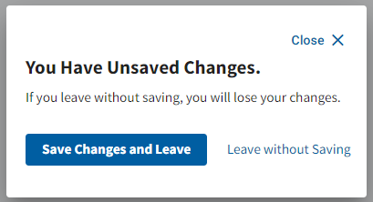
Edit Mode/Saving

Slide 16
Organization’s Unique Protocol
Enter UAB IRB Number:
IRB-300015234
OSP number can be added in
Parentheses:
IRB-300015234 (000521354)
Grant/Funding numbers do not go here.

Slide 17
Secondary ID
Required field for all funded studies
Secondary ID = Funding Source
Grant/Funding Information: 1R21AR083566-01A1
If funded by UAB enter UAB as “Other”.
Only leave blank if there is no funding.
If you use the grant number to refer to the study change your customizable columns to show Secondary IDs.

Slide 18
Study Start Date

Slide 19
Primary Completion Date
When do you plan to have your primary outcomes completed?
This must match your grant.
This cannot be pushed out for convenience.
NIH is monitoring when results are due closely.

Slide 20
Study Completion Date
When do you plan to have your secondary outcomes completed?
This must match your grant.
This cannot be pushed out for convenience.
NIH is monitoring results submissions closely.

Slide 21
Investigator Information
Only Sponsor entering records will select the “Sponsor” option.
UAB PIs should always choose Principal Investigator.
PIs cannot ‘approve’ or ‘release’ the record for review until entered as Responsible Party.

Slide 22
Collaborators
Organizations only in this section.
Study personnel are entered in the Contacts and Locations section.
Not all collaborating organizations are pre-programmed in the drop- down box.

Slide 23
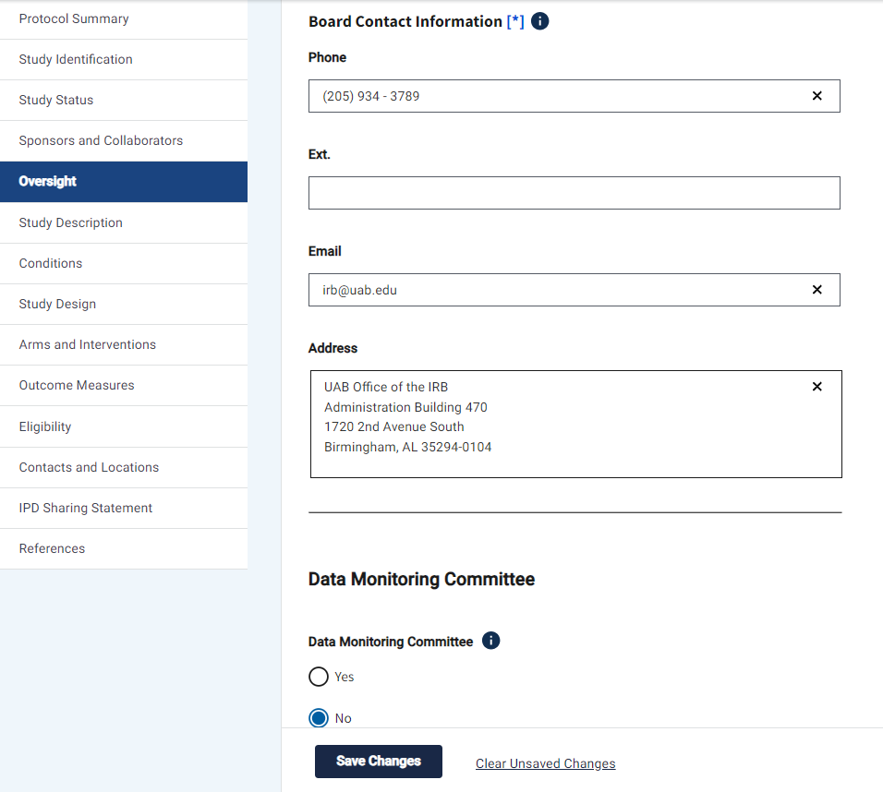
Human Subjects Protection Review

Slide 24
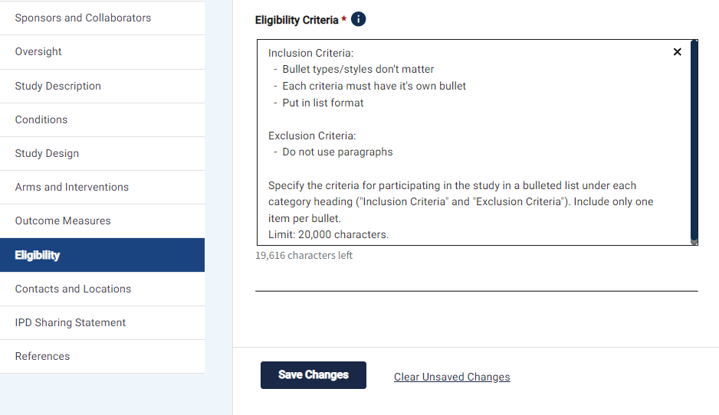
Eligibility
Age limits must match Assist or HSS exactly.

Slide 25
Contacts
Add all main study personnel
Central Contact
Central Backup
Overall Study Officials

Slide 26
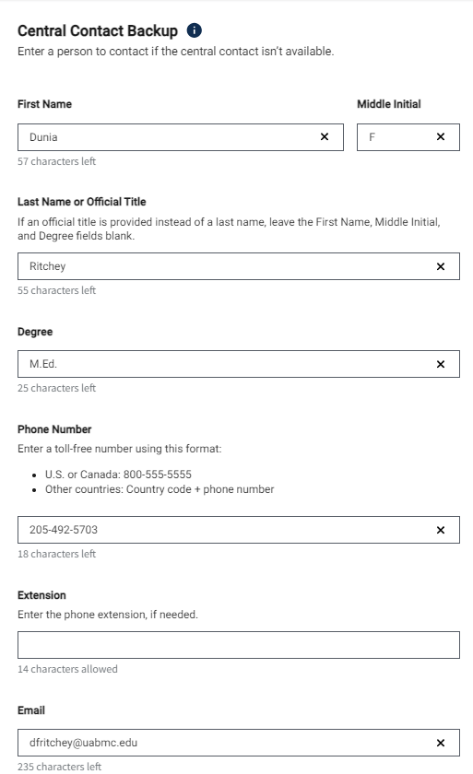
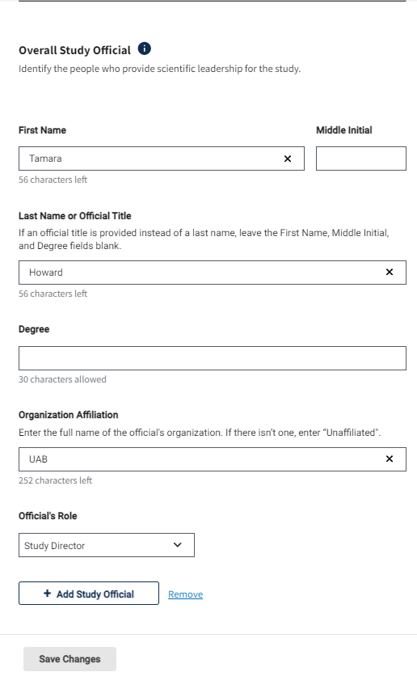
Contacts

Slide 27
Locations
Add all the locations where the study will take place, including UAB
Facility Information
Recruitment status
Facility Contact
Facility Contact Backup
Investigators/Sub-Is

Slide 28
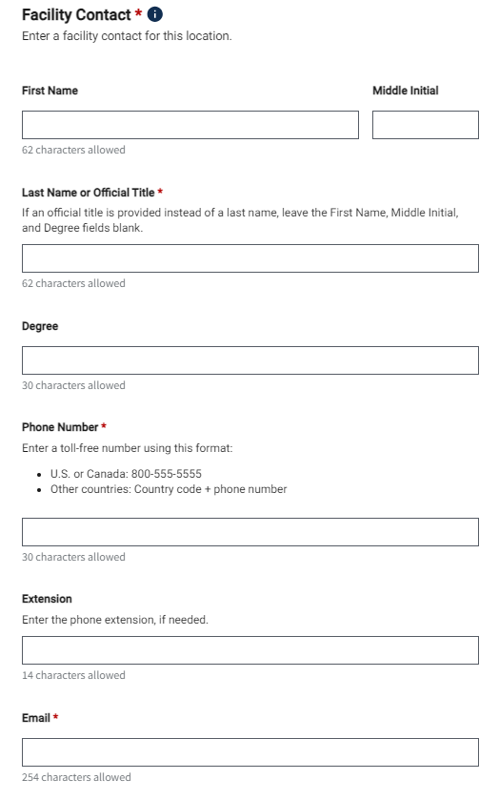
Locations

Slide 29
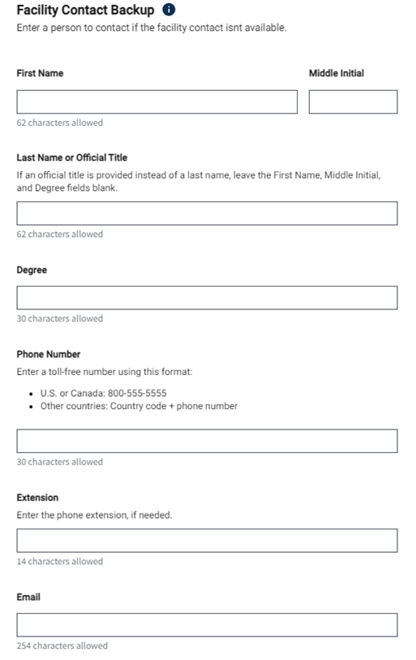
Locations

Slide 30
Errors Must be corrected before releasing the study

Slide 31
Individual Participant Data (IPD) Sharing

Slide 32
References

Slide 33
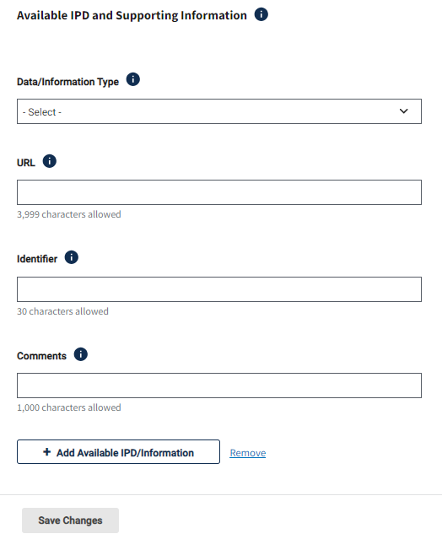
References

Slide 34
Don’t Forget to Approve and Release
If the Responsible Party still says “Sponsor,” the PI will not be able to approve and release.
Approve and Release is a multi-step process for PI.
Click Approve
Click Release
Check boxes for confirmation and click final release button.

Slide 35
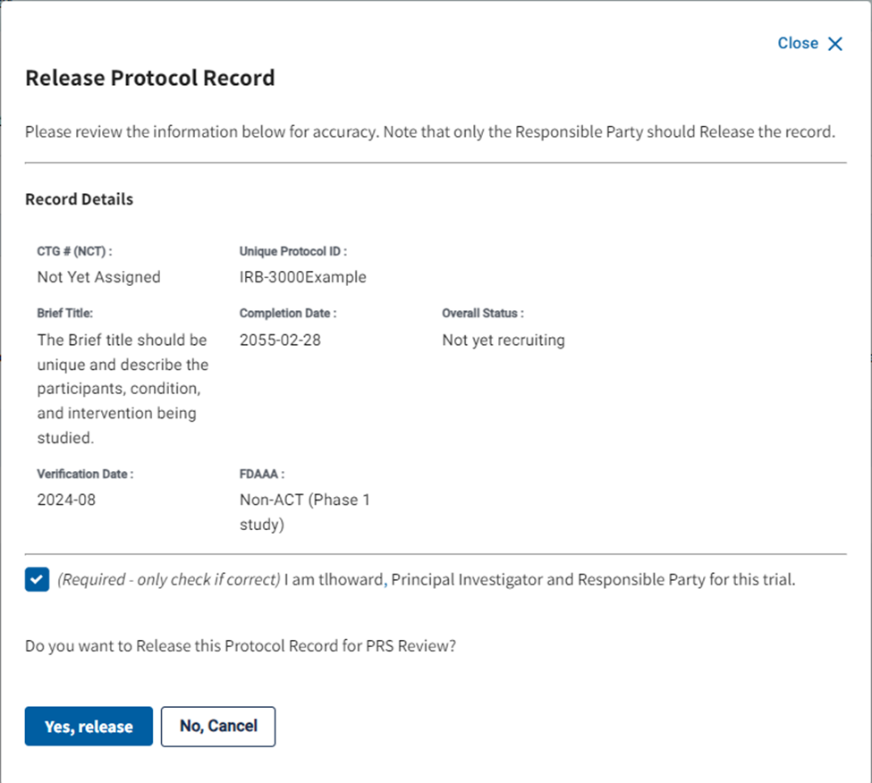
Don’t Forget to Approve and Release
Remember: Only the PI can release the record.
Must click the box to confirm you are the responsible party before you are allowed to release.

Slide 36
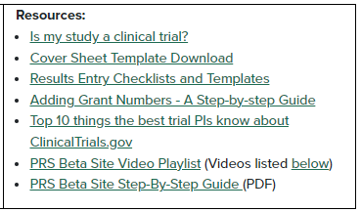
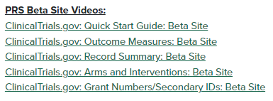
CCTS ClinicalTrials.gov Webpage
https://www.uab.edu/ccts/clinical-research/clinicaltrials-gov

Slide 37
Need help?
CCTSclinicaltrials.govHELP@uabmc.edu
Tamara Howard
TLHoward@uabmc.edu
205-934-3796
Dunia Ritchey
DFRitchey@uabmc.edu
205-492-5703

Slide 38
Ideas for New CT.gov Training Topics???

